Slide 1
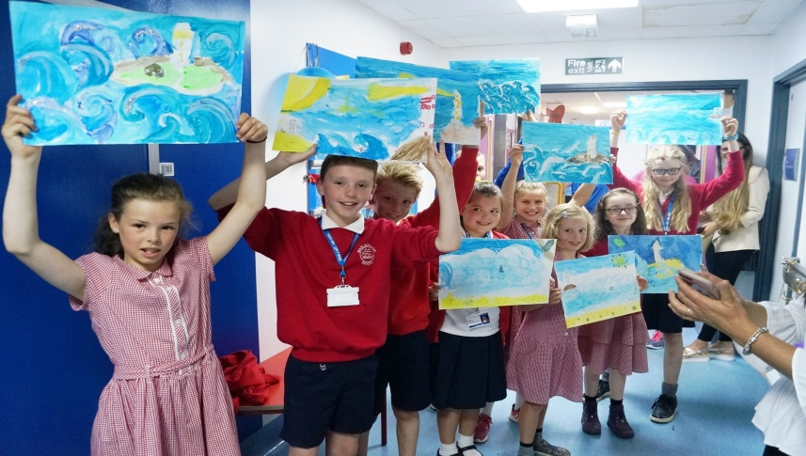
Using Insight for Improvement
The Success of Takeover Day
Tabitha Fergus Practice Development Nurse @Tabi121

Slide 2
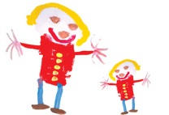
Picker Survey
Insight
Decisions
Open discussion Questions
Planning Phase:
Find a school
Consent
Inpatient status
What did we want help with….
Engage 8-10 year olds
4 Topics for the day:
Wonderwall design
Survey Design
Handwashing Audit
Unit tour and SIM

Slide 3
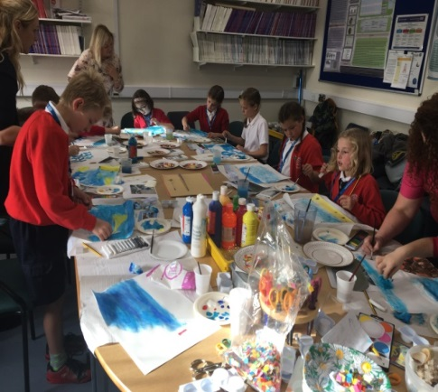
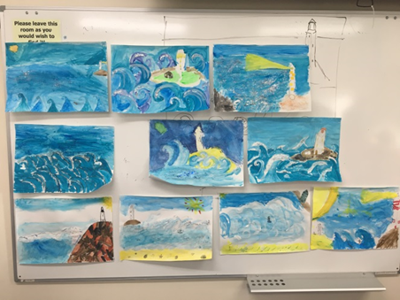
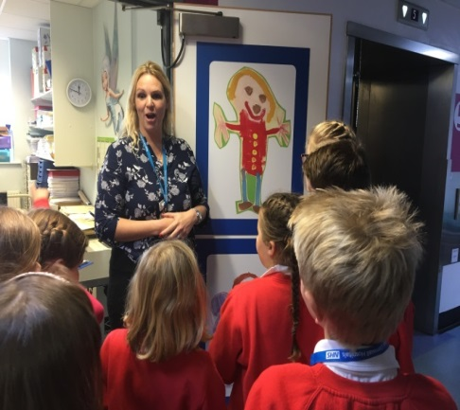
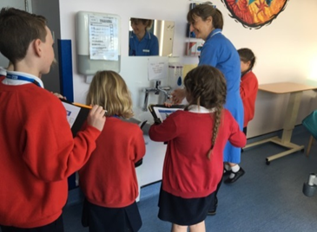
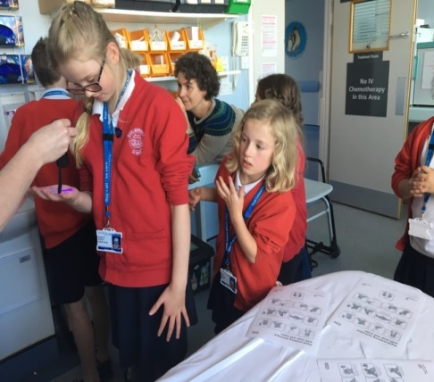
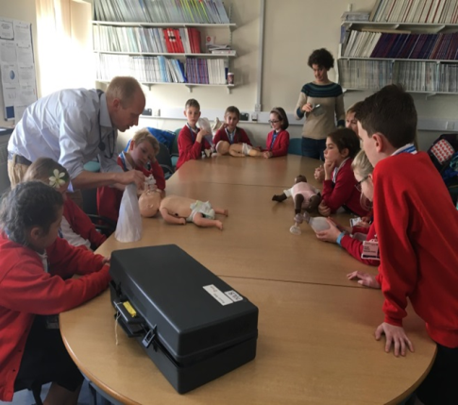
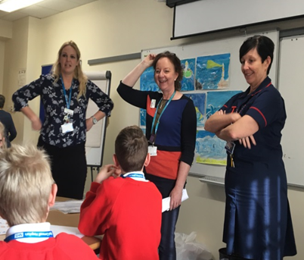

Slide 4
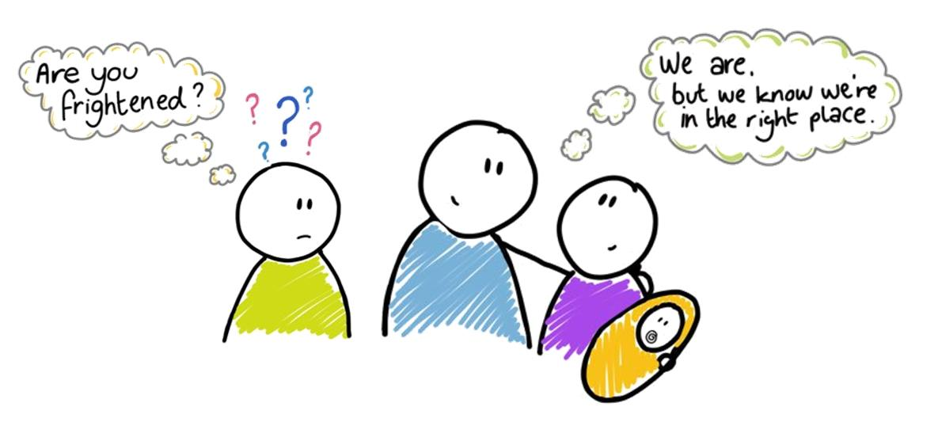
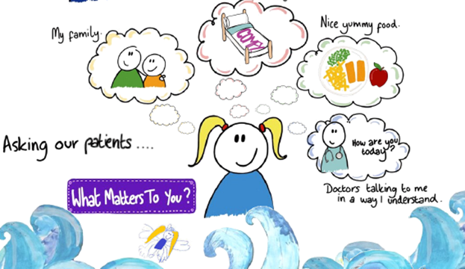
Highlights, Insights and Improvements..
What is important to children may not always be what adults expect.
Simplicity was a key theme….

Slide 5
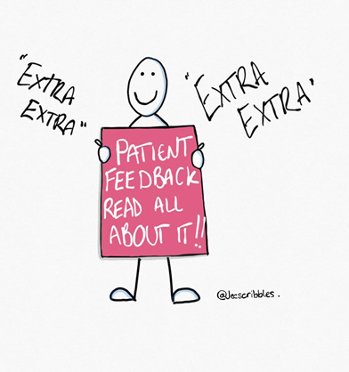
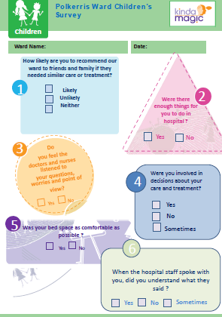
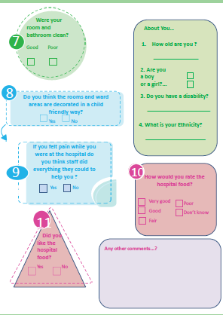
Really Listening
What we did..
Wonderwall in full use and helped raise our profile in the Trust.
Changed our surveys to reflect the top themes.
Children felt our observation area was the most daunting area for parents as children were younger and it was their first time –Sensory tour Video .
Stepping into the child's world…Harry Potter.

Slide 6
“A child's voice, however honest and true,
Is meaningless to those who’ve forgotten how to listen.”
Albus Dumbledore

Slide 7
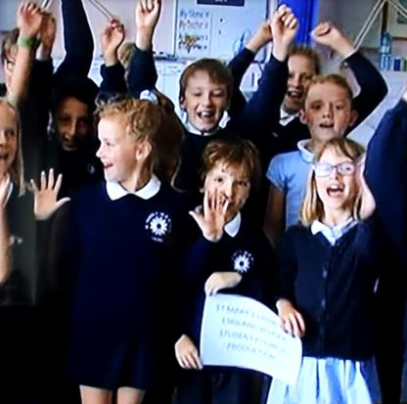
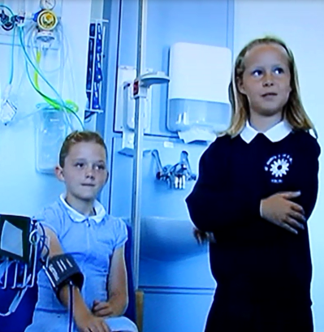
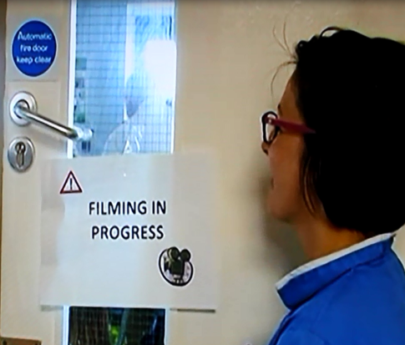
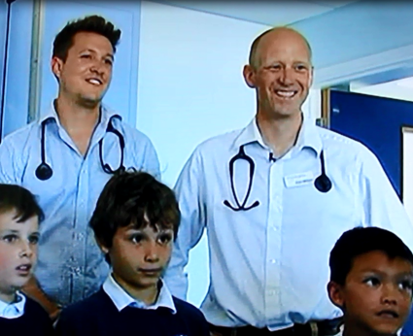
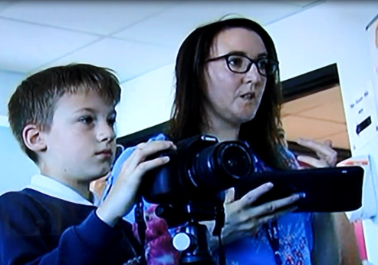
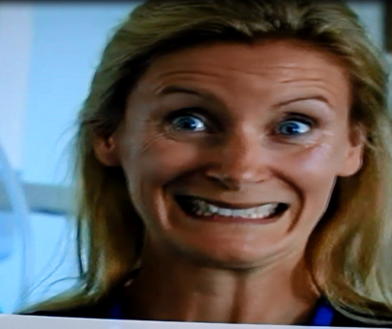
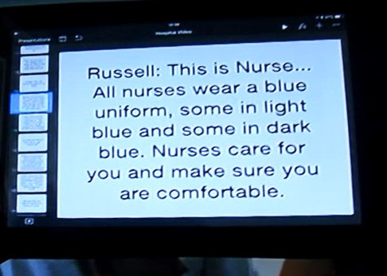
Paediatric Observations Unit – A Sensory Tour

Slide 8
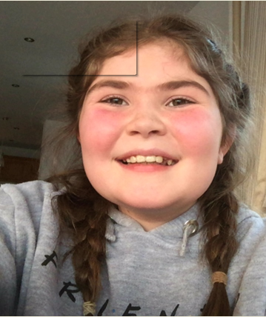
Maddie's Story

Slide 9
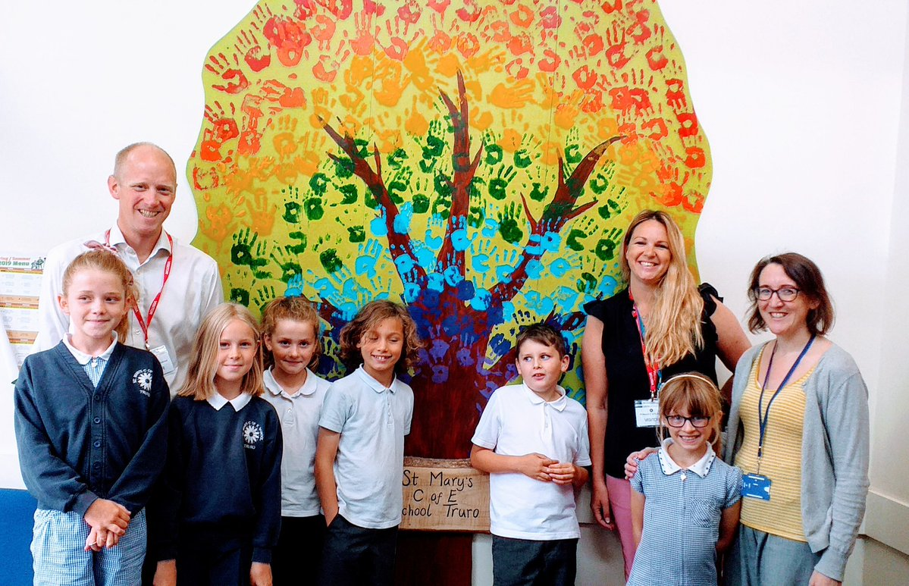
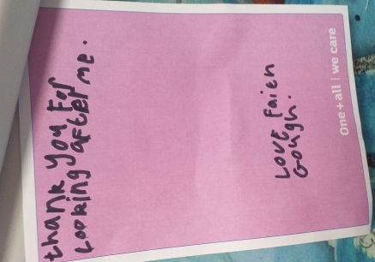
Wonderwall pic
What's been happening…

Slide 11
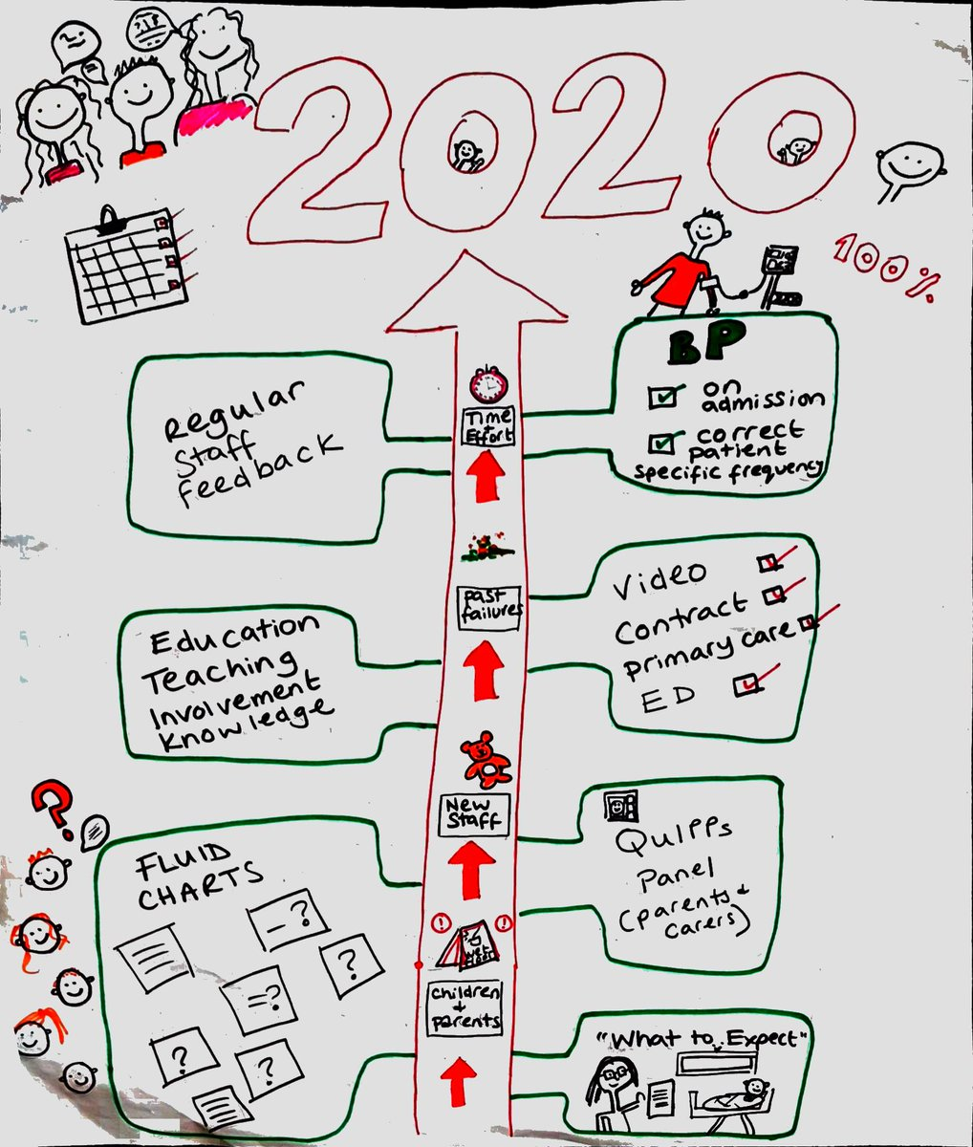
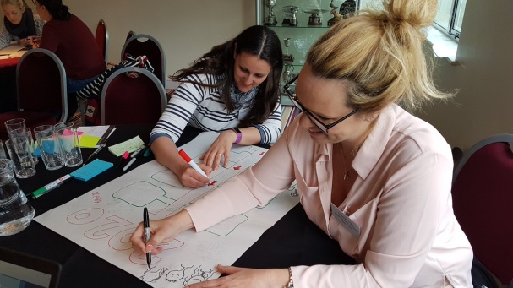
What's Next …..
Quality Improvement Project
Deterioration patient
Parental Concern
Patient information
Working with the Patient Partner Panel

Slide 12
QuIPPs
Quality Improvement Partner Panels
Welcome to the QuIPPs Panel
Today’s presenter is Tabi Fergus
RCHT Practice Development Nurse for Child health
Notes:
Instructions: Please ensure this information is correct to your innovation.

Slide 13
Narina-
Does lot’s of things!
Arthur-
Pharmaceutical rep.
Jono-
AHSN
Annette- Physio
Patient public forum Devon and Exeter
Sarah-
Family magistrate
Me
Sophie-
Nurse training Dom Care
James- NHS England specialist services Public and Patient Information Group
Peter-Patient partner group Dementia Action

Slide 14
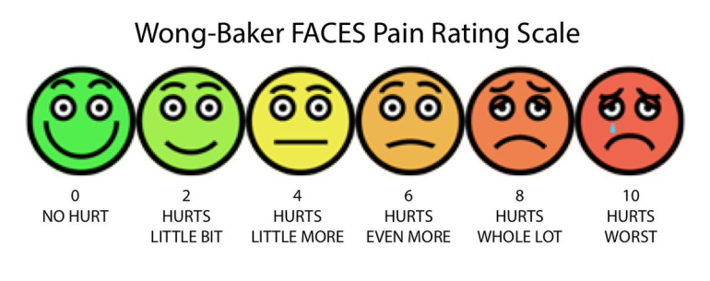
How worried are you ?
Looking at escalating parent /nurse or doctor concern.

Slide 15
Any Questions ?

