Slide 1
Building a Carer Friendly Organisation
Paul Sanguinazzi, Ann Parkes, Jane Danforth
Nottinghamshire Healthcare NHS Foundation Trust
@
@InvolveT1

Slide 2
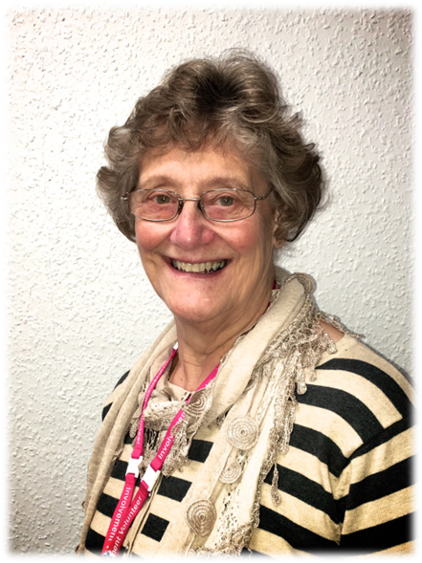
Ann Parkes
Involvement Volunteer/Carer
My Grandson GUY

Slide 3
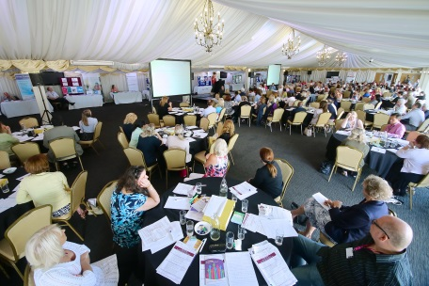
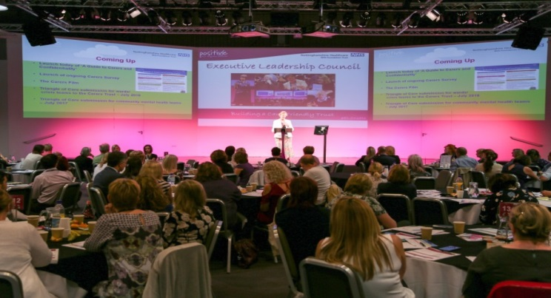
We have developed and implemented an ambitious, transformational and comprehensive programme in partnership with our carers to build a carer friendly trust

Slide 4
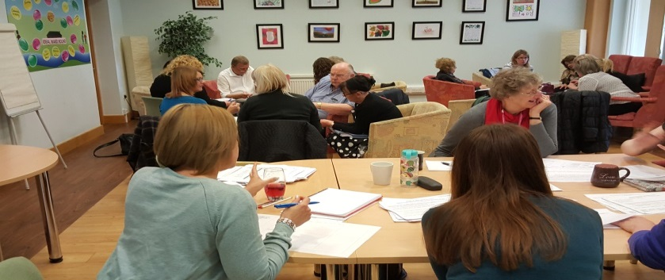
Ensured that all our 100 plus mental health teams have evidenced that they have improved their involvement of, support for and communication with carers. Now working with physical health teams,

Slide 5
Triangle of Care Six Standards:
1. Carers and the essential role they play are identified at first contact or as soon as possible thereafter.
2. Staff are “carer aware” and trained in carer engagement strategies.
3. Policy and practice protocols regarding confidentiality and sharing information are in place.
4. Defined post(s) responsible for carers are in place.
5. A carer introduction to the service and staff is available, with a relevant range of information
across the care pathway.
6. A range of carer support services is available.

Slide 6
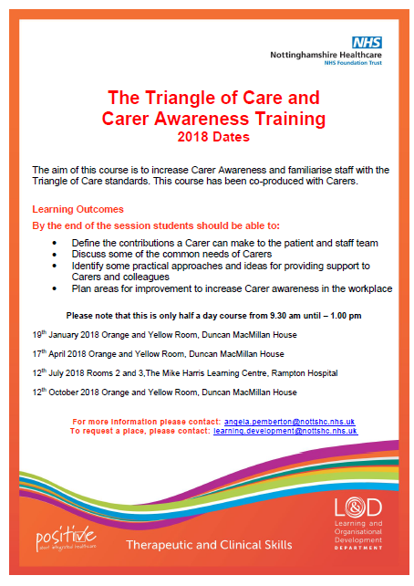
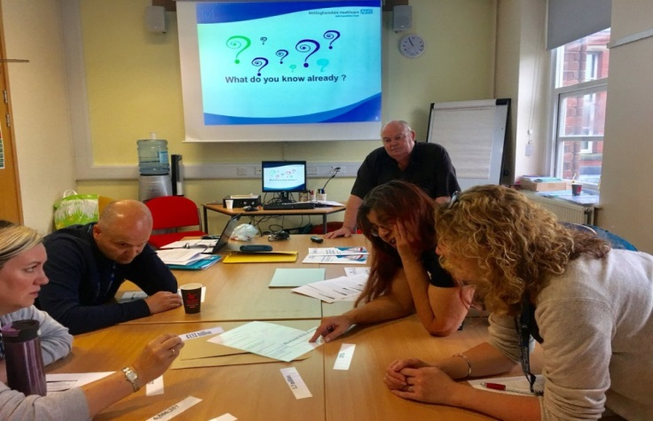
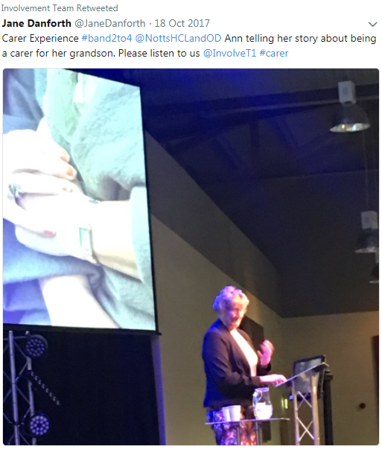
Changed culture and practice through staff induction and development programmes

Slide 7
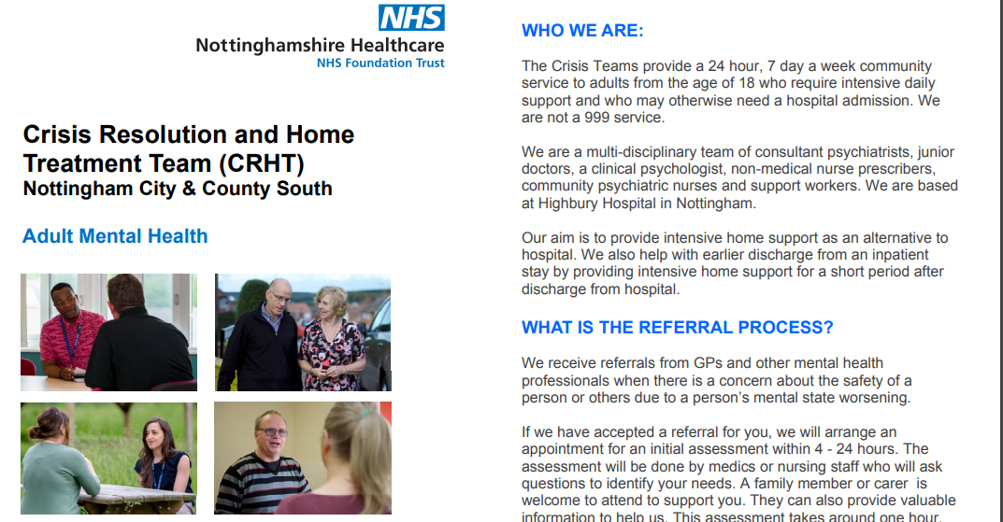
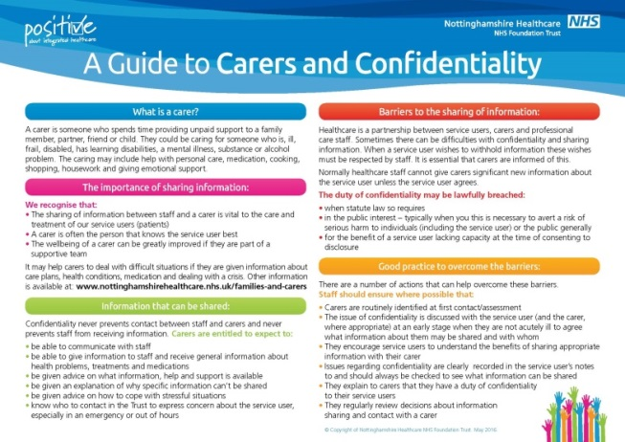
Tackled issues that carers raised (e.g. information sharing, crisis information) with carers

Slide 8
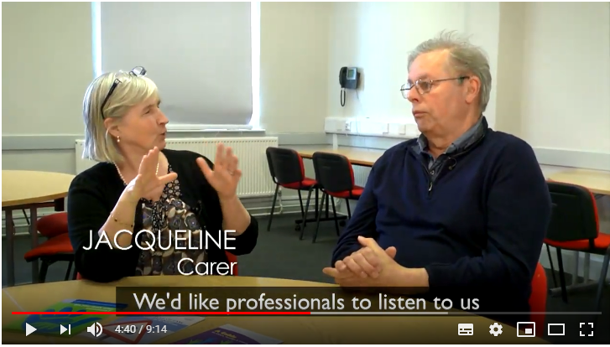
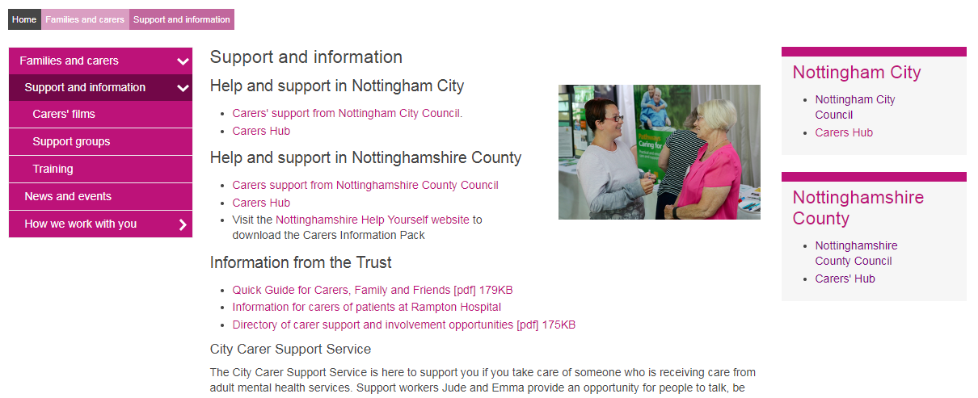
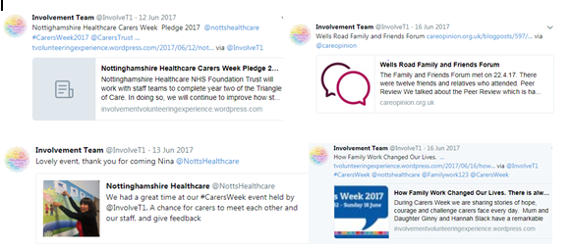
Raised awareness through innovative films, the carers section on our website and increased social media presence

Slide 9
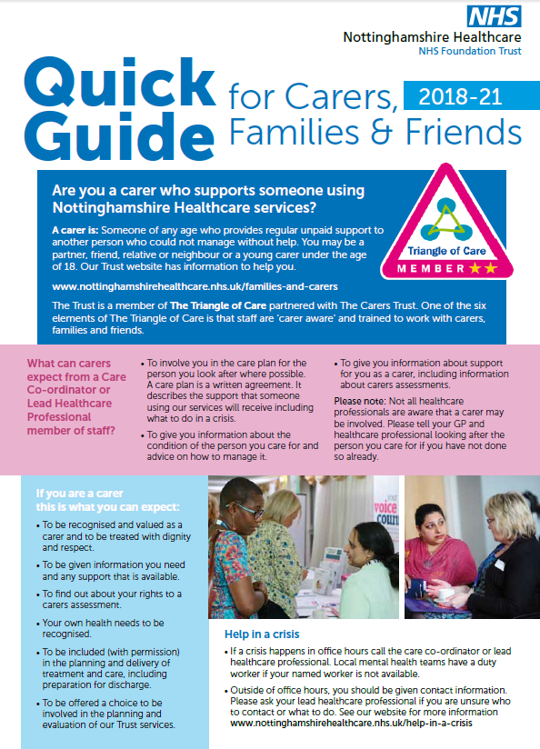
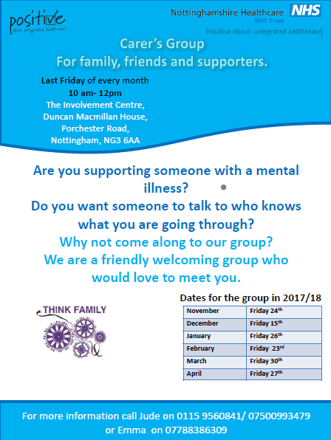
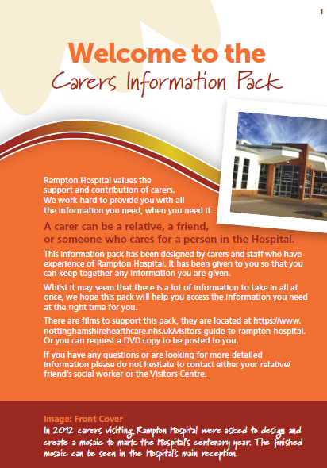
Supported and informed carers through guides, information, support groups and forums

Slide 11
#NottsPCX
Notes:
Rowan 1 Highbury Hospital
Where is this?
Bansky style quotes appearing across the Trust 10y care Opinion celebrations and CO heroes
Please contact me if you want to be on the subscription
End 13.39

