Slide 1
PENNA AWARD PRESENTATION SEPTEMBER 2021
Leeds Teaching Hospitals
Story

Slide 2
Meet (some of) the Team
Betty Jackson
Sister Ward 42
Judy Turley
Business Manager
Karen Henry
Lead Cancer Nurse
Richard Seddon
Patient
Tracy Holmes
Communications Lead, WY&H Alliance
Notes:
Hello, we are XXX– part of a team of people responsible for delivering this project. We are joined by Richard Seddon one of the wonderful Patient Partners we have working alongside us in the Trust.
A bit of context – Leeds Teaching Hospitals delivers services across seven hospitals and treats 1.5 million patients every year, including more than 200,000 emergency patients. The Trust spends around £1.34 billion of NHS money, treating illness and disease in Leeds and on specialised services for people across Yorkshire and the Humber and nationally. We employ more than 20,000 staff and work with universities and industry to play a leading role in education, research and innovation. As a result testing and scaling anything up in the Trust is a massive undertaking – if you can do it in Leeds, you can do it anywhere !
There was a team of people helping to delivery this project who are not on the picture including Louise from our Cancer Support Team collecting the data and colleagues from the patient experience team analysing the data and producing the reports and posters.

Slide 3
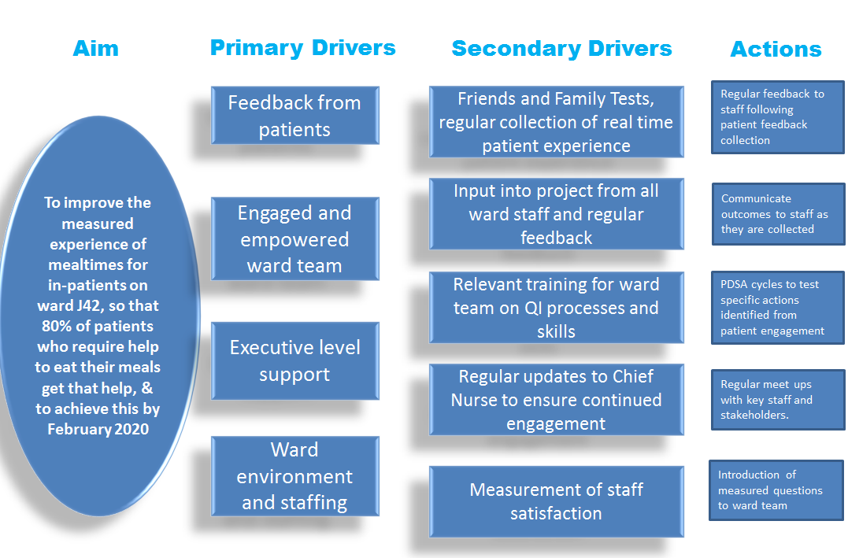
What we were trying to accomplish
Notes:
How it began – Our Lead Cancer Nurse and the Trust Head of Patient Experience realised they had a common goal to improve the experience of in-patients, our National Cancer Experience Survey results showed that we had room for improvement and out Head of Patient Experience had come across some work done in Northumbria where they had improved the scores of the inpatient section by using realtime feedback to staff following questions about their inpatient experience. It just didn’t feel right making decisions about patient care without the contribution of a patient, particularly as there had been an example in the Trust where that contribution had occurred and had been successful. Around the same time NHS England Quality Improvement had put a call out to Trusts via the Cancer Alliances for expressions of interest to join the NHS Improvement ‘Cancer Improvement Collaborative. Out first reaction was that it was a very tight timescale and we thought we did not have the capacity to engage in this piece of work. However, we decided it was really important that we try and improve the inpatient experience for cancer patients so took up the challenge.
We realised that we needed to focus this down to a specific element of care for the improvement collaborative in order to show improvements in patients experience and the question relating to mealtimes was the one that stood out as needing attention.
The challenges – we had no funding, we had limited capacity to support the work, we were unsure how staff would receive the involvement, and we didn’t quite know how we would achieve this.
Our Ambition – To improve the experience of mealtimes for inpatients on Ward J42 with then roll out to all wards not just cancer wards

Slide 4
How will we know that change is important?
Notes:
How did we do this ? -
Data was collected from all inpatients on Ward J42 who were able to appropriately answer a set of 12 questions. The questions covered communication with a range of health care professionals, ward environment, involvement in decision making and trust and confidence in the ward staff.
Data was collected fortnightly and a poster produced to clearly show the responses. Initially we had very fancy laminated posters produced by our medical illustration team - however these were costly and environmentally poor as they were thrown away after 2 weeks. We then produced our own paper version of the poster shown here.
We were able to see that the interventions that had been put in place improved outcomes for patients and that by having a member of staff who had been named as outstanding by their own patients resulted in the ward team including Doctors becoming quite competitive .................

Slide 5
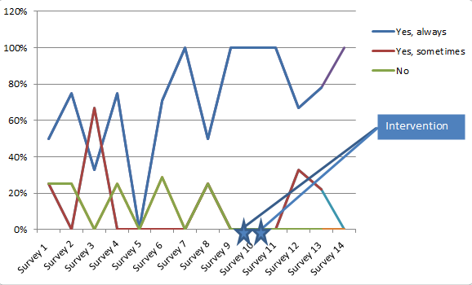
SPC Run Charts
Notes:
The data supported the measures we had set out for this specific piece of work with the improvement collaborative as there was a specific question relating to the outcome measure we had set that 80% of patients who required help to eat their meals got that help

Slide 6
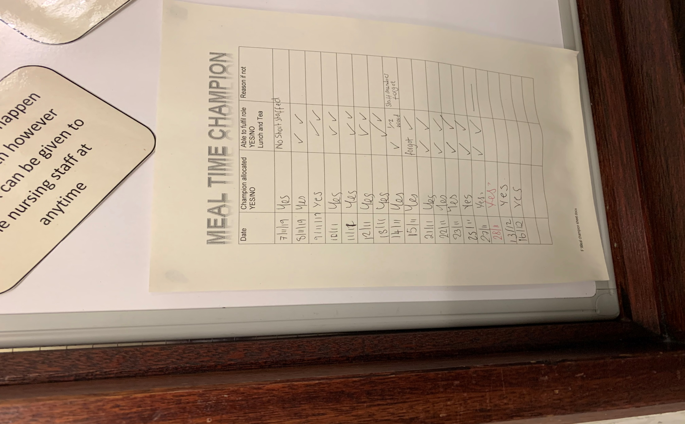
Process and Balancing Measures
Notes:
Process measures was collected by the ward staff - how often was a mealtime champion identified and allocated, how often did the mealtime champion fulfil the role
Balancing measures were being collected from the staff by the team collecting the patient data. All staff were asked about whether they felt the mealtimes champion role ihad an impact for patients and also what impact it was having on their role. T

Slide 7
What change ideas will we make that will result in an improvement?
PDSA Cycle 1
Plan – Reintroduce protected mealtimes
Do - Introduction of the allocation of a mealtime champion to ensure that:
All patients are aware it is meal time
All patients are sat up or out of bed for meal time.
Hand hygiene washing/wipe is offered to each patient.
Tables are clear and trays easy for the patients to access.
Any patients requiring assistance with meals are flagged to the nurse/CSW looking after the patient
Study - in the initial tests after the intervention, patients were reporting that they had help to eat their meals all of the time.
Act - Add in additional measures to strengthen and sustain the impact
PDSA Cycle 2
Plan – Look to better embed the mealtime champion allocation
Do - Board identified to add the Meal Time champions name to on a daily basis and meal time champion allocation added to the daily handover sheet
Study - The ward has found it useful having it written on the daily handover so it prompts them to nominate two members of staff for the day. They are still trying to get into a routine of writing the names on the board and are trying to get better at doing that and filling in the sheet so they know if the role has been fulfilled.
Act – Focus on patients being taken off the ward during mealtimes or having meals interrupted by non ward services
Notes:
The change idea was to reintroduce protected mealtimes and in order to help do that the ward introduced the following initiatives:
Introduction of a meal champion to ensure:
All patients were aware it was meal time.
All patients were sat up or out of bed for meal time.
Hand hygiene washing/wipe was offered to each patient.
Tables were clear and trays were easy for the patients to access.
Any patients requiring assistance with meals were flagged to the nurse/CSW looking after the patient.
The introduction of the mealtime champion was successful and the ward was keen to keep this as business as usual going forward. We identified that we needed to communicate the initiative to the ward housekeeping staff to enable them to be involved and assist.

Slide 8
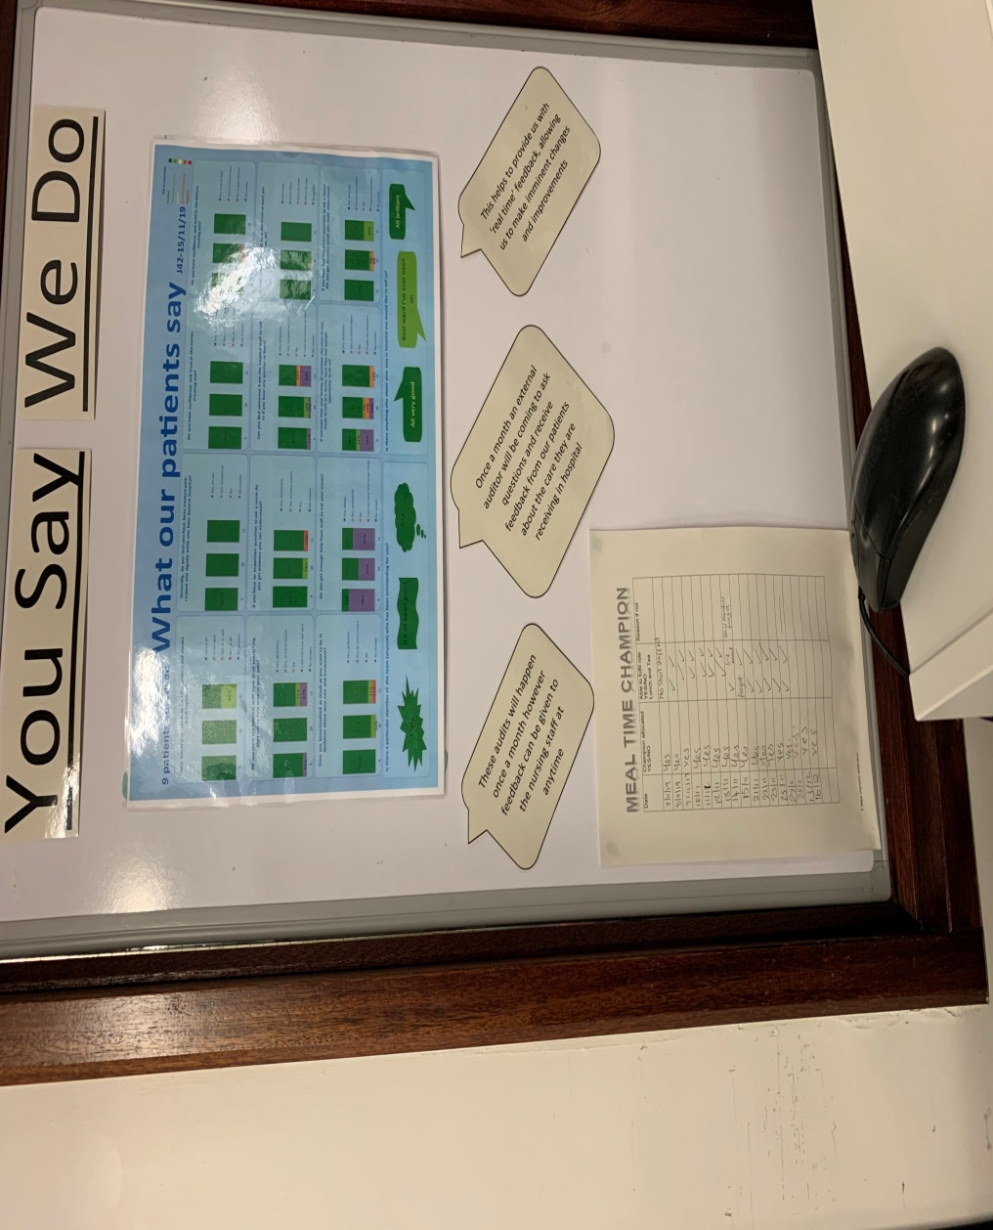
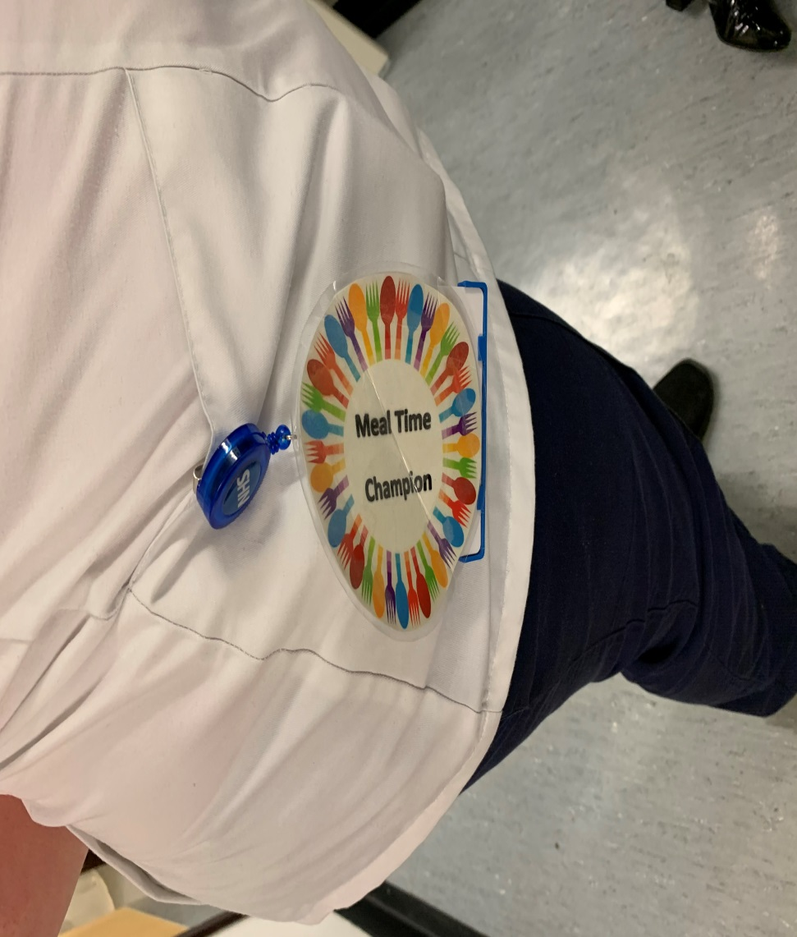
Embedding the work
Notes:
The ward decided to set up a board to display the mealtime champion of the day and added the information to the daily ward handover sheet all which helped to embed this initiative.
The team made their own ‘meal time champion’ badge to clearly show who was responsible for this on any given day, this ideadcame from the ward team and they used their crafting skills to produce their badge………

Slide 9
Considerations for Equality and Health Inequalities
The criteria for including patients in the data collection was anyone who was awake and well enough and able to participate and could understand English, as with was a pilot project we did not have resource to pay for interpreters. We recognised that going forward we will need to ensure that all patients have an opportunity to be involved and will need to build that in to the roll out and sustainability plans.
The data collection team did recognise that the ward team leader could affect which patients they had access to and therefore patients were not selected by the ward team leader, rather the data collection team asked if there were any patients who could not participate due to a specific set of reasons (eg post op, having physio)
Notes:
As stated above we recognised quite quickly that there was a perception that patients were being selected for the team to interview. By subtly changing our approach we were able to collect more meaningful data.
As part of the process we were also being told things by patients which the team felt needed to be fed back to the nursing teams in real time (generally small things which make the difference to how a patient feels) for example: needed extra blanket or pillow, not wanting to disturb ward staff who were busy but wanted to ask a question, didn’t like the food they were being given and were hungry……….it was agreed that before leaving the ward the team would have a couple of minutes huddle with the nurse in charge to feed back these comments so they were addressed immediately. Patients and staff reported that this was an improvement and the members of the team who were told this information felt better that they were able to ensure staff were informed.

Slide 10
Most Importantly
Our Patient Representative
Richard Seddon
Brought the
patient voice
Lived Experience
Attended Cancer Board
to share his experience
Patients are embedded
in Quality and
Safety Review
programmes
Involved in Building The
Leeds Way
Patients representatives
attend our peer reviews
for cancer teams
Understand barriers
to staff engagement
and seek to overcome
these
Patient representatives are Involved in
work across the
wider healthcare
system
Patients are listened to
and their thoughts and ideas
are used to help form and
improve our services
Notes:
Richard was a patient on the ward where the pilot was undertaken and we are very grateful to him for being an integral part of this project, including getting up ridiculously early to catch trains to various parts of the country.
I’ll let Richard speak a little as to why he got involved with this project…………

Slide 11
Next steps – Scale and Spread
01
Continue working with Ward J42
02
Potential volunteers.
03
On going funding
Notes:
The plan was to continue with the ward we worked with and look at any other areas that are highlighted and at the same time plan for how we spread to other clinical areas & then Covid hit us………………we are now starting to think about how we can reinvigorate this project and start to roll out across other wards - not just cancer wards.
In terms of spread:
The metrics are now being used within the Trust compassion audit and we had discussed (prior to Covid) about the possibility of doing more for wards who were struggling, and use the more in-depth approach of going onto the wards and asking all of the questions over a short time period and providing the feedback in the poster format
Scale:
This lends itself to all wards regardless of speciality. We would need to recruit a team of specialist volunteers to facilitate that alongside a team who can analyse the data and produce the poster format to feed back to wards.
Funding:
Initial funding would be requested from our Charitable Funding Partner Leeds Hospitals Charity to prove the concept across all wards, and with a mixture of volunteers and data analysts could be relatively low cost.

Slide 12
Communications
1
Heads of Nursing meeting
2
Verbal updates
3
Social media
4
Presentation at Alliance Events
5
E-bulletins
Notes:
Communication about the project has taken place during a variety of methods, internally within the Trust and involved verbal updates to key stakeholders and presentations at existing meetings. The Lead Nurse for the Trust was the Executive Sponsor for the project and attended a feedback session as well as receiving regular updates from our Lead Cancer Nurse.
This presentation was shared at the NHS Improvement Collaborative Celebration event.

Slide 13
Top Tips
Implement changes that are
measurable & can be sustained
if successful
Start Small
Think outside the box
& be creative
Share widely with as
many others as possible
Create confidence with clinical team as this inspires
them to keep going
Notes:
Working in this way with the Collaborative made us go further with this piece of work than we had originally planned to and instead of just collecting the feedback and sharing that with the wards it made us look at the issues identified and develop ideas to improve them using QI tools

Slide 14
Thank you for listening
?
!
Any questions??

