Slide 1
Transforming services for Hemato-oncology cancer patients
Lesley Chamberlin Lead Haematology Clinical Nurse Specialist (CNS)
Jane Suppiah, Head of Patient Experience and Involvement

Slide 2
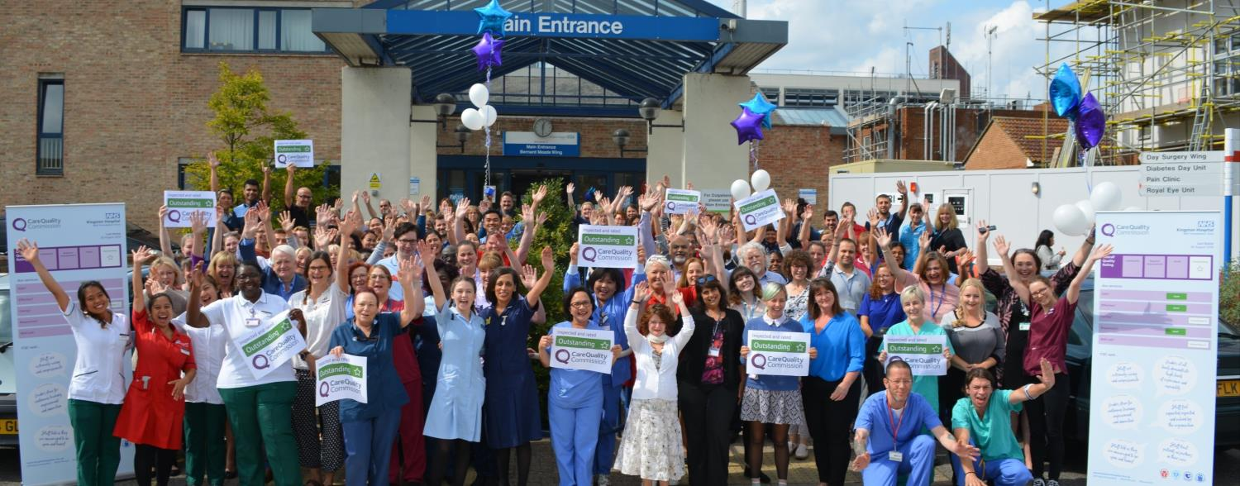
About us
Notes:
Kingston Hospital Foundation Trust (KHFT) – we are a district general hospital supporting around 350,000 people in Kingston, Richmond, Elmbridge (Surrey), Merton, Wandsworth and Sutton.
We have a strong and committed workforce of around 3,000, an ethos of innovation and a commitment to engaging patients as equal partners.
We deliver cancer services in partnership with the Royal Marsden, but manage the entire pathway for haematological cancer.
A laser sharp focus ensures every person with suspected cancer travels through our pathways in the shortest time possible and enables us to exceed expected cancer performance targets.
Involvement of patient partners on our Cancer Board and through our well established Cancer Patient Partner Group (CPPG), motivates and encourages us to respect and listen to patient experience, take heart, and strive to do better.

Slide 3
‘Clearly a lot of thought and investment has gone into Haematology care at Kingston in the past few years, and the unit is now excellent’
Transformation based on
Bringing external resources together with investment from the hospital
Ambitious programme of improvement to enhance the experience of patients and staff
Involving our Cancer Patient Partner Group as much as possible
Co-producing information resources to enhance patients knowledge of treatment and care
Notes:
The quote above is positive and uplifting. Is representative of the many positive comments that patients shared with staff and members of our CPPG in our 2019/20 local patient survey.
Over the last 5 years Kingston Hospital has transformed its haematology cancer service in response to poor patient experience.
By bringing resources from external partners and Kingston Hospital Charity together with investment from the hospital, the service has achieved an ambitious programme of improvement that has seen the service relocate into a purpose built facility, adopt digital ways of working that have enhanced the experience of staff and patients, bring additional nursing resource onboard to ensure all patients are supported throughout their journey and co-produce information resources to enhanced patients knowledge and understanding of treatments and their care.
Findings from the CPES and our own patient survey have confirmed the impact these changes are having, changes that are embedded and can be sustained. This application is in response to our CPPG’s encouragement that this journey is worth sharing, and our desire to share with others that transformation is possible when patients’ experiences of care and treatment are put at the fore of collaborative approaches to harness resources.

Slide 4
Not just one problem….
CPES told us of poor patient experience year on year
Unit poorly located in a old basement – at a distance and other cancer services (in the dedicated Sir William Rous Building).
Patients missed the chance to access support from the Macmillan Cancer Centre
Lack of space to provide confidential information and advice
Notes:
Year on year, findings from the CPES told us that haematological cancer patients, relative to our other cancer patients, were having a poor experience. We wanted to do better. The problem was that there wasn’t just one problem to solve.
The service was poorly located in the basement of an old building, had insufficient treatment facilities and stretched staff.
Patients experienced diagnosis, and their on-going care if treated as outpatients, without the advice and support of a Clinical Nurse Specialist (CNS).
The complex task of treatment scheduling was carried out manually, often resulting in long waits for patients on arrival at the Haematology Day Unit (HDU).

Slide 5
An there’s more….
Manual treatment scheduling resulted in long waits for patients on arriving the Haematology Day Unit (HDU)
Diagnosis and outpatient treatment lacked support and advice of specialist nurse
Isolated attempts at improvement weren’t making a real difference
The team was running on empty
Notes:
Year on year, findings from the CPES told us that haematological cancer patients, relative to our other cancer patients, were having a poor experience. We wanted to do better. The problem was that there wasn’t just one problem to solve.
The service was poorly located in the basement of an old building, had insufficient treatment facilities and stretched staff. Patients experienced diagnosis, and their on-going care if treated as outpatients, without the advice and support of a Clinical Nurse Specialist (CNS). The complex task of treatment scheduling was carried out manually, often resulting in long waits for patients on arrival at the Haematology Day Unit (HDU). Nurses lacked the capacity and space to provide the confidential information and advice patients needed on their journey, and the physical separation of the HDU from the Sir William Rous (SWR) Building which hosts the hospital’s Macmillan Cancer Information Service meant many patients missed the chance to be supported to access the broad range of support the Centre had to offer. Isolated attempts at improvement weren’t making a real difference and the dedicated clinical team by their own admission were running on empty.
A large bequest to the Kingston Hospital Charity provided the tangible opportunity for the service to relocate into a purpose build unit with the hospital’s SWR building dedicated to cancer services. However, it was harnessing our understanding of haematology patient’s experience of care through the CPES together with the collaboration and commitment of our CPPG that enabled us to capitalise on funding opportunities from partners, and make a robust case for sustained service investment from the hospital. It is the coming together of the opportunity to tackle patient’s experience at points that matter most, and the ambition of everyone involved that meant that transformation of patients experience of care and treatment was possible, and that has indeed enabled us to achieve this.

Slide 6
What enabled change….
Large bequest provided the impetus to get something done..
A series of business cases making the case for investment
A concerted effort to bring things together in a coordinated
Ambition to involve everyone and put patients experience of care at the heart of things lead to transformation.

Slide 7
Four things we did…

Slide 8
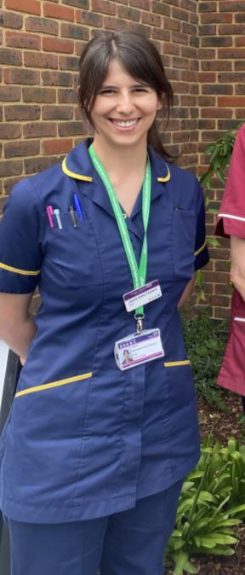
A new Clinical Nurse Specialist role
‘Patients didn’t have consistent support or a point of contact before this post was established in 2018, and the impact of this has been reflected in our CPES results. They’ve valued responsive and practice advice that I’ve been able to give, particularly through the pandemic. We’re now able to deliver holistic needs assessments to all our patients and offer support and preparation for patients to self-manage when they leave the service’
(Joanne Goes-Ferraria, Haematology CNS).
Notes:
The establishment of a new Haematology CNS role (initially funded by Macmillan and sustained by the Hospital) to give all patients advice and support of a named CNS at the point of diagnosis, and holistic care and treatment for patients not requiring active treatment in our HDU.

Slide 9
Implementation of an electronic patient booking system
Enabled efficient scheduling of complex treatments
Immediately reduce waiting times for patients
Immediately made us more effective with our staff resource.
Provided data to make the case for increased staffing
Notes:
The implementation of the BookWise system in May 2019 enabling the electronic scheduling of patient appointments alongside the allocation of treatment chairs and nurse time needed to deliver care. ‘This has been a great success. It immediately reduced the time patients needed to wait for treatment and has enabled us to schedule our work more effectively. Evidence of the scale of work being delivered by the services has contributed to a successful business case for a further nurse for the service’ (Lesley Chamberlin, Haematology Lead CNS)

Slide 10
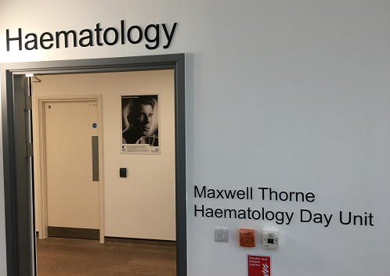
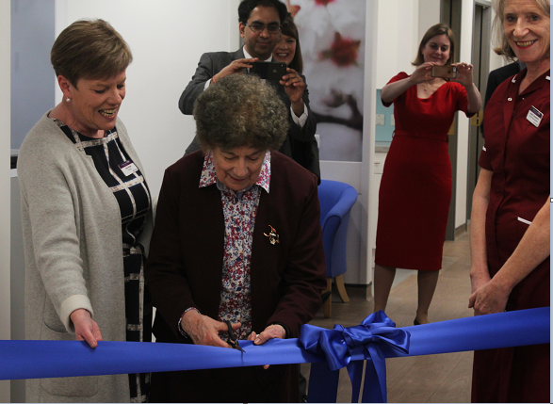
Relocation of the Haematology Day Unit to a purpose built facility
Notes:
The relocation of the Haematology Day Unit, newly named as the Maxwell Thorne Unit, in spring 19. It is now co-located with other cancer services on the newly built second floor of the Sir William Rous building. Plans were shared and discussed with our CPPG, and the group fed into decisions made about the look, feel and layout of the unit. In addition to treatment areas, the unit has a dedicated room for private discussion about care and treatment and counselling support, and a garden for patients.

Slide 11
Work with patient partners to create patient information
Notes:
Working with the CPPG to improve information resources for patients. This included production of a video called Demystifying chemotherapy, co-produced with our CPPG and led by one of its members, Jane Stephenson.
“The Cancer Patient Partner Group was approached by cancer specialist nurses about a plan to offer patients a presentation about chemotherapy before they started treatment. It was in response to findings that we’d noticed in the CPES around patients feeling that they didn’t have enough information about what to expect during treatment. The presentation was very dry and didn’t really convey what it would be like when patients walked through the door. We thought it would be a great idea to hear from patients as well as staff. Story telling really engages people and short films can convey messages really quickly. The staff jumped at the idea. It took a while to get the project off the ground but once funding was secured from the Kingston Hospital Charity we moved ahead with meetings to understand from staff what they wanted to convey and what it was that patients most needed to know. The film features patients explaining their journeys and staff explaining their roles. At 6 minutes each the films are quite long but we all felt that there’s a lot to cover, both about the treatment and side effects, what happens after and how different individuals’ journeys can be. The film has been made in partnership with hospital staff. I did feel listened to and I suppose my own experience as a cancer patient meant I understood the questions to ask. The films are used in initial consultations that cancer specialist nurses have with patients before chemotherapy starts. Jane Stephenson, Patient Partner”

Slide 12
What patients told us about the changes we made….

Slide 13
“The new appointment timings reduce delays and there is no sense of overcrowding now”
Patients no longer had long waits to receive care and treatment
91% were seen within 15 minutes of their appointment time
Notes:
Results from the 2019 CPES showed an improving picture on patient experience measures across the board. Of the 35 questions on which there was haematology respondent data, 26 showed an improvement on 2018 data, 7 showed a decline, and 2 showed no change.
We invited all haematological cancer patients receiving treatment in our HDU (the Maxwell Thorne Unit) to complete an anonymous questionnaire on their experience. It was completed by 81 respondents, a 100% response rate thus capturing the views of all patients receiving treatment over survey period (Nov-19 to Feb 20). The survey found that:
• Patients no longer had long waits to receive care and treatment - 91% were seen within 15 minutes of their appointment time. When patients had to wait, in all but two instances, the reasons for this were clearly explained.
“The new appointment timings reduce delays and there is no sense of overcrowding now. Unit is always very clean and orderly.”[respondent to our 2019/20 patient survey]
• “The new appointment timings reduce delays and there is no sense of overcrowding now. Unit is always very clean and orderly.”[No respondents reported a negative experience.
‘This is a superb facility. It makes treatment of a frightening condition relaxing and 'pleasant'. It is very comfortable, the terrace is an inspiration adding a wonderfully relaxed feel’. [respondent to our 2019/20 patient survey]
• Respondents reported a high level of satisfaction with the nursing team on important measure of patient experience. 98% said that the team as very good or good at providing trust and confidence in their expertise, 97% said the team was very good or good at explaining things in a way they could understand, and 95% said the team was very good or good at being available for advice and support at times when this was needed.
‘Proactive engagement with patients- an exemplary level of care with empathy and understanding.’ [respondent to our 2019/20 patient survey]
• The vast majority of patients felt well informed about chemotherapy treatment before starting it – with 78% of respondents saying they had all the information they needed, and 13% reporting they felt informed to some extent.
“I have experienced some very challenging moments from diagnosis to current remission. Throughout I have received the highest standard of care, compassion, treatment and support from, in particularly, my care team in SWR Day Unit".
"New patients can be confident that their difficult path will be made smoother by staff who genuinely care!!"
"There has also been a good dose of laughter along the way. Good medicine!!”
[respondents to our 2019/20 patient survey]
Since opening the Maxwell Thorne Unit patients have come together to form a peer support group for patients and their families. This group only managed to have one face to face meeting prior to the pandemic but has remained active during the pandemic by moving meetings online and sharing news via a quarterly newsletter. The patient leading this initiative has since joined our CPPG thus providing robust lived experience of care of the haematology service.

Slide 14
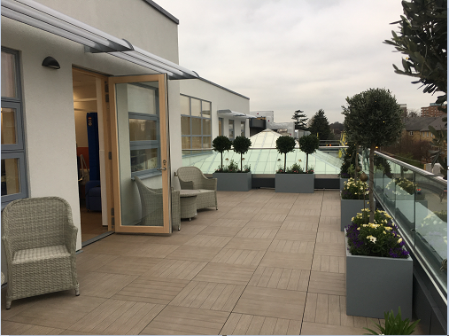
‘This is a superb facility. It makes treatment of a frightening condition relaxing and 'pleasant'. It is very comfortable, the terrace is an inspiration adding a wonderfully relaxed feel’.
Patients had a universally positive experience of the new unit
99% reported that their privacy and dignity was always respected, 98% said they always felt comfortable and put at ease.
Notes:
Results from the 2019 CPES showed an improving picture on patient experience measures across the board. Of the 35 questions on which there was haematology respondent data, 26 showed an improvement on 2018 data, 7 showed a decline, and 2 showed no change.
We invited all haematological cancer patients receiving treatment in our HDU (the Maxwell Thorne Unit) to complete an anonymous questionnaire on their experience. It was completed by 81 respondents, a 100% response rate thus capturing the views of all patients receiving treatment over survey period (Nov-19 to Feb 20). The survey found that:
• Patients no longer had long waits to receive care and treatment - 91% were seen within 15 minutes of their appointment time. When patients had to wait, in all but two instances, the reasons for this were clearly explained.
“The new appointment timings reduce delays and there is no sense of overcrowding now. Unit is always very clean and orderly.”[respondent to our 2019/20 patient survey]
• “The new appointment timings reduce delays and there is no sense of overcrowding now. Unit is always very clean and orderly.”[No respondents reported a negative experience.
‘This is a superb facility. It makes treatment of a frightening condition relaxing and 'pleasant'. It is very comfortable, the terrace is an inspiration adding a wonderfully relaxed feel’. [respondent to our 2019/20 patient survey]
• Respondents reported a high level of satisfaction with the nursing team on important measure of patient experience. 98% said that the team as very good or good at providing trust and confidence in their expertise, 97% said the team was very good or good at explaining things in a way they could understand, and 95% said the team was very good or good at being available for advice and support at times when this was needed.
‘Proactive engagement with patients- an exemplary level of care with empathy and understanding.’ [respondent to our 2019/20 patient survey]
• The vast majority of patients felt well informed about chemotherapy treatment before starting it – with 78% of respondents saying they had all the information they needed, and 13% reporting they felt informed to some extent.
“I have experienced some very challenging moments from diagnosis to current remission. Throughout I have received the highest standard of care, compassion, treatment and support from, in particularly, my care team in SWR Day Unit".
"New patients can be confident that their difficult path will be made smoother by staff who genuinely care!!"
"There has also been a good dose of laughter along the way. Good medicine!!”
[respondents to our 2019/20 patient survey]
Since opening the Maxwell Thorne Unit patients have come together to form a peer support group for patients and their families. This group only managed to have one face to face meeting prior to the pandemic but has remained active during the pandemic by moving meetings online and sharing news via a quarterly newsletter. The patient leading this initiative has since joined our CPPG thus providing robust lived experience of care of the haematology service.

Slide 15
‘Proactive engagement with patients- an exemplary level of care with empathy and understanding.’
High level of satisfaction on important measures of patient experience
97% said the team was good at explaining things in a way they could understand, 95% said the team was available for advice and support at times when this was needed.
Notes:
Results from the 2019 CPES showed an improving picture on patient experience measures across the board. Of the 35 questions on which there was haematology respondent data, 26 showed an improvement on 2018 data, 7 showed a decline, and 2 showed no change.
We invited all haematological cancer patients receiving treatment in our HDU (the Maxwell Thorne Unit) to complete an anonymous questionnaire on their experience. It was completed by 81 respondents, a 100% response rate thus capturing the views of all patients receiving treatment over survey period (Nov-19 to Feb 20). The survey found that:
• Patients no longer had long waits to receive care and treatment - 91% were seen within 15 minutes of their appointment time. When patients had to wait, in all but two instances, the reasons for this were clearly explained.
“The new appointment timings reduce delays and there is no sense of overcrowding now. Unit is always very clean and orderly.”[respondent to our 2019/20 patient survey]
• “The new appointment timings reduce delays and there is no sense of overcrowding now. Unit is always very clean and orderly.”[No respondents reported a negative experience.
‘This is a superb facility. It makes treatment of a frightening condition relaxing and 'pleasant'. It is very comfortable, the terrace is an inspiration adding a wonderfully relaxed feel’. [respondent to our 2019/20 patient survey]
• Respondents reported a high level of satisfaction with the nursing team on important measure of patient experience. 98% said that the team as very good or good at providing trust and confidence in their expertise, 97% said the team was very good or good at explaining things in a way they could understand, and 95% said the team was very good or good at being available for advice and support at times when this was needed.
‘Proactive engagement with patients- an exemplary level of care with empathy and understanding.’ [respondent to our 2019/20 patient survey]
• The vast majority of patients felt well informed about chemotherapy treatment before starting it – with 78% of respondents saying they had all the information they needed, and 13% reporting they felt informed to some extent.
“I have experienced some very challenging moments from diagnosis to current remission. Throughout I have received the highest standard of care, compassion, treatment and support from, in particularly, my care team in SWR Day Unit".
"New patients can be confident that their difficult path will be made smoother by staff who genuinely care!!"
"There has also been a good dose of laughter along the way. Good medicine!!”
[respondents to our 2019/20 patient survey]
Since opening the Maxwell Thorne Unit patients have come together to form a peer support group for patients and their families. This group only managed to have one face to face meeting prior to the pandemic but has remained active during the pandemic by moving meetings online and sharing news via a quarterly newsletter. The patient leading this initiative has since joined our CPPG thus providing robust lived experience of care of the haematology service.

Slide 16
“I have experienced some very challenging moments from diagnosis to current remission. Throughout I have received the highest standard of care, compassion, treatment and support from, in particularly, my care team in SWR Day Unit".
Most felt well information about chemo treatment before started it
78% had all information needed, 13 % informed to some extent
Our CPES results improved on 26 out of 35 questions
Notes:
Results from the 2019 CPES showed an improving picture on patient experience measures across the board. Of the 35 questions on which there was haematology respondent data, 26 showed an improvement on 2018 data, 7 showed a decline, and 2 showed no change.
We invited all haematological cancer patients receiving treatment in our HDU (the Maxwell Thorne Unit) to complete an anonymous questionnaire on their experience. It was completed by 81 respondents, a 100% response rate thus capturing the views of all patients receiving treatment over survey period (Nov-19 to Feb 20). The survey found that:
• Patients no longer had long waits to receive care and treatment - 91% were seen within 15 minutes of their appointment time. When patients had to wait, in all but two instances, the reasons for this were clearly explained.
“The new appointment timings reduce delays and there is no sense of overcrowding now. Unit is always very clean and orderly.”[respondent to our 2019/20 patient survey]
• “The new appointment timings reduce delays and there is no sense of overcrowding now. Unit is always very clean and orderly.”[No respondents reported a negative experience.
‘This is a superb facility. It makes treatment of a frightening condition relaxing and 'pleasant'. It is very comfortable, the terrace is an inspiration adding a wonderfully relaxed feel’. [respondent to our 2019/20 patient survey]
• Respondents reported a high level of satisfaction with the nursing team on important measure of patient experience. 98% said that the team as very good or good at providing trust and confidence in their expertise, 97% said the team was very good or good at explaining things in a way they could understand, and 95% said the team was very good or good at being available for advice and support at times when this was needed.
‘Proactive engagement with patients- an exemplary level of care with empathy and understanding.’ [respondent to our 2019/20 patient survey]
• The vast majority of patients felt well informed about chemotherapy treatment before starting it – with 78% of respondents saying they had all the information they needed, and 13% reporting they felt informed to some extent.
“I have experienced some very challenging moments from diagnosis to current remission. Throughout I have received the highest standard of care, compassion, treatment and support from, in particularly, my care team in SWR Day Unit".
"New patients can be confident that their difficult path will be made smoother by staff who genuinely care!!"
"There has also been a good dose of laughter along the way. Good medicine!!”
[respondents to our 2019/20 patient survey]
Since opening the Maxwell Thorne Unit patients have come together to form a peer support group for patients and their families. This group only managed to have one face to face meeting prior to the pandemic but has remained active during the pandemic by moving meetings online and sharing news via a quarterly newsletter. The patient leading this initiative has since joined our CPPG thus providing robust lived experience of care of the haematology service.

Slide 17
Learning that we’d like to pass on

Slide 18
Be ambitious and don’t give up – it took the service over 10 years to achieve it’s goal.
Allow patients voices to be heard – the CPES is a powerful tool that is enabling if you choose to use it.
Be clear about what will make the biggest difference – a lot of effort can be wasted on doing things that don’t make a big difference. Everything we did as part of our transformation of this service made a big difference to patients.

