Slide 1
Integration & Continuity of Care
Providing support and resources for people affected by cancer
Shrewsbury and Telford
Hospitals NHS Trust
Presented by:
Leah Morgan
Living With & Beyond Cancer (LWBC) Project Manager
Jessica Greenwood
Lead Cancer Nurse

Slide 2
Who is Supporting People LWBC?
Shrewsbury and Telford Hospitals NHS Trust (SaTH) is the main provider of District General Hospital services for people in Shropshire, Telford & Wrekin and mid Wales.
SaTH is the 13th biggest receiver of patients on an urgent suspected cancer pathway referral (based comparatively over 160 Trusts)
NHS Shropshire, Telford & Wrekin Clinical Commissioning Group has 51 member GP practices which fall into eight Primary Care Networks
The voluntary or ‘third’ sector provide a range of services to support different groups including those LWBC
There is currently 2.5 million people in the UK LWBC and this is set to rise by 3.2% to 4 million by 2030
Approximately 3,570 people receive a new cancer diagnosis per year in Shropshire, Telford & Wrekin and Powys
Estimated that there are over 50,000 people Living With and Beyond Cancer (LWBC) that are cared for and treated at the two hospitals within our Trust

Slide 3
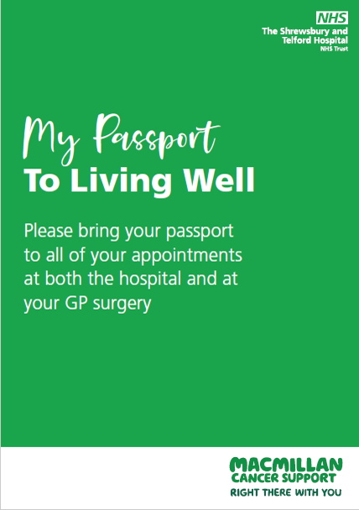
My Passport to Living Well
A patient handheld Passport, given at diagnosis, full of information about local services and support available for people LWBC
It is actively encouraged to be used across the healthcare sectors to empower and give the patient some control back in their life
Explanation of the Holistic Needs Assessment (HNA) and Care Plan
The HNA and care plan can act as a baseline of concerns that have been self –identified to aid the Cancer Care Review (CCR) undertaken in Primary Care
The passport aims to strengthen communication between all care sectors to improve the support for the patient

Slide 4
Feedback
The Passport showed me where to go for some extra support when I needed a listening ear
It was good to get it when I was first diagnosed –
I felt less alone
The Passport enabled me to take notes for myself
I was able to help a person LWBC by using the Passport to call the Team and enquire how they could help
C&CC based at a GP Practice
Why has it taken so long to get everything in one place?! A brilliant ‘one stop shop’ of information

Slide 5
Living Well Sessions
11 month pilot in 2019: over 321 people attended
Held in different community venues: bringing the service closer to those in the locality
Enables other support services to present their Programmes and actively encourages networking amongst the organisations in the county
The Living Well Sessions were attended and facilitated by fully trained patient volunteers as well as members from primary and secondary healthcare sectors
Adaptable and sustainable to be held within the hospital and at other community venues
Online platform in response to global pandemic
Currently running an ‘opt out’ pilot with the Breast Team
Living Well Videos available via the SaTH Website
Collaboration with other health economies to reach a population of over 100,000 people

Slide 6
Living With and Beyond Cancer Advisory Network
Formed from people affected by cancer who attended the Living Well Sessions
An opportunity for professionals across all care sectors to ask for feedback, opinions and comments from a network of people who have been affected by cancer
The patient and their loved one’s voice is vital!

Slide 7
Working Together
New roles being developed locally to provide excellent quality of care for people Living With and Beyond Cancer
Roles being developed in all care sectors to support those LWBC within the hospital as well as in their local community:
Cancer Care Navigators
Community Care Co-ordinators
Macmillan Community Care Co-ordinators
Social Prescribers
Using the initiatives we have spoken about to link the care sectors together to enable consistent support for the person LWBC
HNA & Care Plan
adaptable LWS’s
Cancer Care Reviews in Primary Care
Treatment Summaries for the patient and GP produced by the teams within the Trust

Slide 8
Sharing Good Practice
The initiatives that have been developed within the LWBC Programme have been recognised as good practice at some Trusts throughout the country.
The LWS sessions have been recognised as an innovative model of delivering health and wellbeing information to the patient and their loved ones.
The Passport has been identified as a resource that is beneficial for supporting patients at all stages of the pathway. We have spoken about this Passport with several Trusts including:
Birmingham Women’s & Children’s NHS Foundation Trust
The Royal Wolverhampton NHS Trust
University Hospital Birmingham
Mid & South Essex NHS Foundation Trust
University Hospital Coventry & Warwickshire NHS Trust
Sherwood Forests Hospitals NHS Trust
We are proud to say that a number of Trusts have asked to adapt the Passport for their patients and locality.

Slide 9
QUESTIONS
Thank you for listening
For any further information about the Living With & Beyond Cancer Programme, please contact:
Leah Morgan (LWBC Project Manager)
01743 492 424
sath.lwbc@nhs.net
Twitter: @sathlwbc

