Slide 1
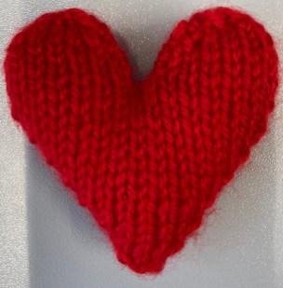
Bereavement Support Service
Support for Caregivers, Friends and Family
Gillian Sykes and Andrea Vickerman
Calderdale and Huddersfield NHS Foundation Trust

Slide 2


The country went into lockdown in March 2020 due to covid and following government guidelines, Trusts were advised to cease patient visiting immediately

Slide 3

Lockdown - Impact on patients, staff and families/patients
Upset
Concern
End of Life Care Team
Supported to lead and develop the service from Senior Team.
Worry
Patients dying alone
The impact it would have on families
Distress

Slide 4
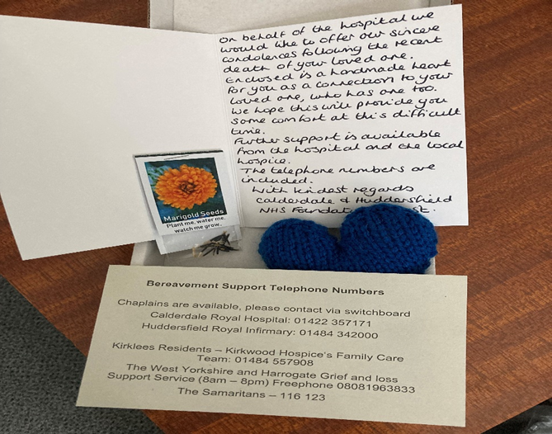
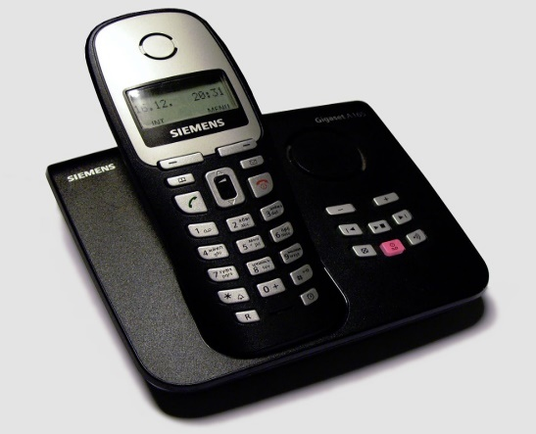
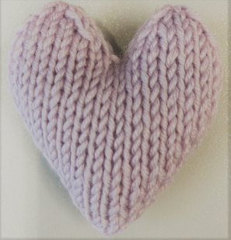
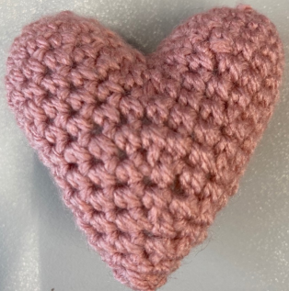
Bereavement Box
Contain:
Hand written card
Handmade heart
Marigold seeds
Bereavement support
telephone numbers
Phone Call
Relatives are rang 5 – 10 days after death. We represent the extent of our service users. For e.g Use of interpreters if needed
Hearts
A handmade heart is placed with the deceased patient by the mortuary staff as a connection with their loved one who has one too
Any feedback for the ward is timely with an agreement to ring relatives and address issues immediately rather than letting problems potentially worsen.
Notes:
Bereavement box – contents and telephone call

Slide 5

Feedback
During this scary and uncertain time, it was very sad to see the daily large numbers of families who lost loved ones, however supporting this service felt like a very worthwhile small way we could help relatives and made us feel like we were playing our part
This service has really supported grieving families and friends. So many people have thanked us for contacting them providing help with any questions and passing messages of thanks to ward teams
Feedback from staff making calls
Feedback from administration staff supporting the Bereavement Support Service

Slide 6
Feedback from Relatives
Heartfelt thanks for the card and heart, I loved that the card was handwritten as it made it more special, and that Mr B also had a heart. I slept with the heart the day it was received and had it with me when I did the eulogy. I am going to put the seeds on his grave
I can’t describe the feeling when we got the box. Totally overwhelmed and speechless. Made us feel so connected and close to A – we were happy knowing he had a heart too
As an employee of the Trust and someone with personal experience of dealing with the sadness of Covid, I would like to say, we are getting it right. My family found the bereavement box, containing a heart, some marigold flower seeds and a heart-warming message from the Trust comforting
‘It was lovely of you to send a handwritten card. Lovely, thoughtful’ ‘So impressed with the call. So lovely of you to ring’. Thank you for making me smile’
Notes:
Staff and relative impact

Slide 7
Results
From March 23rd 2020 – End of April 2021
The results are as followed:-
Deaths at CRH | 1949
Bereavement Boxes sent | 1710 (88%)
Telephone calls made (from 20th April 2020) | 1239
Boxes not sent, due to a number of factors including: No NOK details Solicitor/Power of attorney details only NOK living abroad
Notes:
Results

Slide 8
Outcomes
Measured through qualitative feedback which has described the impact for relatives and staff involved in the process. The achievements have been in relation to the relatives’ experience with us as a Trust. The relative’s wellbeing is at the heart of the service.
The initial aim of the service was to provide support for bereaved relatives. However, it has also enabled the Trust to respond quickly to feedback provided, sharing positive messages, and addressing learning opportunities - leading to improvements in future end of life care
Unaware how long the project would run, paper records were used. We now have a section on the Datix reporting system, enabling us to monitor outcomes, trends and impact.
Complaints – under end of life care heading
Date | Amount | Number of actual EOLC complaints
March – September 2019 | 14 | 10
March – September 2020 | 25 | 1

Slide 9
The Bereavement service - Key elements that contributed to the success
We have been innovative in a very demanding year to make bereaved relatives feel connected and valued. Starting a valuable 2 way dialogue that will not only benefit our bereaved relatives but also influence the care for our end of life care patients.
The backing, support and encouragement from all the senior teams at CHFT to continue the service ‘ Together we will deliver outstanding compassionate care to the communities we serve’ .
This is a proactive service with a personal touch . Hand written cards by staff, handmade hearts from the local community delivered by a very passionate team who have driven the service through the covid 19 period and plan to continue
the service as part of ‘business better than usual’
The extended team are from different areas and professions have all come together with a shared goal of supporting our bereaved relatives

Slide 10
Future…..
This service addresses many of the issues highlighted by relatives in a national bereavement survey that took place during Covid – including the ‘increased needs for bereavement care’ so we plan to continue the service
Funding has been received from the CHFT Charity to provide the bereavement boxes for another 12 months
We have an agreement with our local community for continued supply of handmade hearts
Administration support continuing as now embedded in daily roles
A submission of a business development plan to gain substantive funding
A submission has been made to CHFT Charity to have 12 months funding to maintain the service – to provide extra staff to support the service and also provide in reach into wards where areas of need are highlighted.
New working relationship with the ME service – supporting each others service to enable to seamless bereavement service.

Slide 11
