Slide 1
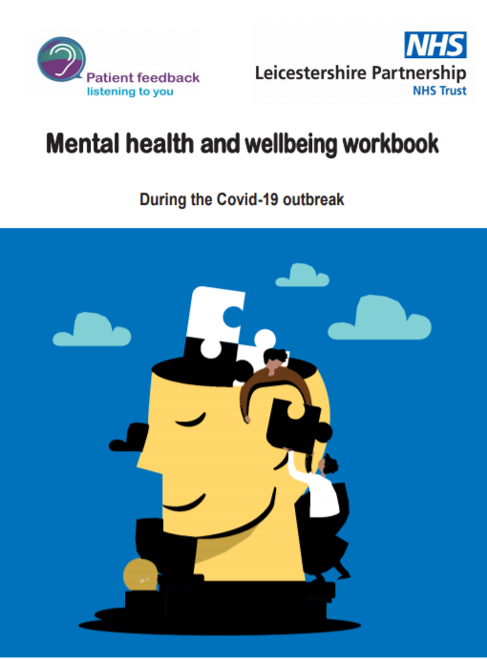
Mental Health and Wellbeing Workbook
Support for Caregivers, Friends and Family
Sandie Warden, Patient Experience and Involvement Coordinator

Slide 2
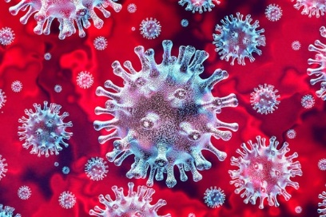
Motivators

Slide 3
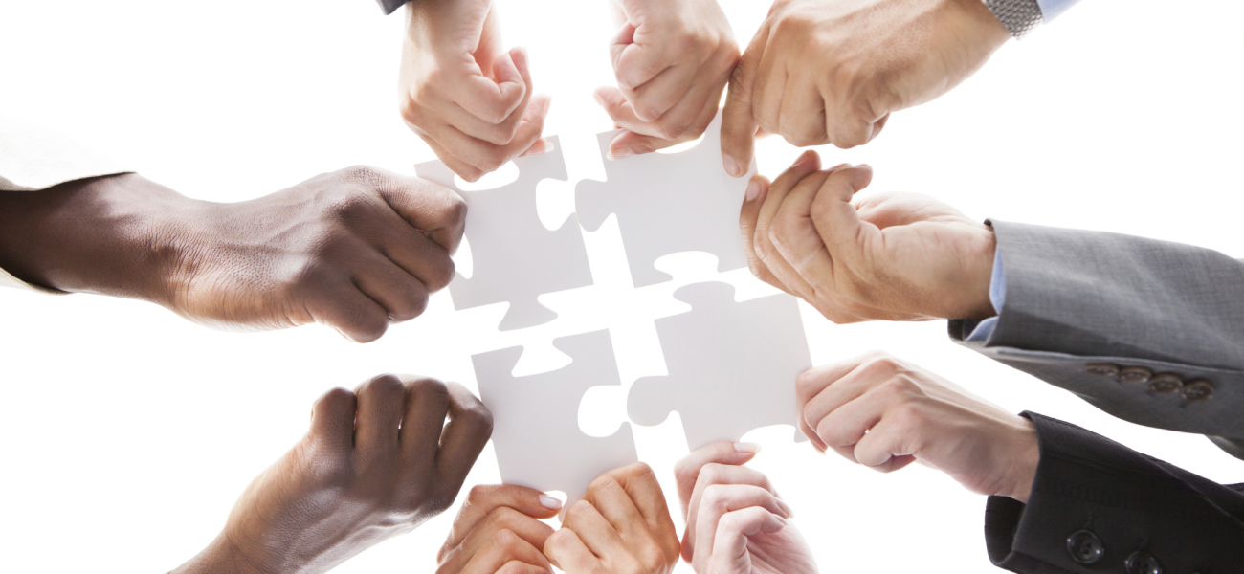
Collaborative working

Slide 4
Feedback from the network
Illustrator – member of the public
"I've always found colouring, and creativity in general, a really helpful distraction technique when struggling with my mental health. I wanted to make art-based wellbeing activities accessible to everyone so I created my own mindful colouring designs, which I shared in the workbook."
Working group/network member
“I have felt very involved at all stages of producing the workbook. My voice has been included and any ideas or concerns I have expressed have been taken into account. I feel that the group has worked well together to pool ideas and implement suggestions for the workbook. It has been rewarding to see the document take shape and evolve over the course of the group meetings…I have enjoyed being part of the group as it has given me a purpose and something to focus on during a very difficult and unsettling time. It has also allowed me to make new connections with people I wouldn't otherwise have met.”
Working group/network member
“It's been a very good experience to co-produce something that will help others to manage their mental health during this Covid19 pandemic. It's been so good too to use some of my skills again, and my insights and experiences of mental illness, and to be valued for all that…I'm delighted to have been a part of it, it's given me a huge sense of worth…It's been an important experience for me, especially as I've been going through a very difficult time health-wise. Thank you so much for inviting me to be a part of this.”
LPT Service user/carer Network member “Once again you have brought out a masterpiece with the MH and Wellbeing workbook… I have tried a lot of the links and copied where possible the leaflets on all the different mental health problems… I love the bright and cheerful logo for wellbeing. So very well done to everyone involved I am well impressed. Probably the best example of what co-production can produce”
Illustrator – member of the public
“Having had my own mental health struggles in the past, designing some of the Illustrations gave me a positive focus that kept my mind occupied during a difficult period. Not only did I get to spend some time doing something I love, it was to help others that could be feeling the same way as me”

Slide 5
Feedback from staff and partners
Local CCG’s
“We absolutely love it and will be including the MH and Wellbeing Workbook on our websites/start a conversation.”
LPT Matron for OT/CMHT’s
“just wanted to say what a fantastic resource this is”
LPT Lead Nurse for Suicide Prevention
“full of good advice and signposting to useful websites”
LPT Service Improvement Manager
“this is brilliant. Can I share it with my own family and friends?”

Slide 6
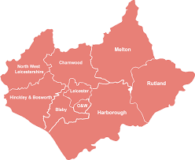
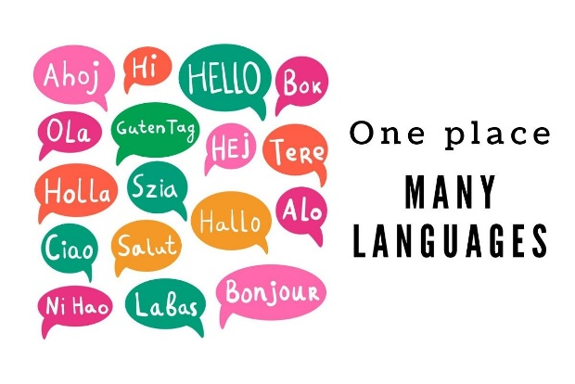
Demand and diversity

Slide 7
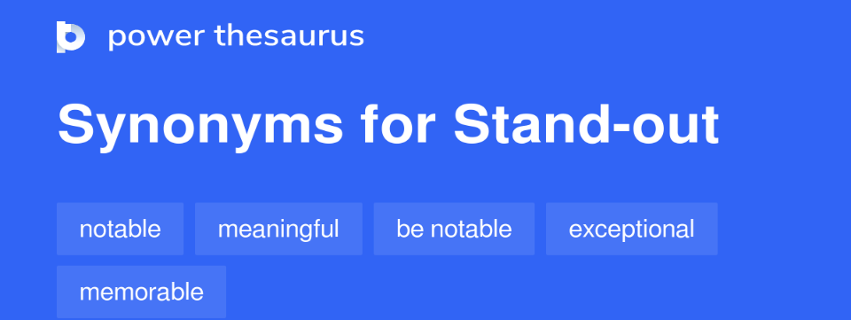
Learning
Meaningful - Completely co produced with service users
Emotionally rewarding – providing all involved in the co production of the workbook with a purpose and focus
Exceptional - Created during an exceptionally uncertain time (first lockdown)
Notable – Feedback received from our network, LPT staff , external agencies and the wider community energised us to take further steps to increase the workbooks accessibility.
Relevant - to the climate we faced at the time and remains relevant today with the longer term effect the pandemic will have on our mental health and wellbeing.

