Slide 1
I have been referred for tests to investigate possible cancer. What does this mean for me?
Tracey Ryan
Macmillan User Involvement Manager
NHS Kent and Medway Cancer Alliance
tracey.ryan1@nhs.nhs

Slide 2
Why
One patient said he had no understanding of what would happen after being referred by GP to hospital. We spoke to other patients, their families and providers.
Patients and their families told us that patients:
often left GP not knowing “what next”
did not know
how to explain to family
in some cases, they were being referred to rule out cancer
when they should hear something
If contacted within two weeks, raised anxieties that they were being seen so quickly
If not contacted, did not want to “hassle” already busy NHS, so would leave it, which could delay diagnosis
family’s anxieties were raised as didn’t know what was wrong
Providers told us:
Some patients did not know they had been referred to investigate possible cancer, so were very surprised/upset when contacted by cancer service.
Not all patients knew the importance of attending the first appointment

Slide 3
Aim
To produce a user-friendly flyer to:
give basic, understandable information on “what happens next”
complement information available from Cancer Research UK
be shared with friends and family
reduce anxieties for all
make patients aware they have been referred to investigate possible cancer.
aid GPs with that “awkward” conversation
highlight the importance of attending appointments as soon as possible
be used for patients to mark off where they were in their pathway
provide details of trusted websites for information and guidance, avoiding internet searches that could further raise anxieties
give tips to help prepare for appointments from people that had been there
highlight that they can take someone with them.

Slide 4
How
Engagement and co-production
Over 12 months, we worked with:
cancer patient involvement groups, including families and friends, across Kent and Medway
non-cancer patients via east Kent patient forum (Approximately 97 per cent of referrals will not have cancer, so needed to include non-cancer patients in the design.)
Alliance Early Diagnosis Working Group
Alliance Personalised Care Working Group
Cancer commissioners and Macmillan GP
NHS Kent and Medway Cancer Alliance operational meeting.

Slide 5
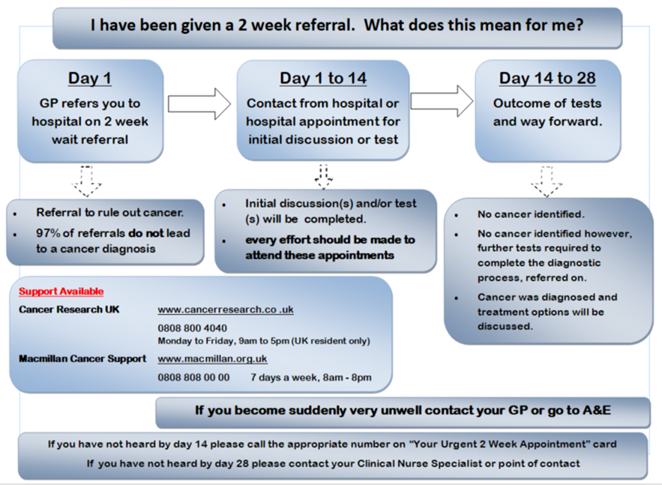
One of the early versions

Slide 6
Some of the feedback
I passed this over to my husband as he has Lymphoma. He said the information I have just shown him would have made all the difference as he would have had a guide to work by. He really liked it
It might be an idea to add what the action they should take should they not receive contact from the hospital by Day 14 or should they not receive the outcome of tests and way forward by day 28
I like this format and do so wish this had been available to me. I had no clue I was even being referred under the two-week thingy!
This would be helpful for GPs, so they know what happens once a referral is made
I think the overarching question is a bit ‘wordy’. How about something like: “I have been given a two-week referral. What does this mean for me?”
I think the information would gain if on the leaflet you could emphasise how essential it is for the patient to be accompanied by a friend or relative from initial consultation and throughout their care plan

Slide 7
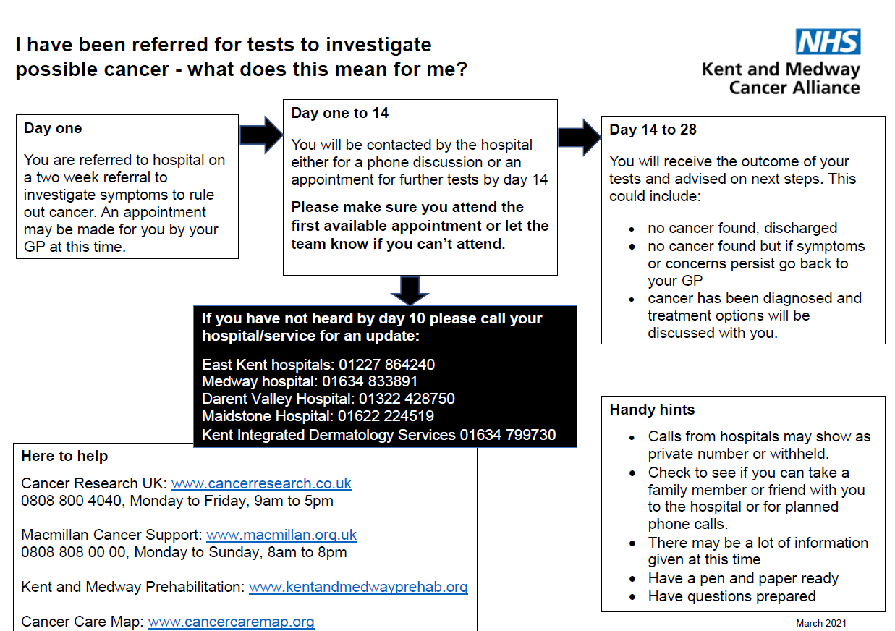
Final versions

Slide 8
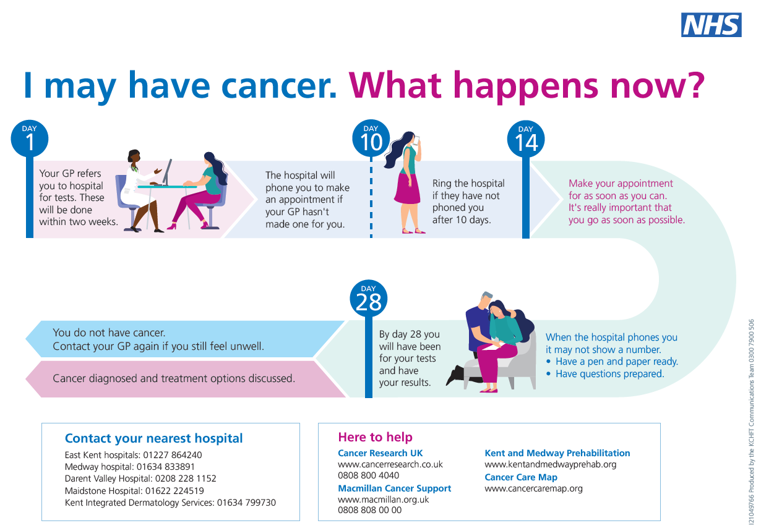
Final versions

Slide 9
Learning
Success started with listening not just hearing the patients concerns, picking up on something that was said in conversation.
Kept in mind that we need to ask “What matters to you” rather than “What is the matter with you”
Patients and professionals worked together in partnership
Created by patients for patients, by friends and families for friends and families
ensured information is right for them
what they need when they need it
Grown beyond all expectations
started to help patients know next steps after referral
evolved into a training aid for GPs and care staff
Concept transferable to many other services.
all on one page
reference point for trusted information and support.

Slide 10
Thank you!
Comments or questions?
Tracey Ryan
Macmillan User Involvement Manager
NHS Kent and Medway Cancer Alliance
tracey.ryan1@nhs.nhs

