Slide 1
Swan Scheme Wedding Boxes for Patient’s Receiving End of Life Care

Slide 2
Background
We undertake very last minute wedding ceremonies, renewal of vows or blessings of commitment across our hospitals.
During the pandemic the number of ceremonies increased and we found that we were lacking in items for the ceremonies.
The few wards which had their own items were reluctant to lend due to infection risks.
We asked local companies for donations of flowers, rings and cake for each ceremony. Staff lent things from their own weddings but it meant the families couldn’t always get to keep anything that reminded them of the wedding day.

Slide 3
We wanted to find a way to make these weddings as special as possible, giving a positive focus to the time that families and loved ones spend together before bereavement. That is when we came up with the idea of a wedding box.
The box includes decorations to help create a celebratory atmosphere, including a bouquet & buttonhole, bunting, confetti, wedding rings with a ring cushion and as small mementoes for loved ones to keep and remember the special day. We also include our Treasured Moments handprint kits.
Chaplaincy teams have an additional box containing a polaroid camera, Bluetooth speaker and spare wedding rings.
These boxes allow the ward teams to quickly create special memories for the couple and their families.

Slide 4
Time can be of the essence, so having these decorations readily available makes a huge difference in helping us fulfil the wishes of patients and loved ones and keep spirits up in what may be their final few days or hours. They can still have that special day they had hoped for, with excitement, love and happiness.
Our Charities Team have funded 20 individual boxes
The wedding boxes are held by our chaplaincy teams so when a box is needed, staff organise to collect one.
Swan Scheme wedding boxes inspired and developed by Sharon Kidd, Patient Experience Manager

Slide 5
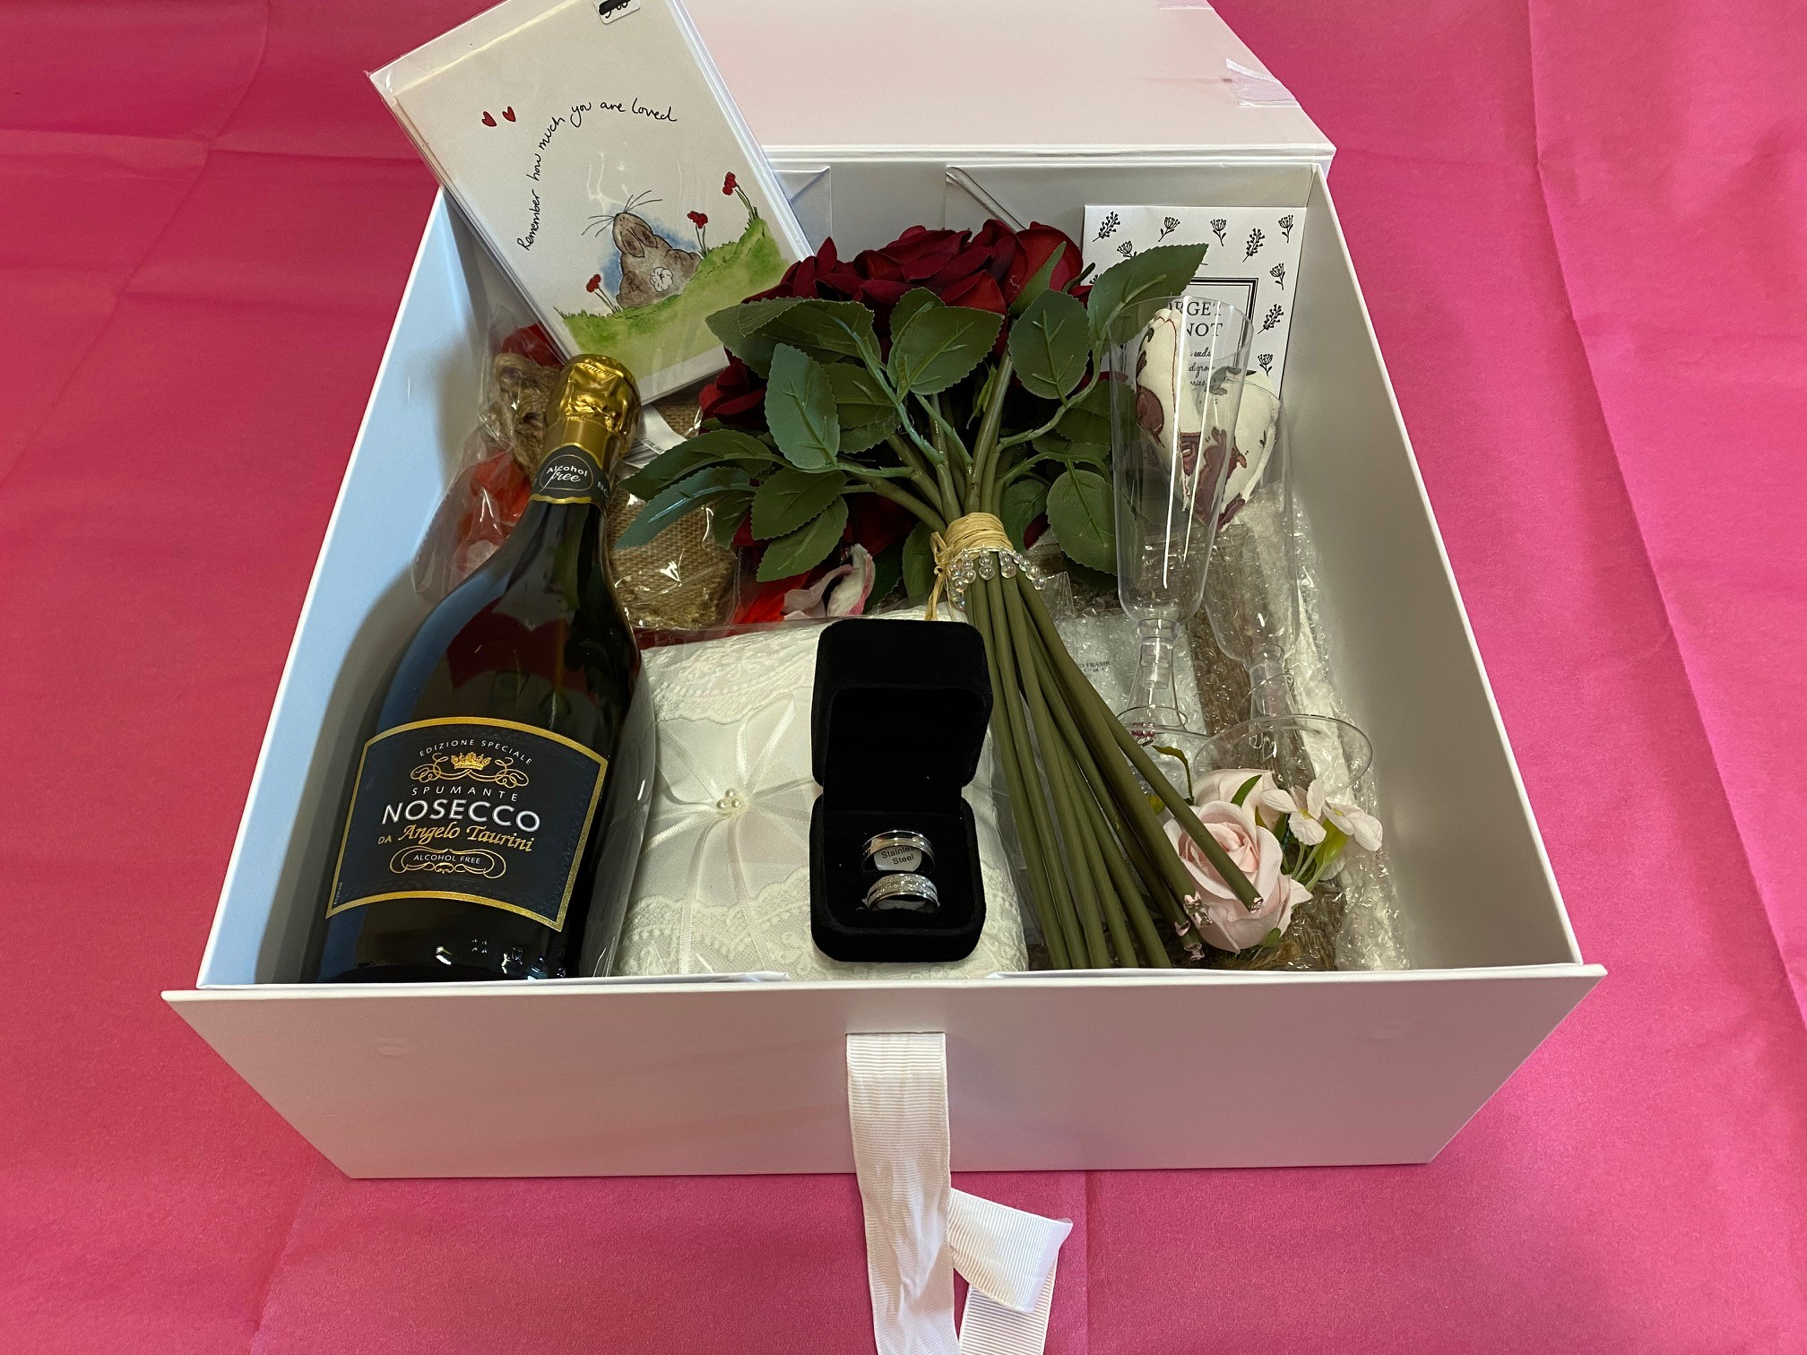
Swan wedding box

Slide 6
Wedding rings & ring cushion

Slide 7
Bouquet & button hole

Slide 8
Bubbles, flutes and treasured moment hearts

Slide 9
Bunting, confetti, frame, forget me not seeds & card

Slide 10
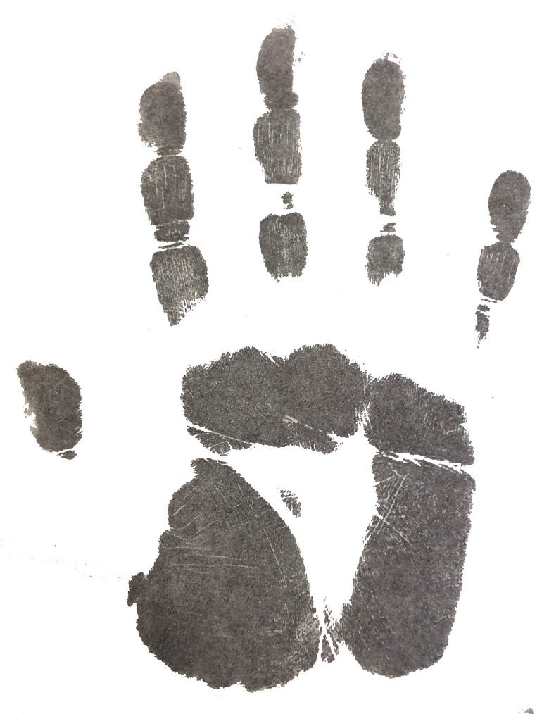
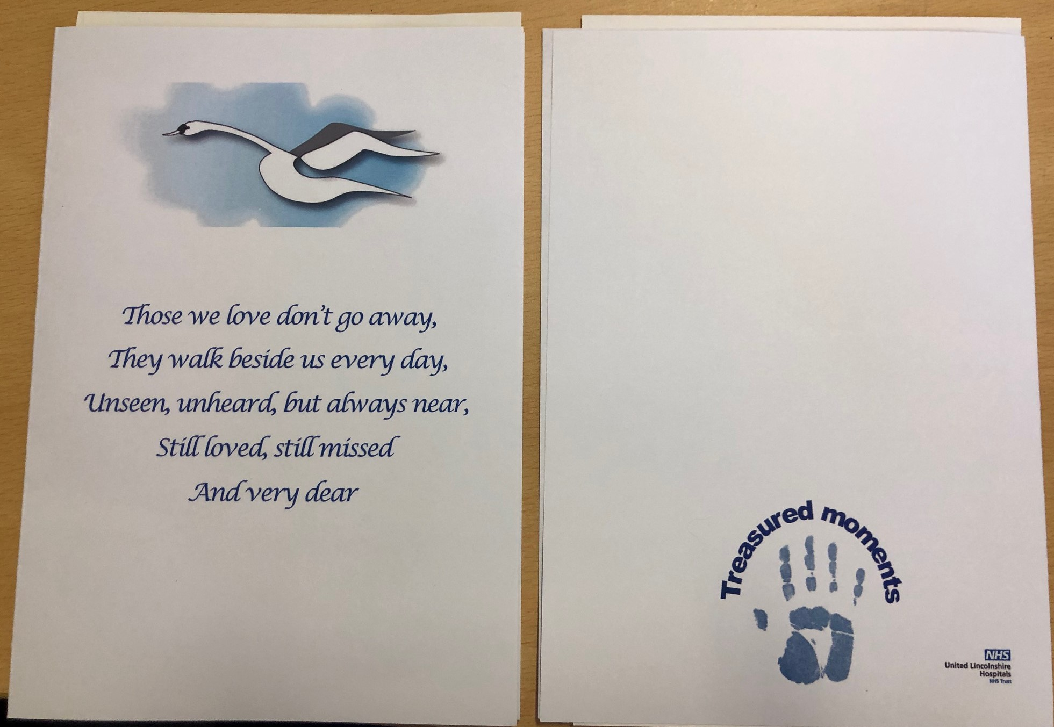
Treasured moment handprint kit

Slide 11
Chaplaincy box

Slide 12
https://youtu.be/Tdowm8fJoB8

Slide 13
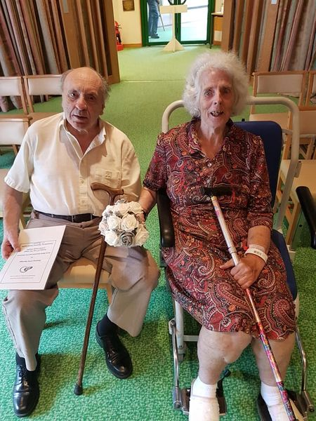
Renewal of wedding vows after 60 years of marriage
“When we got married 60 years ago, we were very, very poor. We have nothing, it was rationing and times were really hard.”

Slide 14
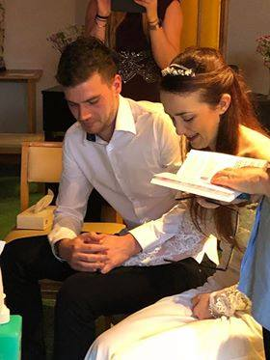
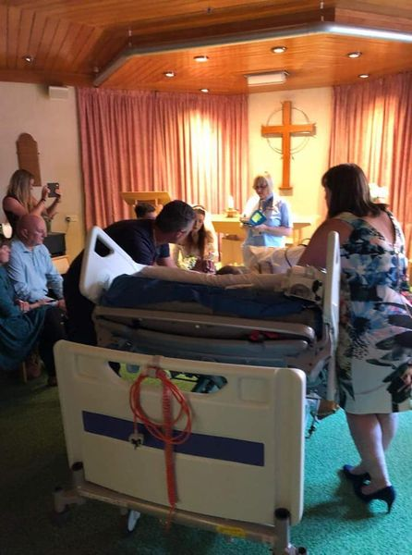
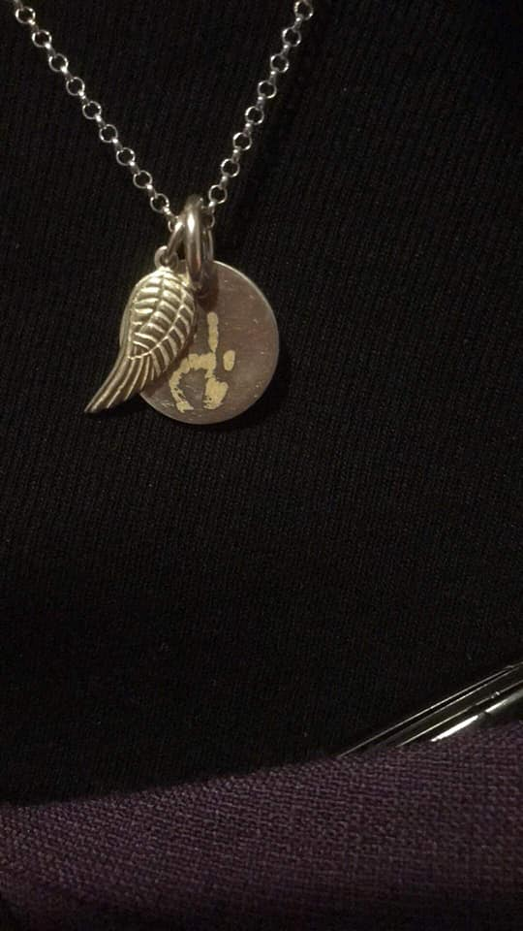
A wedding ceremony
From the handprint kit, a piece of beautiful jewellery was made

Slide 15
Staff feedback
Thank you to Alison from chaplaincy who provided a lovely impromptu service on our ward today. From idea to renewal of vows in less than an hour for a lovely couple who have been married over 60 years.
Thank you also to those who provided the wedding box, we were able to provide them with such beautiful memories and a physical keepsake at a really emotionally difficult time 😊

