Slide 1
Commissioning for Patient Experience
Jenny Scott and Fiona Jenkins
Cheshire and Wirral Partnership NHS FT – Commissioning Team
28th September 2022

Slide 2
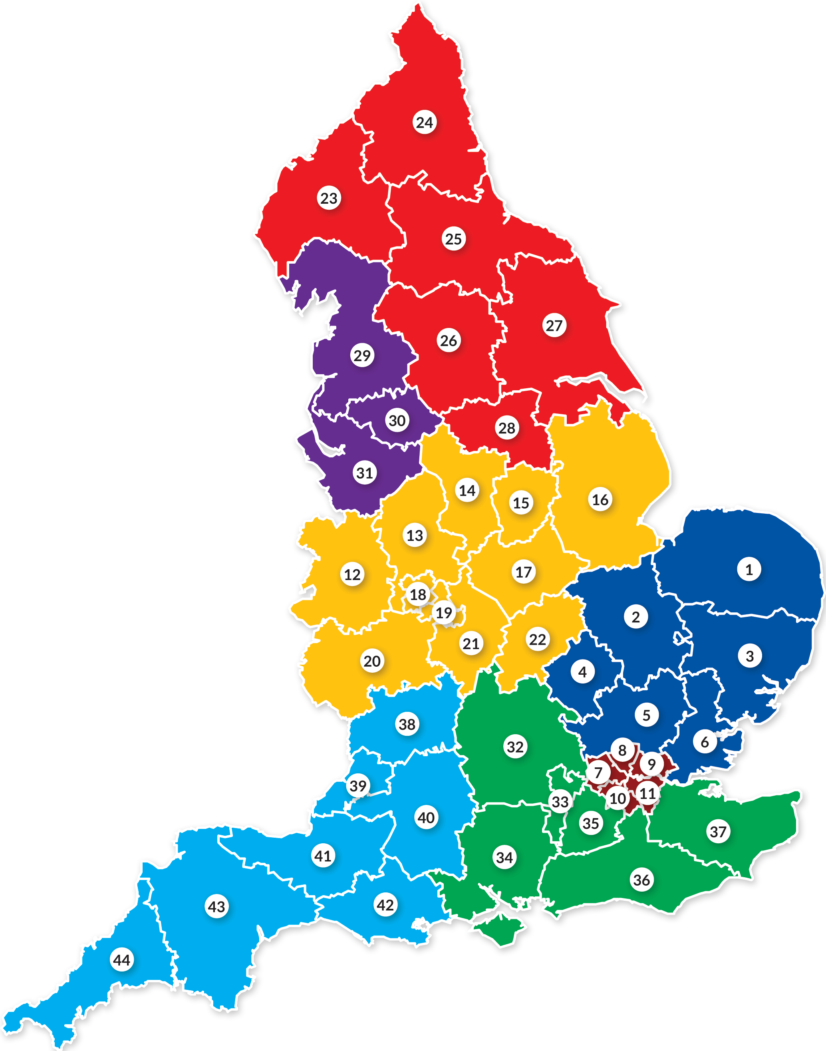
Our Provider Collaborative Commissioning Focus
Empowered Adult Eating Disorders PC (North West)
Serving a population of circa 6 mill
NHS and IS Provision
Challenges: increasing referrals post pandemic community eating disorder gatekeeping, Consistency in admission criteria gaps in service provision, Inpatient capacity across NW
Level Up Young People and Families PC (Cheshire and Merseyside)
Serving a population of circa 3 mill
NHS and IS Provision
Challenges: increase in referrals, young people with highly complex needs young people with eating disorders strengthening Local Authority partnerships inappropriate use of acute paediatrics as safe places. Delayed transfers of care Harm from inappropriate admission

Slide 3
Specialised Mental Health Provider Collaboratives were established by NHSE/I with a mandate for creativity and innovation driven through delegated commissioning.
Collaborative partnerships spanning health and social care pathways are fundamental to achieving truly person centred care.
We want our young people, their families and adults with experience of eating disorders to work alongside us as equal partners in driving service change.
Our postcards from the future will describe a shared vision of possibilities and unite us in our determination for service improvement.
Not a soft option but a relentless focus on commissioning for quality, clinical outcomes and most importantly, patient experience.
Our ambition for change

Slide 4
What do our Experts by Experience think?
Play video

Slide 5
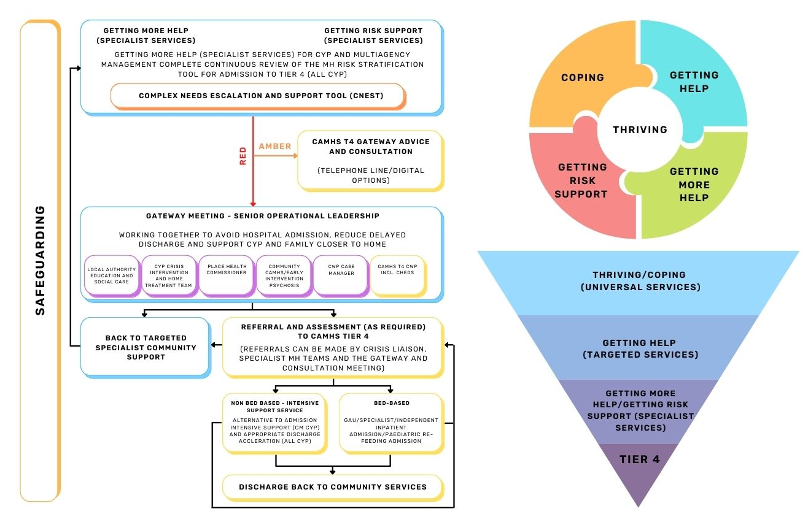
Co-produced model of care for our young people and families

Slide 6
Our approach
A cultural focus – our work with experts by experience is cultural and is constant in all our planning and development not just at certain points in time e.g. co produced clinical models
Third sector partner expertise – commissioning support from Beat, Young Minds and Inspire Motivate Overcome (IMO) – formal recruitment, training and community connections.
Experts by Experience Groups – people with lived experience are trained and empowered to play a full and active role in PC groups and decision making.
Lived Experience Charter – to be published to make explicit our commitment to listen, learn and address all views but also to outline responsibilities from our experts by experience.
Community engagement – harnessing the energy and enthusiasm of different communities in raising awareness of mental health.
Transparency and honesty – we are open about the challenges we collectively must address in our services.

Slide 7
Impact on commissioning
Unique perspective – people with lived experience of services (either as service users or families / carers) tell us how services feel in reality.
Collective action - by being honest and open about key challenges, we can move forward together in partnership to seek solutions.
Organisational consensus - a reality based focus on person centred care unites disparate organisations in the important issues.
Evidence based discussions – we reference best practice evidence alongside the views of our experts by experience.
Resilience – we can face future uncertainties and challenges more robustly through our strengthened partnerships.
Early actions – our name and logos, our website, reflective and sharing event

Slide 8
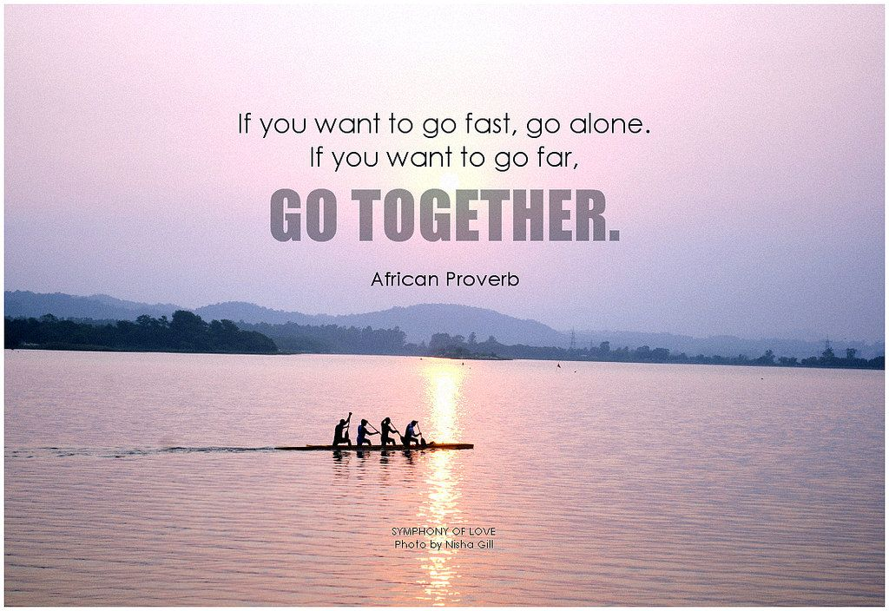
In summary

