Slide 1
Redesigning our communication and engagement approaches to broaden and maximise involvement with patients and carers Engaging and championing the public
Jennie Negus. Head of Patient Experience

Slide 2
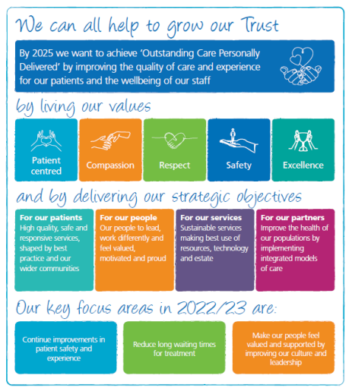
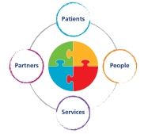
This work is one of the core strategic objectives within our ULHT Integrated Improvement Plan.

Slide 3
Purpose:
To put our patients at the beginning and at the centre, giving them a valued voice in decision-making; engaging and involving from the outset and not just informing them afterwards.
To drive, deliver and demonstrate Trust-wide measurable improvement and continuous learning in outcomes, delivery, performance, sustainability and transformation in Patient Experience.
To provide diverse forums and approaches for influencing and contributing to discussions and planning of the most effective health services for the local population.
To support the Trust in its aim to ensure that all communication and engagement is fit for purpose, appropriate and accessible to all relevant groups e.g. patient information.
For our Patient Panel and Expert Reference Group members to be welcomed as critical friends and experts by and of experience.
To ensure our public and relevant other stakeholders are well informed about the workings and strategic direction of the Trust; for example feeding back to local GP Patient Participation and support groups.

Slide 4
As a Trust we are committed to designing and delivering patient-centred care and patient-centred services and as such needed to refocus away from ‘doing for’ and ‘doing to’ to ‘doing with’ and this became our Patient Panel and Expert Reference Group strapline and logo.

Slide 5
DEMENTIA CARERS ERG
PATIENT PANEL
BREAST MASTALGIA ERG
PATIENT EXPERIENCE GROUP
SENSORY LOSS ERG
CANCER PATIENT ERG

Slide 6
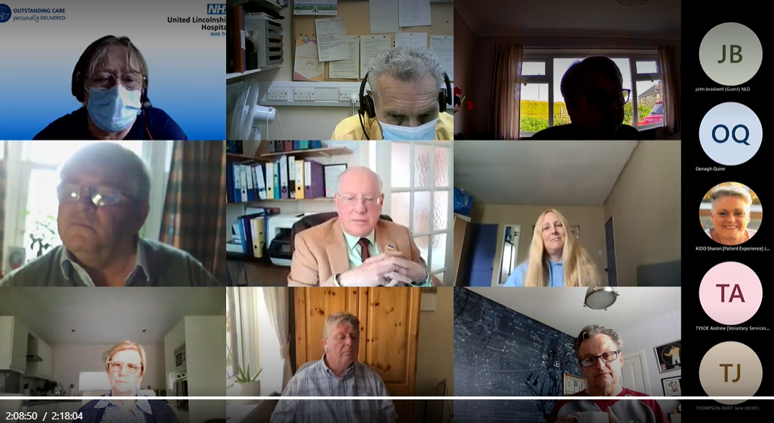
33 members; average 17 at each meeting.
Meet monthly via MS Teams for 2.5 hours.
The first 30 minutes is Panel business such as minutes and action log.
We then have 4 x 30 minute slots when staff attend to discuss a project, issue or idea. We send briefings beforehand and ask staff to speak for no more than 10 minutes so that time is protected for questions and comments.
Notes are taken of the meetings and questions and answers detailed so that these can then be followed up by the presenters and enable feedback further down the line.

Slide 7
More than 70 staff have attended Patient Panels and 53 presentations have been given on a whole host of topics and we have also held 8 standalone workshops when the topic has needed more time
Outpatient improvements programme
EHR Electronic Patient Records
Pre-Operative Assessments
Safety & Quality of SDEC
Developments in Dermatology
Video Consultations
Communication training
Patient moves
Patient Initiated Follow Up (PIFU)
Digital records
Visiting precautions
Improving Respiratory Services Programme
Re-brand of all ULHT hospital sites.
Nuclear Medicine Service – Co-design of future options

Slide 8
Staff have told us:
It has been invaluable to hear the panel's thoughts and feedback. There are many occasions where we are implementing something internally and think we have addressed the patients point of view/experience but it becomes very apparent there may be things we have not considered - both positive and negative
The panel was a great way for us to gauge how our patients will view the implementation and also ensured that we have taken earlier patient engagement to heart when implementing the project as we were able to address the questions.
I really enjoyed presenting to the Panel and was really pleased to see so many patients and stakeholders. They interacted and you can see that they were listening to what I was saying. I appreciate them giving up their time for us and for actively engaging and working with us to improve our services.
As a member of ULHT staff that is not patient facing on a daily basis, it was really grounding to meet with some of our patients and further cements why we are all here doing what we do....

Slide 9
Panel members have told us:
I feel like my input is important and valued. It helps give a patient voice and experience into the planning process of new ideas. I can raise queries or concerns and they are always addressed.
We get to hear about new projects and ideas to improve patients care and experience. Having this insight into what the providers responsibilities are helps us understand the complexities involved in delivering local health services.
The Panel is never short of presenters who want to come and talk to us and we are never short of comment.
It is good to know that the voices of the panel are not only listened to but in many cases have been acted on.

Slide 10
https://youtu.be/F3z5YL-LdcQ

Slide 11
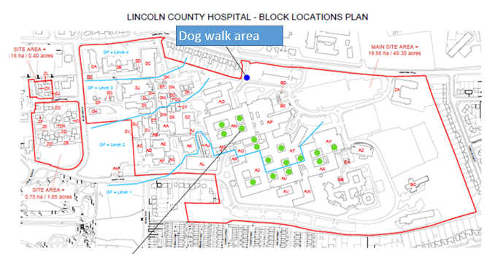
We reached out to patients with sensory loss to invite them to be involved and they chose to work as a sub-group of the main Panel, in part due to the practicalities of needing signers. We have 5 members in the group and have taken forward two co-production projects with them.
We saw that we needed to widen our existing ‘Guide Dogs’ guidance to embrace all Assistance Dogs. Together we developed a new policy, signage and posters and have also identified dog walk areas on our 3 hospital sites.
We asked ‘What Matters to you’ (#WMTY) and the members told us that not all staff are aware of their needs, such as a porter taking them to x-ray or a pharmacist checking their meds. They suggested symbols at the bedside would raise awareness and together we developed laminated signs and guidance for all our wards.

Slide 12
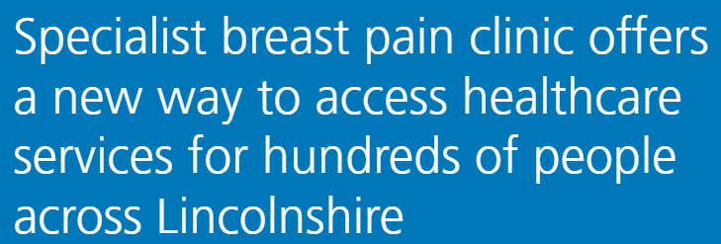
Patients presenting with any breast pain, lumps or any other breast presentations were referred into us via the 2 week wait pathway, the pathway for all suspected cancers. Naturally this can induce anxiety, stress and worry for patients and particularly as we know that breast pain alone, as a symptom, IS NOT indicative of a cancer.
Our clinicians, managers and CCG colleagues wanted to create a local service that would meet the needs of those patients presenting with breast pain alone, alleviating the anxiety of an unnecessary suspected cancer referral.
So, we asked our experts:
6 patients joined the ERG and worked together to map out the pathways, referrals & how the clinics would run.

Slide 13
Commissioned by Lincolnshire CCG Cancer Board, building on the success of the ULHT Patient Panel.
8 people responded to the advert and joined the group. All have different cancer diagnosis and very powerful stories to tell and experiences to share.
First meeting agenda included involvement in designing a new Late Effects Clinic and giving advice on how to explain to patients what to expect from chemotherapy.

Slide 14
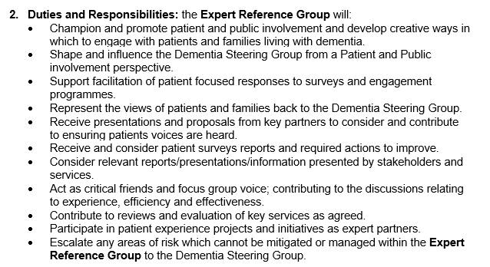
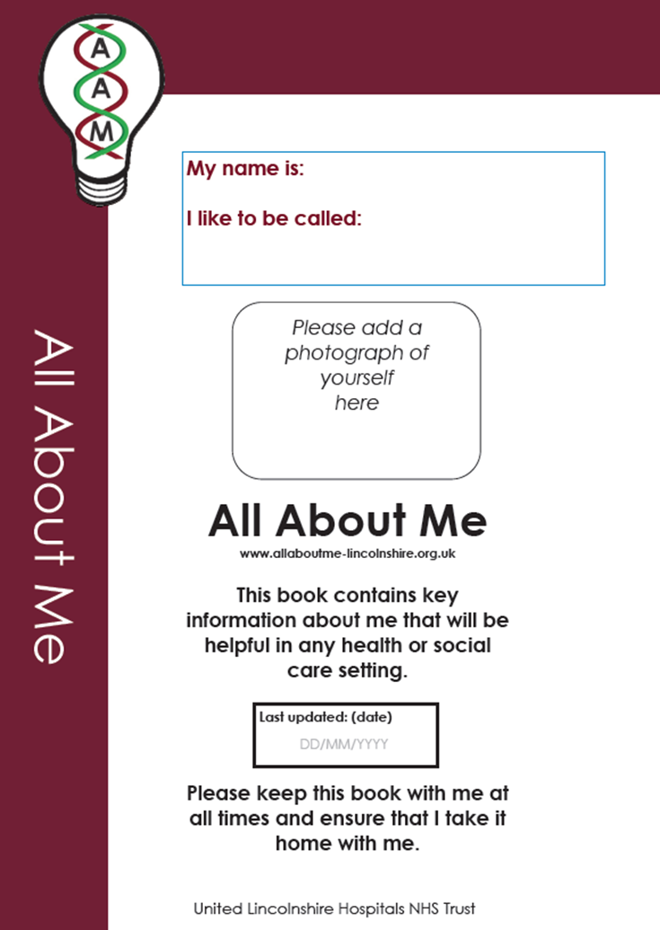
This is our latest ERG; we had our first getting to know you meeting in August and at our inaugural official meeting in October will be discussing All About Me Hospital Passports and experience of carers in our Emergency Departments. We have 5 carers of different ages, bringing different experiences of caring for someone with dementia.

Slide 15
Thank you

