Slide 1
Co-producing our Patient Improvement
(PPIQI) Strategy and Plan
Strengthening the foundations to improve patient and carer experience
Trish Cargill - Patient Volunteer
Sandra Minich - Senior Improvement Lead
Linda Pitchford – Head of Transformation
Michael Prior – Patient Volunteer

Slide 2
Nottingham University Hospitals (NUH)
We provide services to 2.5 million residents of Nottingham and its surrounding communities
A further 3-4 million people across our region access our specialist services - stroke, renal, neurosciences, cancer and trauma
Long History of Quality Improvement but have an ambition to shift the balance of power incorporating co-production as a default in all QI work
Our Quality Improvement Volunteers comprise of 10 core members
70% have had QSIR fundamentals training

Slide 3
Strengthening the Foundation – 5 Elements
Our Journey to ensuring co-production in Quality Improvement as a default
New Thinking
Leadership
Involvement
Outcome and Sustainability
Transferability and Dissemination

Slide 4
New Thinking
Despite the unprecedented circumstance we have found ourselves in over the past two years, we have undertaken a tremendous amount of improvement and made significant progress against our improvement strategic plan that we should rightly be proud of. This PPIQI strategy seeks to support our NUHqi journey by describing how we will undertake a complementary path towards “co-producing” our Quality Improvement priority areas.
Improvement only happens by those closest to it
Co-production
Quality
Improvement
Where the
magic
happens
Our shared goal - Improved experience of care

Slide 5
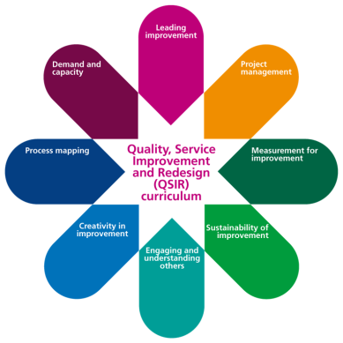
Leadership – Governance
QSOG
Quality Improvement Management Board
QUAC
Patient Engagement & Experience Group (PEEG)
PPIQI
Patient Partnership Group (PPG)
Supporting & Enabling Delivery
Executive Sponsor: Alison Wynne
Improvement & Transformation Lead: Sandra Minich
Patient Volunteer Lead: Trish Cargill
Patient Volunteer Lead: Michael Prior
Board to ward supported
Expertise dedicated to delivery – Improvement, Insight and PMO
Permission to do – PDSAs built from the bottom up
Division Improvement Support
System and Trust Improvement Support
Divisional and Corporate Improvement Leadership Teams
Enabler - Measurement for Improvement

Slide 6
Leadership – Shifting the balance of power
The default position is often insight and feedback and not involvement
Co-production by definition requires the sharing of power
Ceding Power
OPERATIONAL MANAGMENT
QUALITY IMPROVEMENT
MOBILISING SOCIAL ACTION
Its about doing Quality Improvement in a completely different way
Sharing Power
Keeping Power
CO-PRODUCING
QUALITY IMPROVEMENT
PERFORMANCE MANAGEMENT

Slide 7
Involvement
Over the last 18 months we have enabled our patient volunteers to work side by side with our staff on over 40 improvement projects resulting in systematic culture changes enabling genuine co-production benefits and impacts.
Aims and Objectives:
Listening, Learning and Acting on Feedback from Staff and Patients experiences using an appreciative enquiry approach.
Reflected on the feedback and suggestions from patients, families, carers and staff for improving patient experience.
Created an environment to share ideas for learning and improvement, including quick wins and longer term goals.
Developed an experienced based co-production Improvement Plan that was reflective of the workshops discussions to impact on;
Patient Safety
Patient and Staff Experience
Clinical Effectiveness
Better use of Resources

Slide 8
Outcomes and Sustainability
Our example from the Going Home From Hospital Shared Learning Workshop enabled the co-production of a discharge improvement plan. The outputs included:
Co-designed ICS wide D2A patient leaflet
Implemented best practice for board rounds
Implementation of criteria for discharge
Impact:
Decreased pre MSFT LOS by 1 day – reduction of delay related harm potential
Improved patient involvement in their discharge process using the 4 patient questions
“The projects and outputs have significantly helped raise the profile and understanding of the importance/benefits of involving patients and adopting a co-production approach and are seen and used as exemplars for patient involvement and QI.” Head of Patient & Public Involvement.

Slide 9
Transferability and Dissemination
Our example from the Health Watch Appreciative Inquiry Workshop made the following recommendations:
Operational Excellence
Capability
Shared Purpose and understanding of co-production
Our next steps will be the development of ‘Best practice guides' to strengthen our foundation by bringing together best practice for improvement and provide an overarching trio of framework to furnish people with the requisite knowledge and skills to impact on better care outcomes for patients, better staff and patient experience and better use of resources.
Competency Framework
PPI Framework
Impact and Effectiveness Framework
The aim of the Competency Framework is to enable anybody undertaking an improvement initiative to have the core competencies and knowledge and skills (technical and non technical) at the appropriate level
The aim of the PPI Framework is to ensure staff and patients have the knowledge and skills to undertake Improvements using a co-designed approach involving patients and carers in all improvement initiatives as a default
The aim of the Impact and effectiveness ‘How to’ guide is to provide an overarching framework that enables anybody undertaking an improvement initiative to deliver successful improvements and tell their improvement story

Slide 10
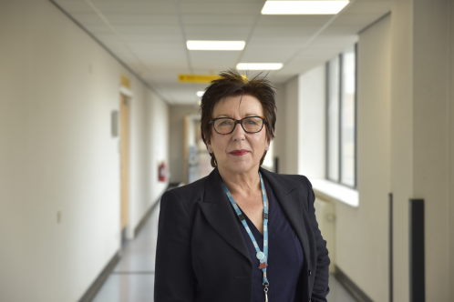
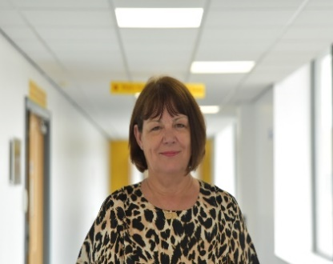
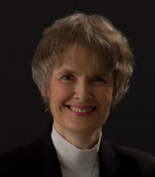
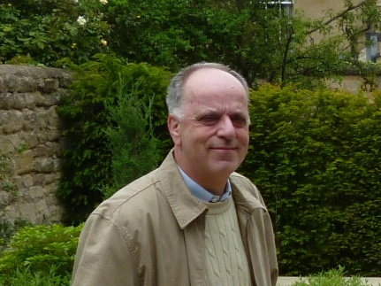
Thank you for allowing us to share our project.
We welcome any questions…
Sandra
Linda
Trish
Michael

