Slide 1
Cancer Improvement Collaborative (NHSE/I): To improve the explanation of diagnostic test results in a completely understandable way for adult cancer patients in ethnically diverse communities Kings Cancer Collaborative Project Team

Slide 2
Targeted NCPES Question
 | King’s (2019) 299 replies | National Average (2019) 67.858 replies | Breast Team (2019) 116 replies | National Average for breast (2019)
(Q.7) Test results explained in completely understandable way | 77% | 80% | 71% | 83%
Notes:
Irina- The above slide highlights the growing gap in the disparity between the Kings white and ethnic minority breast cancer population in understanding the explanation of their diagnostic test results
Comparison between GSTT and LGT National Cancer Patient Experience Survey (NCPES) results for this question as follows:
GSTT – no difference with Kings
LGT – no disparity found between white and ethnic minority population (however very small sample sizes compared to KCH and GSTT)

Slide 3
Demographics breast population
DESCRIPTION – Denmark Hill Hospital (January 2019-December 2019) | NUMBER
White- British | 52
White- Irish | 5
White- any other white background | 13
Mixed- White and Black African | 5
Mixed- White and Asian | 1
Mixed- any other mixed background | 5
Asian or Asian British-Indian | 2
Asian or Asian British-Pakistani | 1
Asian or Asian British-any other Asian background | 1
Asian or Asian British-Bangladeshi | 3
Black or British Black-Caribbean | 12
Black or Black British-African | 4
Black or British Black-ay other Black background | 7
Other ethnic groups-any other ethnic group | 5
Not stated | 39
 | 155
DESCRIPTION - Princess Royal Hospital (January 2019-December 2019) | NUMBER
White- British | 130
White- Irish
White- any other white background | 5
Mixed- White and Black African
Mixed- White and Asian
Mixed- any other mixed background
Asian or Asian British-Indian | 1
Asian or Asian British-Pakistani | 1
Asian or Asian British-any other Asian background
Asian or Asian British-Bangladeshi | 2
Black or British Black-Caribbean | 3
Black or Black British-African
Black or British Black-ay other Black background
Other ethnic groups-any other ethnic group | 1
Not stated | 62
 | 205
Notes:
Sola to present

Slide 4
Revised Quality Improvement Aim
Improve the experience of the Black African breast cancer population at DH and Asian breast cancer population at the PRUH, as measured by the NCPES Q7, with a target improvement of 10% by February 2022

Slide 5
Stakeholder Engagement
Our working group has engaged with a number of internal and external stakeholders to help inform and shape the project
South East London
Trust Teams
Wider Breast Care team
(Engagement Event)
Kings Cancer Collaborative Working Group
Cancer Alliance
GP Leads
Equality Diversity and Inclusion
Communications
Transformation
Patient Experience
Ops Managers
Support Worker
Consultants
Nurses
Notes:
Sola to present

Slide 6
Summary of Patient Feedback
Care and Compassion
CNS and consultant explanation of diagnostic testing, care and compassion is great!!!! 89% of respondents commended this aspect of care
Wider Experience of Care
Difficult to talk about one aspect of patient care in isolation, i.e. separating experience of care from support received
Communication and access to information is a ‘golden thread’ running through the patient experience programme of work
Communication and Information
Consistency of information provided
Ongoing support and access to CNS and Support Workers
Areas for Improvement
Consistency of CNS presence in 2WW / One Stop Clinics
2ww clinic letters (liaised with GP leads to discuss changes required on eRS) - clear and concise with accurate and accessible information to help manage patient expectations
Breast care pathway for diagnostic testing for quick reference point on what to expect (for patients and clinical colleagues referring to the service
Glossary of terms – explaining ‘medical terminology’
Notes:
Sola to present

Slide 7
Our Change Ideas
Piloting change…….
Breast care flowchart for diagnostic tests
Updated 2ww clinic letter
Staff Training Video
Consistent presence of CNSs in 2ww / One Stop Clinic
Updated breast care unit webpages
Key
Pilot has commenced
Pilot is on track to commence by agreed date
Notes:
Emma to present
Staff Engagement events - Oct and Nov 2021 – presentation of collaborative work, change ideas being discussed and invitations to engage in the change
Flowchart links to GPs as well to see if making impact
Website

Slide 8
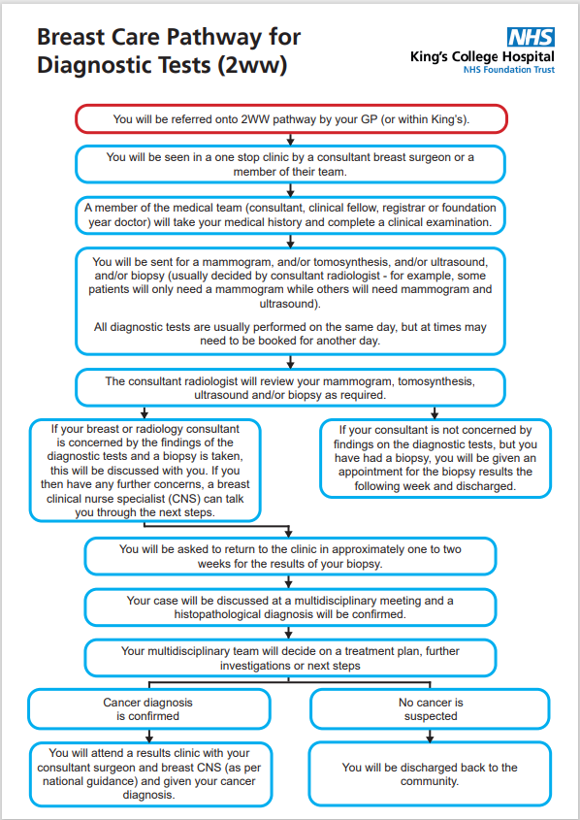
Change 1 - Breast Care Flowchart
Notes:
Impact & Success So Far (including tackling Health Inequalities)
- feel free to include what you have done, measures if you've tested a change idea, unintended impact (ripple effects), what hasn't worked, the difference people who use services (LEPs) have made
2ww letter

Slide 9
Change 1 - Breast Care Flowchart
Patient Feedback
10 of the 12 (83%) patients surveyed in the first phase pilot found the flowchart very useful
The breast care flowcharts are really useful
Straight to the point
The flowchart made sense. I understood the steps
Really liked it found it really useful, helped to understand what the process will be
Would have liked to have had it before my appointment
Wording was great. Generally understandable
Danger of overcomplicating for other patients, but for me it was clear
Enabled me to understand stages prior to my appointment
Yes it was helpful. Most useful for people coming in for their cancer treatment
I didn’t understand the steps due to learning disability
Ensure steps are made simple for people with learning disabilities
Important to know what the steps are before being called in by a consultant. Flowchart simply acts as a guide
Notes:
Impact & Success So Far (including tackling Health Inequalities)
- feel free to include what you have done, measures if you've tested a change idea, unintended impact (ripple effects), what hasn't worked, the difference people who use services (LEPs) have made
2ww letter

Slide 10
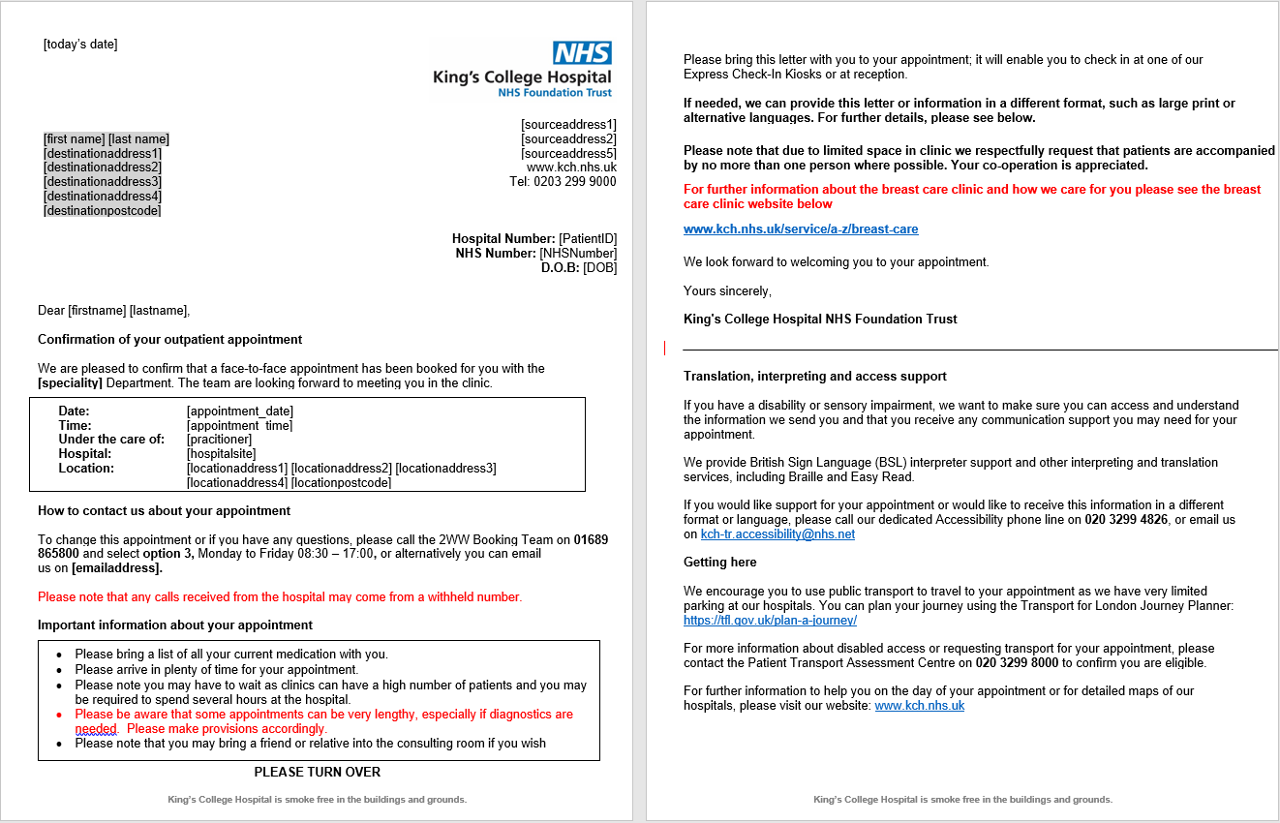
Change 2 - 2ww Appointment Clinic Letter
Notes:
Impact & Success So Far (including tackling Health Inequalities)
- feel free to include what you have done, measures if you've tested a change idea, unintended impact (ripple effects), what hasn't worked, the difference people who use services (LEPs) have made
2ww letter

Slide 11
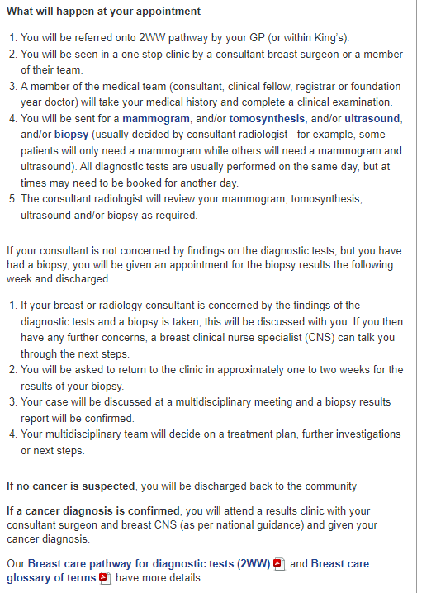
Change 3 - Breast Care Unit Webpages
Notes:
Impact & Success So Far (including tackling Health Inequalities)
- feel free to include what you have done, measures if you've tested a change idea, unintended impact (ripple effects), what hasn't worked, the difference people who use services (LEPs) have made
2ww letter

Slide 12
Change 2 & 3 – 2ww Clinic Appointment Letter
and Breast Care Webpage - Patient feedback
All 9 of the patients surveyed so far have found the revised 2ww clinic appointment letter easy to understand and helped them to understand how to prepare for their breast care appointment
They give indication of how long you are there for the appointment so you can prepare
(It) told you where to report to. Gave all information needed.
Very helpful in general
Previous letter did not help did not know what to expect - now that the time is available absolutely yes.
Yes in that it said where to go
4 / 9 patients surveyed accessed the link to the webpages in the clinic appointment letter all of whom found the content useful/very useful
(The website is) self explanatory, tells you what you need to know and has option to explore further if you would like to without being to overwhelming.
It has enough information - flow chart very useful and fits to 1 page.
Breast CNS could use in clinic for reference to refer back to - especially if you are not computer savvy to explain to patient about the letter
Notes:
Impact & Success So Far (including tackling Health Inequalities)
- feel free to include what you have done, measures if you've tested a change idea, unintended impact (ripple effects), what hasn't worked, the difference people who use services (LEPs) have made
2ww letter

Slide 13
Change 5 - Staff Training Film
89% of our breast cancer patients from ethnically diverse backgrounds fed back to us that they were treated with dignity, care and compassion at the time of their one stop clinic referral to reach diagnosis
11% said that we could make every intervention matter more
King’s in partnership with Afta Thought Training Consultants have developed a film to bring to life the lived experience of the 11% of women patients whose voices we need to hear, whose experiences we need to change
The kings staff training video can be obtained by contacting kch-tr.macmillan1@nhs.net

Slide 14
Change 5 - Staff Training Film
Patient Feedback
Everyone in the NHS needs to see this video. It ought to be made compulsory watching
CIC Launch event
29 June 2022
Loved the video from Kings – Brilliant work across the board
CIC Recognition Event
28 April 2022
The video of patients talking about their experience was brilliant and emotional which make me feel that it is important we get it right for the patient
CIC Recognition Event
28 April 2022

Slide 15
Sustainability and Spread
Sustainability
Rollout of multi-media communication to support patients around their diagnosis
Webpages, online portal, written communication in leaflet format
Continued use of the National Cancer Patient Experience Survey (NCPES) and the trust’s own Real Time Feedback Survey (RTF)
Continuing quality improvement project aimed at ensuring presence of CNSs in all breaking bad news (BBN) clinics
Spread
Presentation within South East London Cancer Alliance (SELCA), to other breast teams, and more widely to other tumour groups
National submission to PENNA and HSJ
Training videos for staff to address awareness on cultural differences among diverse population
Presented at NHSE/I Recognition event, Launch event and Pan London to all Lead Cancer nurses
Notes:
Sola to present
Sustainability
Expect to have multi-media communication to support patients around their diagnosis
NCPES and RTF to ensure continued monitoring of patient experience and immediate actions to address adverse changes in patient experience
Spread
If we prove its working present at SELCA and other breast units and other tumor groups across SEL, nd happy to present at Pan London level
Submitting work for national recognition (PENA, HSJ)

