Slide 1
Finding cards
Improving the experience for friends and family
on arrival at the Emergency Department
Dr Joanna Rowlinson
Consultant in Emergency Medicine
Queen Alexandra Hospital, Portsmouth

Slide 2
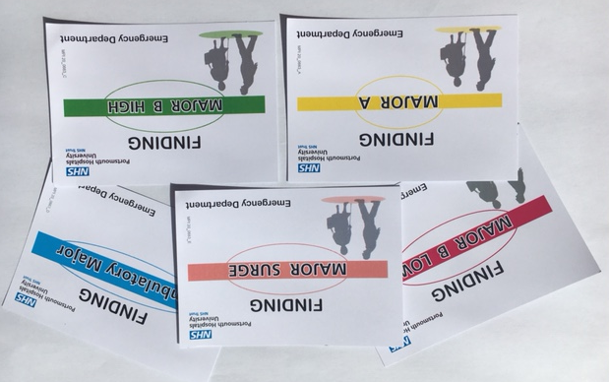
Finding Cards are now routinely given to every visitor entering our Emergency Department
Finding Cards are A7 size 74 mm x 105 mm

Slide 3
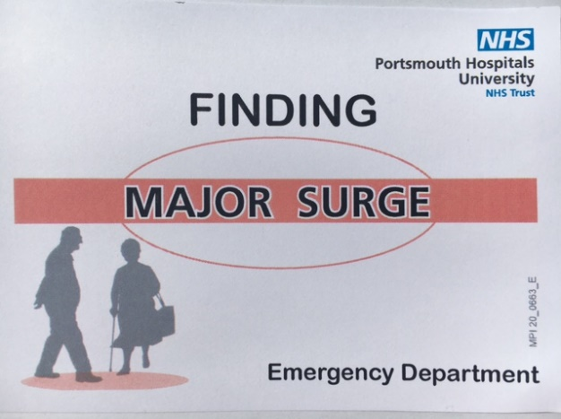
Finding Cards Improve Friend and Family Experience
Removes a layer of worry, confusion and stress when trying to first find, and see, their loved-one
Helps the relative remember the patient location
Reassures and gives confidence that help will be available if they become lost
Empowers relatives to approach any staff member for help
Supports relatives to feel at ease

Slide 4
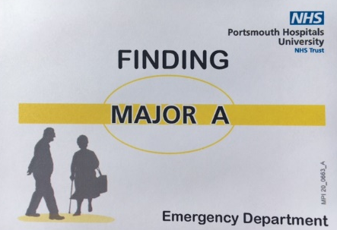
Finding Cards Improve Staff Experience and Improve Patient Safety
Staff can quickly read the card and immediately help with onward direction
ED Nurses and Doctors no longer need to repeat lengthy database searches of patient lists across multiple care areas to help locate patient
Shortens staff interruptions and distractions
Improves patient safety through reducing harmful interruptions and loss of concentration
Allows more ED staff to help with onward directions (incl housekeeping, security) as access to confidential database is now not required to help

Slide 5
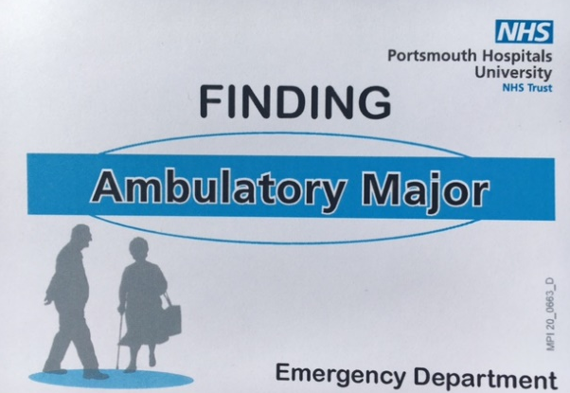
Transferability
Innovative, creative solution for a common problem
Flexible and uncomplicated tool
Easily transferable to any other healthcare setting
No major additional funding, staffing recruitment or training is required to implement
Printing cost £25 per 1000 cards
Complex IT skills and bespoke software not required
Future proof and sustainable, only needing occasional card reprinting

Slide 6
Nice to go to anyone
knew what to do to ask
Just showed my card
Feedback quotes from friends, family and relatives
I like it
Easy to know who to help (nurse)
Such a simple thing that works (doctor)
Still got lost but easier to ask for help
It worked to get me here
Felt not so silly walking about
Straight away knew where to show to go (nurse)
Got a clear indication of where they are going (reception)
Feedback quotes from Emergency Department staff
Read their card, so much quicker not having to log back in (doctor)
Can just show them when walking around (security)
Easier for us all to help out (nurse)

