Slide 1
A community services approach to using insight for improvement

Slide 2
Patient Experience activity during the pandemic
Virtual visiting introduced
Volunteers brought on to wards as well as voluntary and community sector settings including foodbanks, befriending services, medical and food deliveries
Developing relationships with faith organisations including temples, Gurdwaras, Mosques, Churches and Synagogues.
Letters to loved ones helped keep families connected to relatives
Interview 300 patients and carers following discharge to explore discharges during the pandemic
A Big Community Conversation - over 320 interviews with patients in their homes conducted by District Nurses who were given protected time to each do one survey with one patient

Slide 3
The story so far….
Move to Remote Consultation since March 2020 in response to COVID pandemic:
Increased numbers of Telephone Consultations (March 2020 onwards)
Roll-out of Attend Anywhere Video Consultation (April 2020 onwards)
Use of MS Teams video conferencing for group consultations (from June 2020)
During COVID – aim to keep service users and staff safe whilst maintaining critical services
Post-COVID – there is an opportunity to embed remote consultation as part of the BCHC service offer

Slide 4
Implementation approach
Phase 1 – Agile Implementation in Response to Pandemic
Phase 2 – Response and recovery
Phase 3 – “A New Normal”
Pilot within defined services
Establish Divisional project teams
On-board services to platform
Trust wide rollout
Remote consultation used to support COVID R&R
Agree KPIs
Develop supporting governance and guidance
Policy
SOP
QRG
Complete EHRA
Public and staff engagement
Pilot and embed interpreting support
EPR / PAS integration
Remote consultation used routinely in all services
Project evaluation and closure report
Benefits analysis
Co-design of BAU process with service users and wider public
Staff engagement – sharing good practice
Digital inclusion

Slide 5
How are we using remote consultation?
Telephone consultation – where considered safe and effective
Video consultation – where there is added benefit over telephone
Face to face – if telephone / video not considered appropriate or not accessible by the service user

Slide 6
Patient Selection Matrix
Indication for Face to Face Intervention | Indication for Remote Consultation
Need to physically facilitate movement Need to feel movement / posture Need to physically examine the patient Patient / parent/ carer have insufficient technical knowledge to manage virtual contact and phone call insufficient Cognitive / communication / psychological / visual / hearing impairment prevents interaction remotely Remote interaction would result in confusion or anxiety, or potential falls / physical risk Need to provide / demonstrate equipment or resources Remote contact would not achieve optimum outcomes or goals Unable to achieve holistic assessment from the remote contact | Patient/parent able to respond to questions and directions via phone / video call Information required can be gained verbally / auditory / visually Intervention can be completed with direction without need for clinician to be present Patient / carer / parent / family member has technical knowledge to use video / phone option Patient /parent has selected remote contact as preferred choice Patient/parent or member of their household is shielding Patient/parent is Covid-19 positive / suspected

Slide 7
Impact – activity
 |  | Activity type | Remote Consultation Total | Remote Consultation Total
Pre-Pandemic | 2019/20 | Face to Face | 96.34% | 3.66%
 |  | Telemedicine AA | 0.00%
 |  | Telemedicine (MS Teams) | 0.00%
 |  | Telephone | 3.12%
 |  | Other | 0.54%
Pandemic | 2020/21 | Face to Face | 78.01% | 21.99%
 |  | Telemedicine AA | 2.62%
 |  | Telemedicine (MS Teams) | 0.37%
 |  | Telephone | 16.63%
 |  | Other | 2.37%
Post-Pandemic | 2021/22 | Face to Face | 83.43% | 16.57%
 |  | Telemedicine AA | 3.18%
 |  | Telemedicine (MS Teams) | 0.28%
 |  | Telephone | 10.51%
 |  | Other | 2.60%

Slide 8
Case study - MSK

Slide 9
Case Study – SLT

Slide 10
Patient Feedback

Slide 11
Patient Feedback

Slide 12
Listening when it matters most

Slide 13
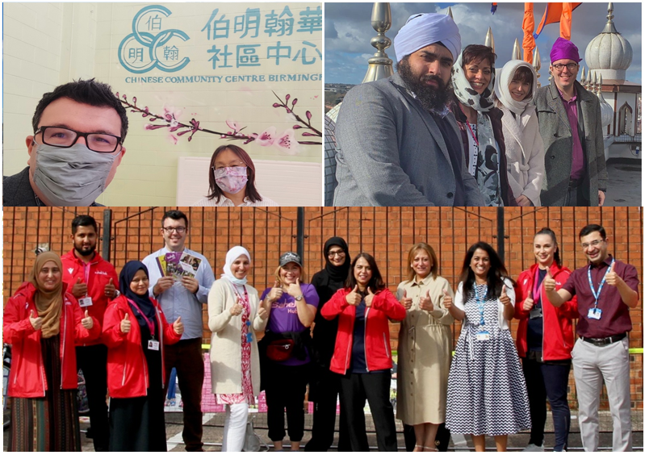
Bringing people together to make a difference

Slide 14
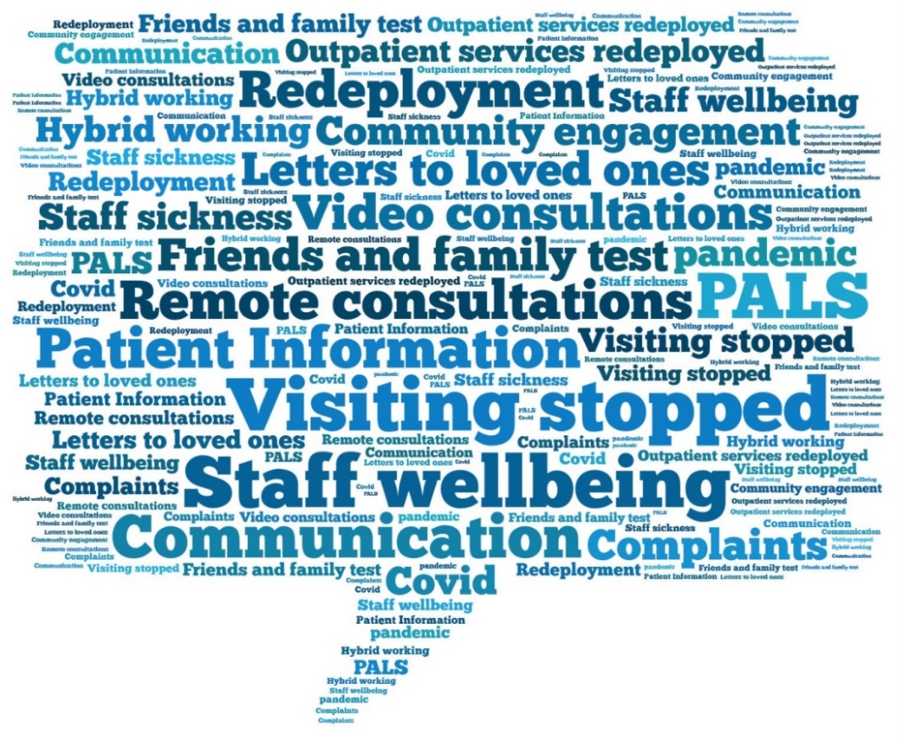
A snapshot of some the themes that arose during the pandemic

Slide 15
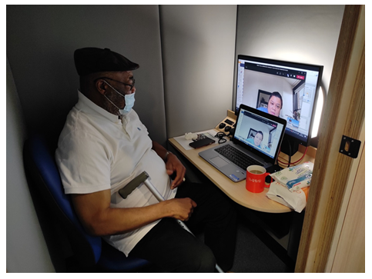
Patient Pod introduced to highlight
challenges with digital inclusion

Slide 16
What matters to you?
We asked patients, public and communities at a face to face forum and in online surveys to tell us “what matters to you” most when receiving community based healthcare services?
They told us….

Slide 18
To conclude we have used our insight to create the following improvements:
Developed and launched a suite of resources and tools for bringing patient experience to life
Co-designed a new ‘What matters to me’ survey across all services, including virtual consultations
Co-produced a Patient Experience Framework with over 500 staff, patients and service users.
Published a suite of toolkits for involvement and co-production
Authored a remuneration policy for the payment of patient involvement activities in line with recent guidance
Launched a patient stories guide to support colleagues involved in patient experience activity.

