Slide 1
Closer to Home virtual clinics
Support for families affected by dementia at a time and place that suits them
dementiauk.org/closer-to-home
closertohome@dementiauk.org
Dementia UK is a registered charity in England and Wales (1039404) and Scotland (SCO47429)

Slide 2
Background of service
A partnership between Dementia UK and Leeds Building Society offering support to families living with dementia
Virtual clinics offer pre-bookable telephone or video calls with a dementia specialist Admiral Nurse lasting 45 minutes
The service negates concerns around travelling and can adhere to any relevant government guidance around social distancing
It reduces issues relating to mobility, physical health concerns, alternative care provision or time off paid employment

Slide 3
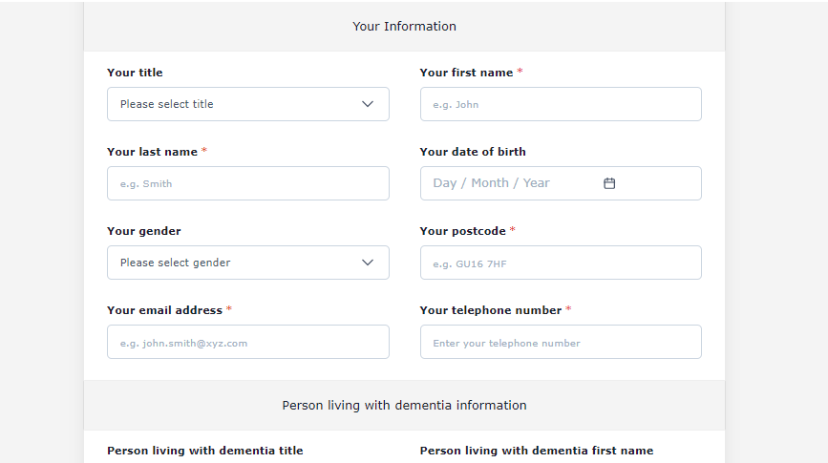
New look Closer to Home
The service has been expanded to five days a week, offering 60 appointments
Three additional nurses have been recruited to make a team of five full-time nurses and a team of 15 sessional nurses
The Administrator role has been developed and amended to Project Manager
Improved communication has led to a reduction in missed appointments
Reduction in admin time and automated reminders allow increased peer support for nurses
1,900 families have been supported around the UK and overseas
Notes:
New booking system allows people to enter date and chosen service, system then shows appointments that are available. Form much clearer and easier to complete and only one click needed

Slide 4
The impact
Alzheimer's Society: Left to Cope Alone report 2022
Closer to Home six-month evaluation 2021
One third of people are not receiving sufficient information about dementia
48% of people are not receiving support that treats them as an individual
Around 60% of people are not receiving sufficient emotional and mental health support
54% said they lack the support needed to help them manage their or their loved one’s dementia
“I was worried about wasting someone’s time… We’re just concerned about my dad and behavioural changes and memory issues… The lady I spoke to was immediately welcoming and understanding and very warm… She really understood our worry (my mum and my sister and I). She offered practical advice and next steps but also offered further support for us or Mum if needed.”

Slide 5
Improving lives
Adapting how the carer interacts and communicates with the person with dementia
Implementing practical, legal or financial actions and making decisions about care
Being reassured, confident and able to cope
Helping to improve communication with family members and health professionals
Recognising that they, as carers, need to be supported too

Slide 6
Benefits
Support from the Admiral Nurse Closer to Home virtual clinics service has made a positive difference to…
89%
My understanding
of dementia
90%
My ability to take better care of the person with dementia
88%
My knowledge of other services that can offer support
83%
My ability to cope in my
caring role
79%
My ability to take better care of myself
91%
My ability to make decisions about the care of the person with dementia
The service also helped families to maintain relationships – 80% said it had made a difference to their ability to communicate with the person they cared for and 80% said it had helped with family relationships/communication.

Slide 7
Benefits
Use of health and social care resource
201 respondents told us what would have happened if they hadn’t spoken to an Admiral Nurse in a Closer to Home clinic appointment:
35% would have seen a GP for the needs of the person with dementia
15% would have seen a GP for their own needs
43% mentioned other impacts on themselves and their families, including not knowing what to do, negative impact on ability to care, negative impact on their health and wellbeing and struggling on their own

Slide 8
”This service has been a true lifeline, especially the option to have Zoom calls. Being able to talk to someone who understands the specifics of dementia and the unique issues makes me feel less alone. I am the sole family carer for my mother and so I can feel overwhelmed and exhausted at times. The Admiral Nurse clinic feels like having a ‘personal assistant/mentor/hand holder’ when I draw blanks or feel out of my depth.”
- Carer aged 55-64

Slide 9
Next steps
Twelve-month review in production
Increase promotion of Closer to Home service
Involve family carers willing to share their experiences
Host awareness sessions with external organisations
Present findings at Admiral Nurse Forum and Annual Nurse Clinics Conference

Slide 10
Next steps (continued)
Initial project to become a permanent service and additional funding from alternative partner secured
Integration with Admiral Nurse Helpline
Creation of a business model so that virtual clinics can be offered to other host organisations (currently being trialled with a sporting association and prison service)
Further development of booking system to enable independent rescheduling of appointments

Slide 11
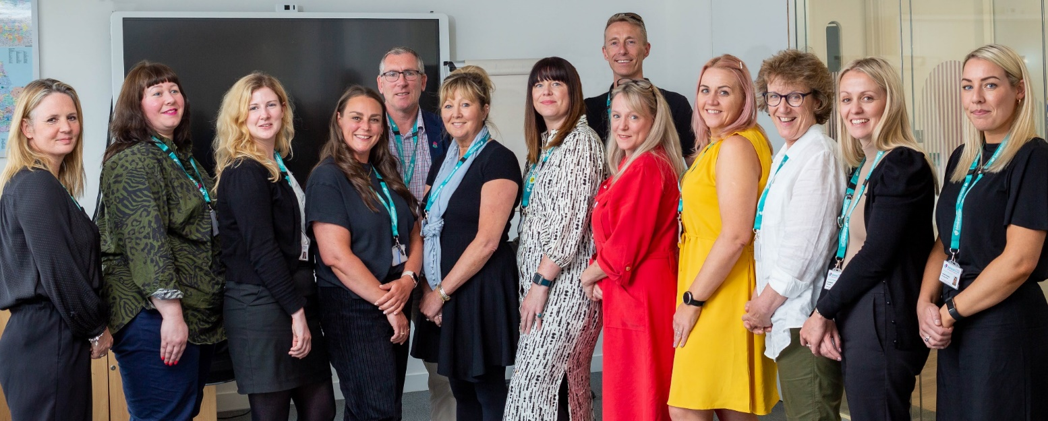
Thank you for listening

