Slide 1
Using technology to increase intensity and frequency of therapy early after stroke.
Louise Jackson – Team Lead Physiotherapist for Early Supported Discharge at Liverpool University Hospitals

Slide 2
This presentation will explore how a range of technologies have been used to augment rehabilitation in the early period (inpatient and community) after stroke. It will highlight the roles needed to make technology use a success with a broad range of service users and how the patients found using the technology as part of their stroke rehab.
Also, we hope to demonstrate how this can be used in other conditions outside of Stroke.

Slide 3
Catalyst Project – 23/24
The Integrated Community Stroke Service (ICSS) model of community stroke care provides guidelines for the frequency and intensity of rehabilitation. The recent National Clinical Guidelines for Stroke also reference the intensity and frequency of rehab.
The baseline within South Sefton and Liverpool Stroke Recovery Network (LSRP) was 1 to 2 sessions per week offering face to face therapy.
The project aims were to
measure whether tailoring digital rehabilitation resources to a stroke patients’ individual capabilities can increase the overall dosage of therapy
2) Measure whether the dose improves patient outcomes from the current baseline
3) to assess the benefit of a role to support patients use of tech.
4) Did the patients like/ find beneficial using tech as part of their rehab

Slide 4
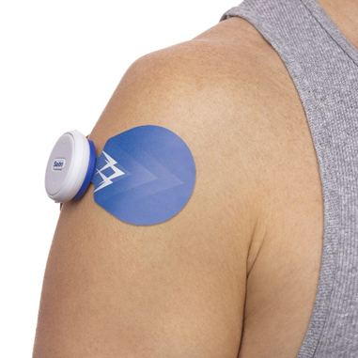

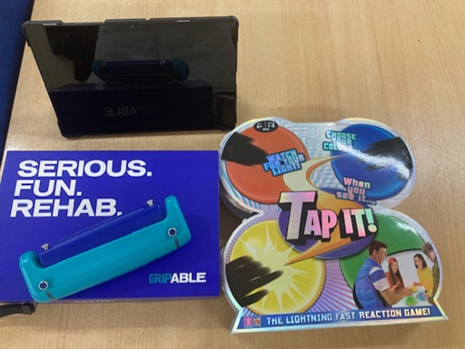
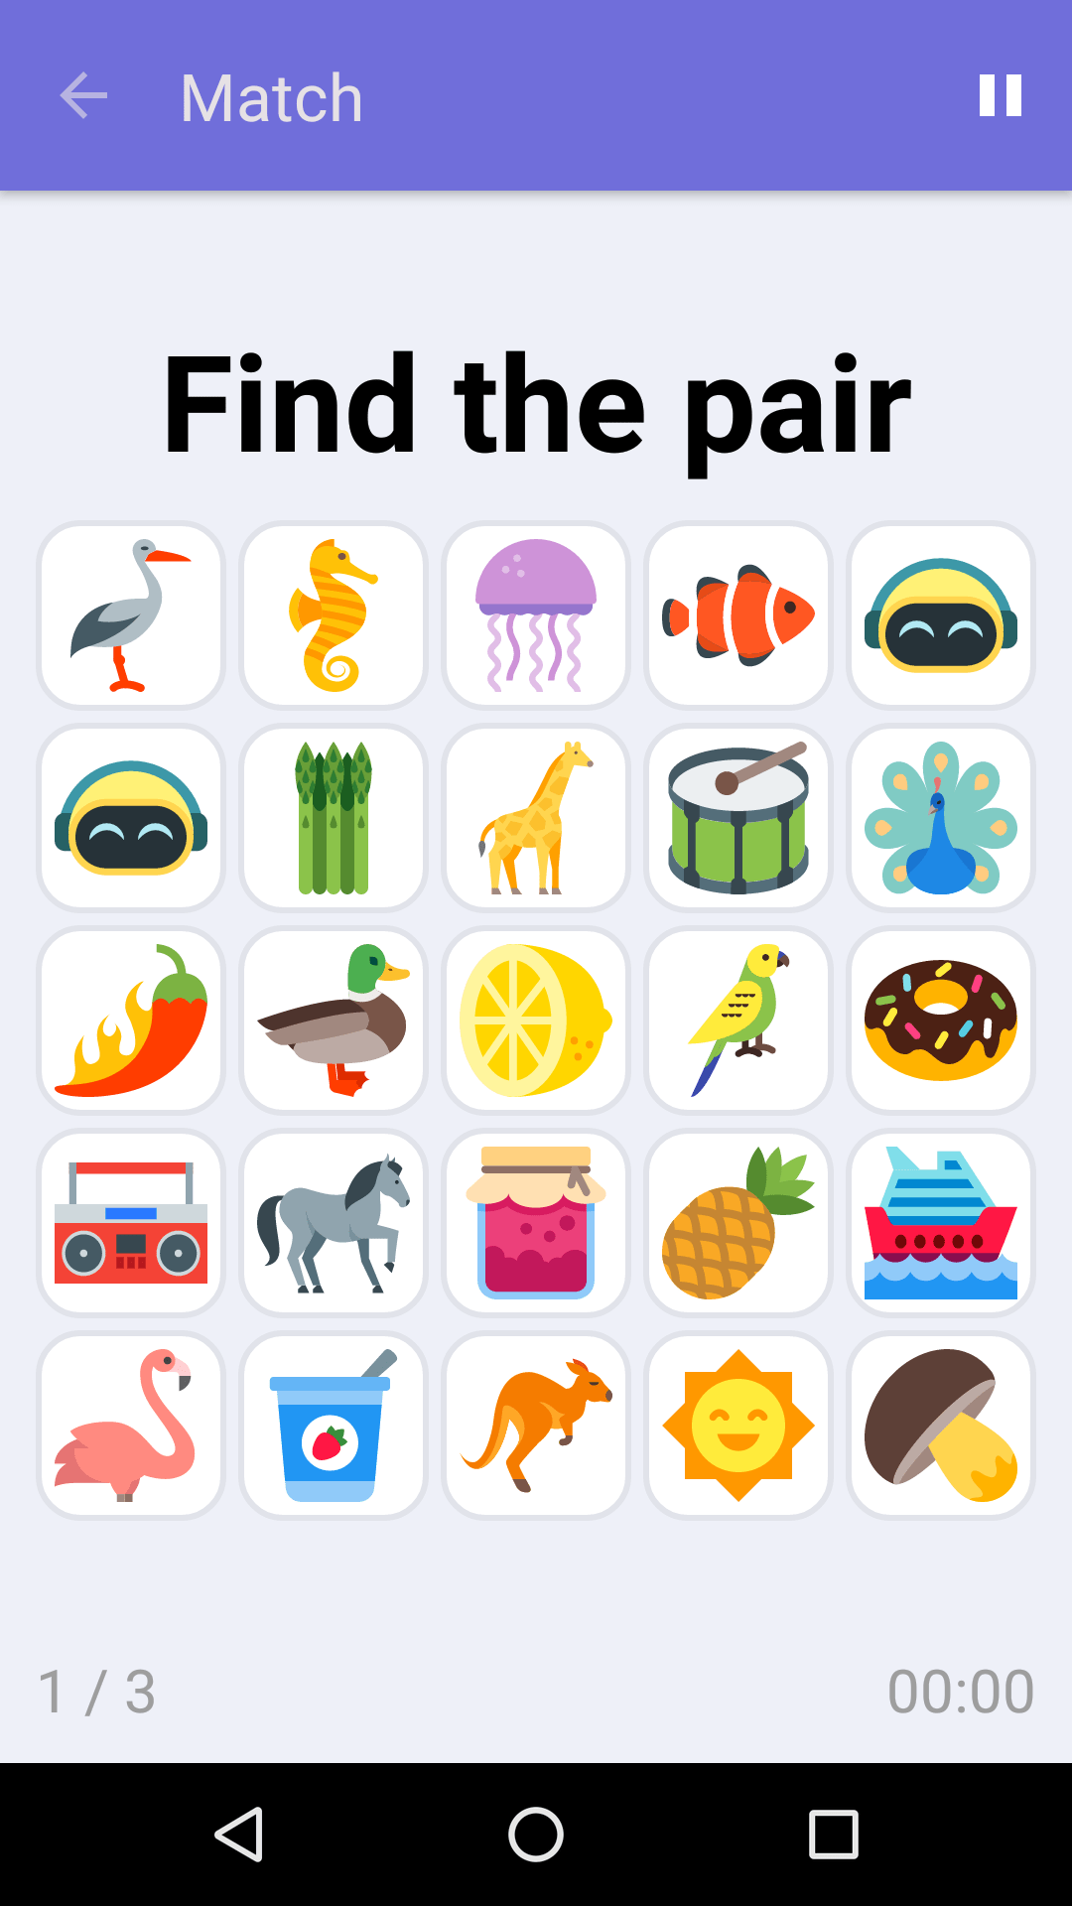
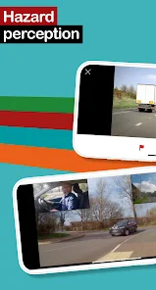

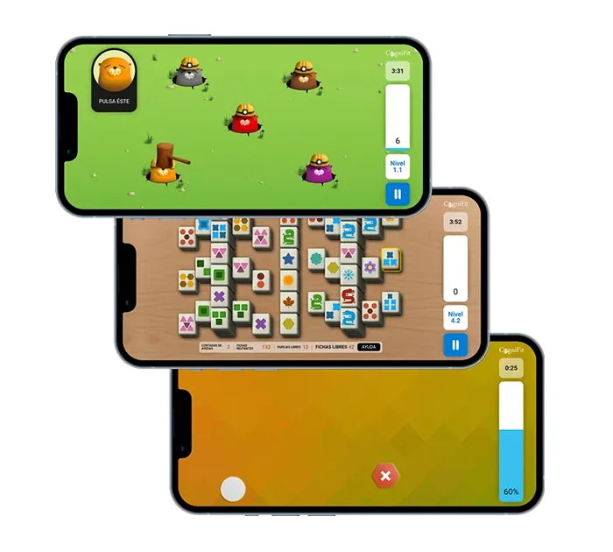
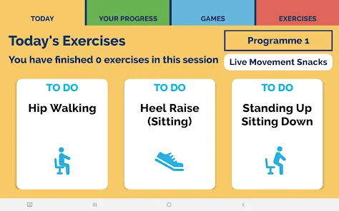

Slide 5
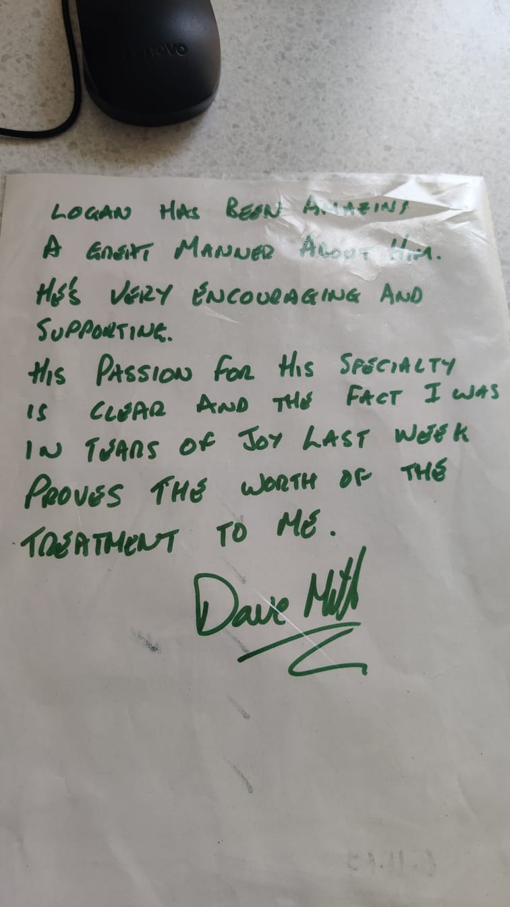

Slide 6
Catalyst Project – 23/24
Benefits
Increased capacity of the team to offer and deliver rehabilitation meaning patients can access more therapy
Improved compliance with the SSNAP guidance - Intensity of rehab (minutes) current LSRP and south sefton
Improved clinical outcomes for patients with a potential impact on their independence -ArmA
Improved quality of life for patients - Stroke Impact Scale
Improved staff experience and an increase in staff capability in using tech.
Support for patients to access tech –Digital inclusion

Slide 7
Patient feedback
"Technology has been a game-changer in my stroke recovery journey. From interactive apps to electrical stimulation, it's made rehab not only effective but also engaging and enjoyable." - NHS Stroke Survivor
"Thanks to technology, I feel more in control in my rehabilitation. With the device tracking my progress and showing my improvements, I'm more motivated to stay on track with my recovery goals." - NHS Patient
Improved quality of life for patients - Stroke Impact Scale The Stroke Impact Scale (SIS) is a stroke-specific, self-report, health status measure.
Baseline – pre project SIS outcome measure collection of 20 patients
Change from beginning to end of input from the team.
Averaged a 26% percentage change in score in positive direction towards recovery.
End of project
Change from beginning to end of ESD input from the team. Change from beginning to end of input from the team.
Averaged a 38% percentage change in score in positive direction towards recovery.

Slide 8
Case Study
Background: Patient A, a 62-year-old retired engineer, suffered a left-hemisphere ischemic stroke, resulting in right-sided hemiparesis and aphasia. He was admitted to hospital and discharged to our ESD services still requiring intensive therapy to regain functional independence and improve his quality of life.
Challenges: Upon admission, Patient A faced several challenges in his rehabilitation journey:Limited mobility and strength on his right side, affecting activities of daily living (ADLs).
Difficulty with speech and language comprehension, hindering communication.
Frustration and decreased motivation due to slow progress in traditional therapy sessions.
Technology Intervention:
To address Patient A’s rehabilitation needs, we incorporated various technologies into his treatment plan:
Saebo One Stim: Patient A used saebo stim, an easy to use wireless electrical stimulation device. The device works by delivering electrical signals through its wireless electrodes to the targeted shoulder and wrist muscles along side an exercise programme.
Grip Able: We introduced Grip Able once patient had started to achieve ore movement. We tailored to Patient A’s rehabilitation goals. These games made therapy sessions more engaging and enjoyable for Patient A enhancing his motivation and adherence to treatment. The device provided real-time feedback and support, enabling him to gradually improve his number of repetitions and overall arm and hand recovery.
Speech Therapy Apps (Tactus): To address Patient A’s speech and language problems, we utilised mobile applications specifically designed for speech therapy exercises. These apps offered interactive tasks for language comprehension, word retrieval, and articulation practice, allowing Patient A to work on his communication skills independently between therapy sessions.

Slide 9
Outcomes:
The integration of technology into Patient A’s stroke rehabilitation yielded significant improvements:
Functional: With regular use of Saebo Stim and Grip Able, he achieved greater independence in ADLs, such as getting washed and dressed.
Speech and Language Recovery: Through consistent practice with speech therapy apps, Patient A made notable progress in language comprehension and expression. He regained the ability to formulate sentences, follow simple commands, and engage in basic conversations with family and caregivers.
Motivation and Engagement: Patient A’s motivation and engagement levels soared as a result of incorporating technology into his rehabilitation regimen. He expressed enthusiasm for therapy sessions and actively participated with apps/ games and interactive exercises, leading to accelerated progress and a more positive outlook on recovery.
Conclusion:
Patient A’s case exemplifies the transformative impact of technology in stroke rehabilitation. By leveraging innovative tools and interventions, we were able to personalise his treatment, optimise outcomes, and empower him to reclaim independence and functionality in daily life. Moving forward, continued integration of technology will play a pivotal role in advancing stroke care and fostering greater recovery for patients like Patient A.
This case study illustrates how technology can complement traditional rehabilitation approaches and contribute to improved outcomes for stroke survivors.

Slide 10
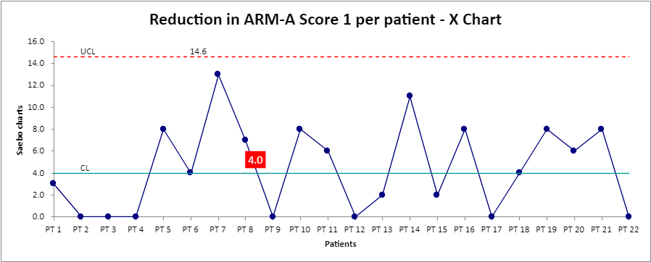
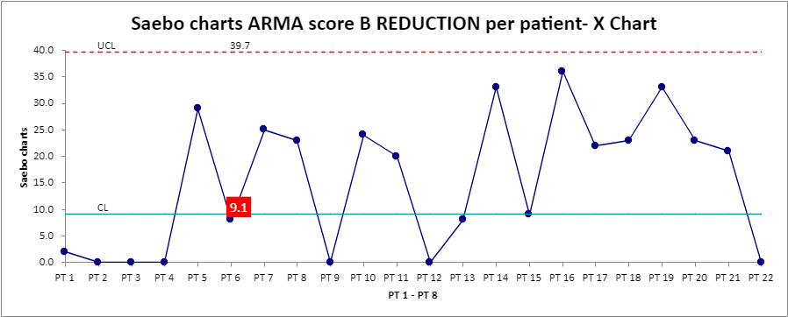

Slide 11
Other things to consider
Technology has been a game-changer in my stroke recovery journey. From interactive apps to electrical stimulation, it's made rehab not only effective but also engaging and enjoyable
Health inequalities – HEAT tool complete
Digital inclusion for internet access was a concern based on the digital deprivation map. This was addressed by purchasing 6 dongles as part of the project.
Key message – Having a specific tech support role was essential for the roll out of the project, both in terms of supporting the patient to use the technology and getting it to patients
Thanks to technology, I feel more in control in my rehabilitation. With the device tracking my progress and showing my improvements, I'm more motivated to stay on track with my recovery

Slide 12
