Slide 1

Patient Experience Monitor (PEM) embedded in Dutch University hospitals
Manou Kessels & Henk Jan Idema
2 OCTOBER 2025

Slide 2

New name
New logo
November 2025

Slide 3

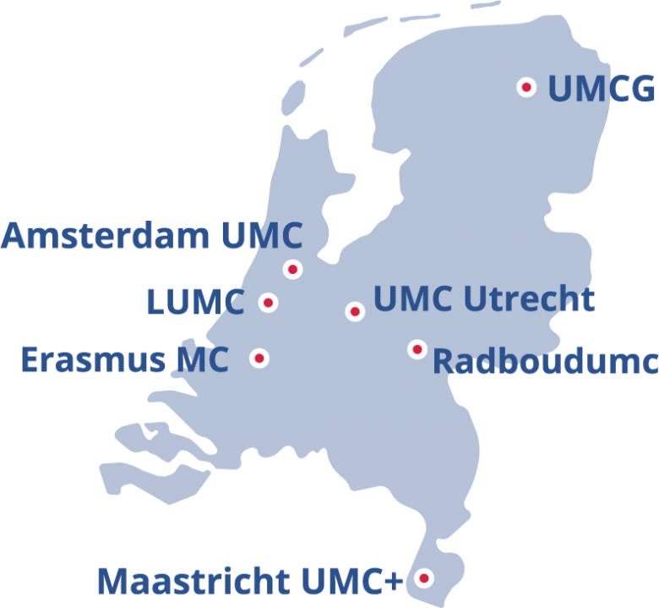




NFU – Dutch federation of university medical centres
NFU represents 7 UMC’s
Together >80,000 professionals
Highly specialised patient care, research & education
National & international collaboration
Innovations in quality, safety & patient-centred care

Slide 4
Example of innovation: Patient experience monitor (PEM)
  Nationwide initiative since 2019
  Continuous measurement of patient experiences
  Shared learning & transparency
  Person-centred themes (e.g. trust, communication, shared decision-making)
  Accesible for limited health literacy levels (Pharos)
  Inclusive design: short, accesible questionnaires
  Core set questionnaires: adult IP + OP, children IP + OP and A&E
  Real-time dashboard enables staff to quickly take action based on patient input
  Translation in progress to reach a broader population
  Supports quality improvement (national, UMC and department level)

Slide 5
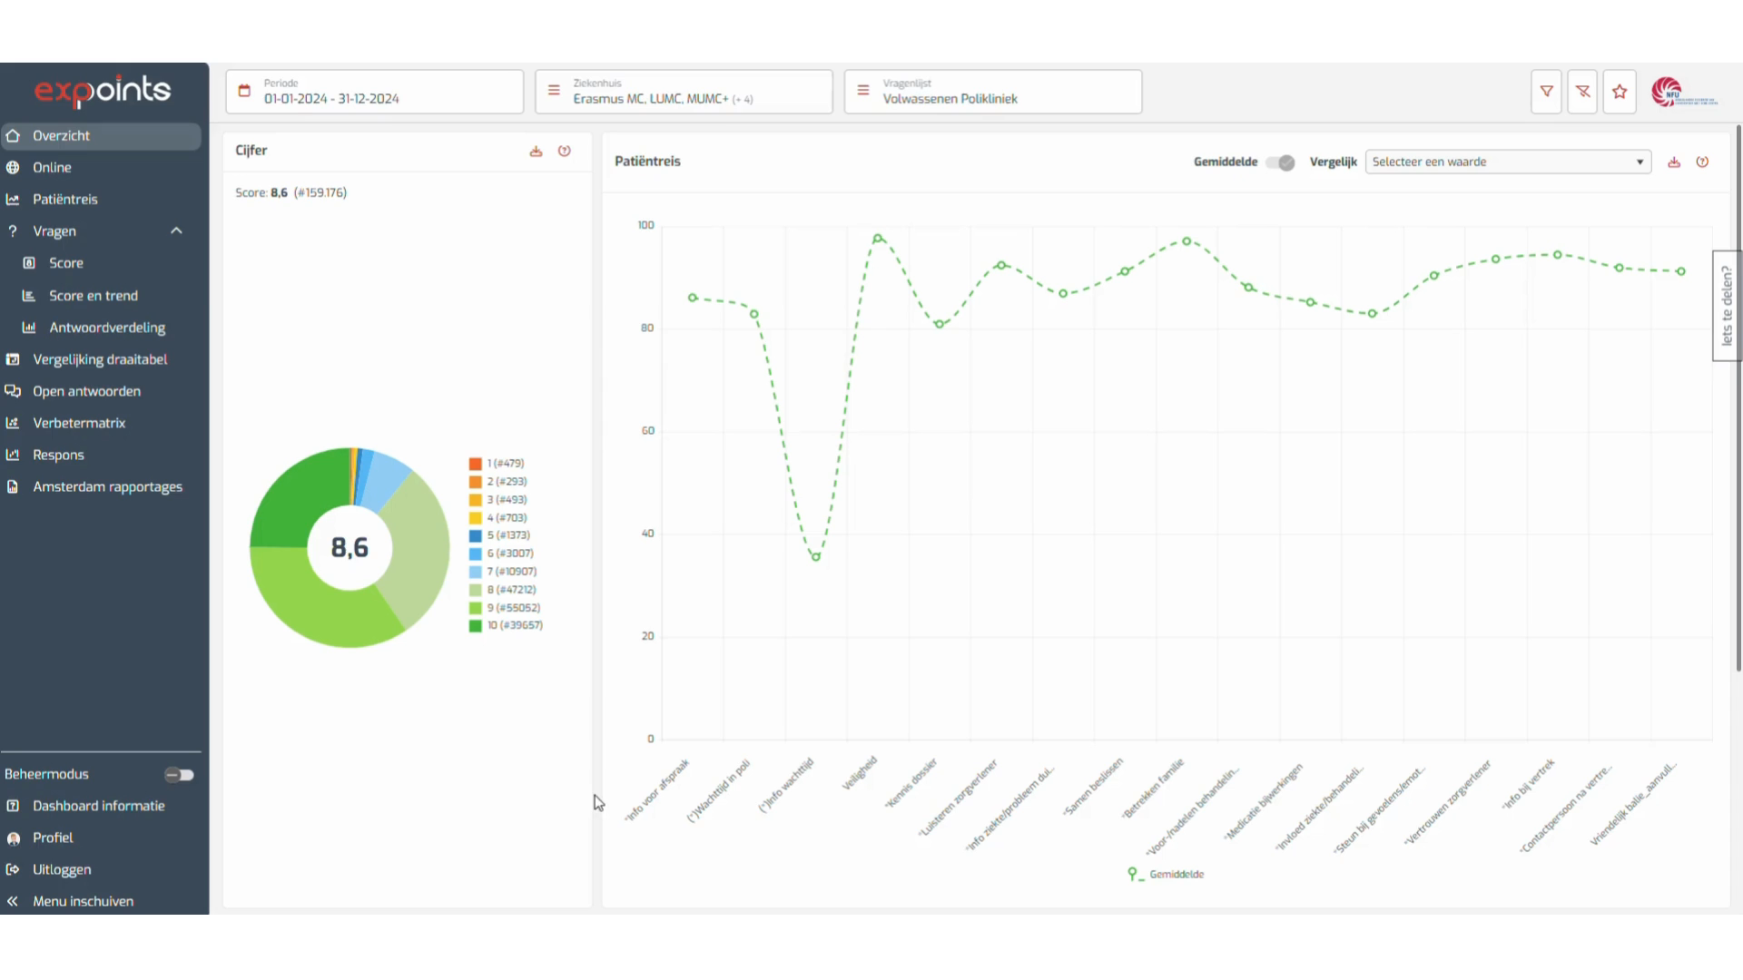
PEM real-time dashboard
  Video real-time dashboard
  Closed and open-ended answers are visible in a structured, real-time dashboard
  Since 2019, more than 1.5 million patients participated

Slide 6
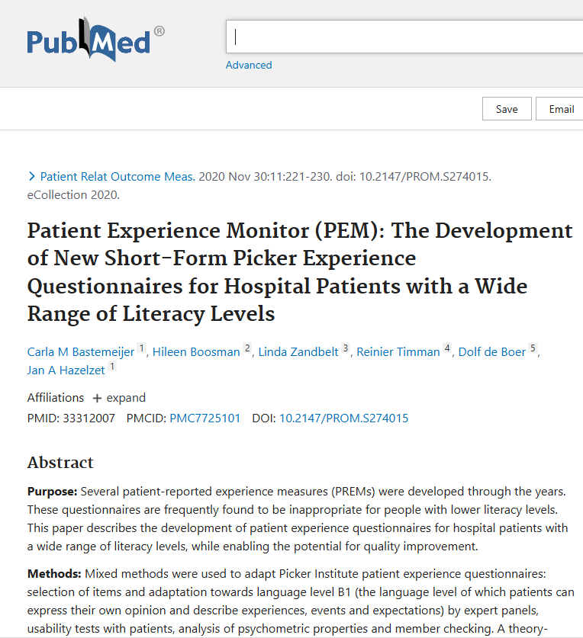
Development of new PEM questionnaires
Challenge existing PREMs: often too long,
complex or lacking impact
How PEM addresses these issues:
Standardisation
Inclusivity
Practical use for improvement
Based on Picker Principles of Person-Centred Care
Short, accessible questionnaires validated with patients
For more information, see article:
Patient Experience Monitor (PEM): The Development of New Short-Form Picker Experience Questionnaires for Hospital Patients with a Wide Range of Literacy Levels – PubMed

Slide 7
Development of new PEM questionnaires
Multi-step development process
Question selection, translation & adaptation
Expert panel review
Cognitive interviews with patients
Psychometric analysis
Member checking
Patients
Expert panel
Picker Institute
Participated in focus groups & cognitive interviews
Ensured questions were clear, relevant & accessible for diverse literacy levels
Healthcare providers, translators, quality managers, staff advisors from UMCs, questionnaire experts, representative from Pharos
Final selection of questions translated back to English and approved by Picker Institute
    Further methodological details are available in the academic article referenced in slide 4.

Slide 8
PEM Impact & best practices
Impact since implementation
Best practices
Measurable outcomes & rich insights
Trough collecting & using patient feedback (closed and open questions)
Annual national benchmark report
Variation, best practices & improvement areas
Improved communication on waiting times in Radboud UMC, Amsterdam UMC & Erasmus UMC
Development of text mining tool for large volume of responses to open-ended questions
“Ask what matters, listen to what matters, do what matters.”

Slide 9
PEM Sustainability
Embedded in quality improvement systems at
all UMCs
Annual review & update PEM questionnaires
quantitative & qualitative
Sustainability
Continuous improvement process = PEM remains dynamic, sustainable and inclusive

Slide 10
PEM Future success
Future priorities
  Boosting response rates
  Translating questionnaires for diversity of patient population
  Improving text mining & real-time dashboard
  Creating a question library
  Driver for quality improvement initiatives

Slide 11
Awareness & Engagement
Active promotion across UMC’s
via Intranet, newsletters and reports & leadership presentations
Results integrated in strategic quality reports
Real-time dashboard accessible to all staff
Annual symposium for PEM coordinators
→ shared learning

Slide 12


Relevance to other groups
Scalable & transferable beyond UMCs
In 2024: cooperation between NFU (university hospitals) and NVZ (general hospitals)
Adopted by 33 general hospitals (in addition to 7 UMC’s)
Growing impact across Dutch healthcare system

Slide 13
What makes pem stand out
National scale & reach
Inclusive design
Real-time insights
Standardised core + locally relevant questions
  Co-created with patients & professionals
Fosters continuous
improvements

Slide 14
Key learning points
Collaborate early & often with all stakeholders, including patients and healthcare professionals
Build flexibility into national content to allow for local relevance
Embed patient experience data into quality systems
Make results visible & actionable for patients and staff
Maintain strong, cross-organisational collaboration
Ensure accessibility for patients of all literacy levels

Slide 15

Thank you for your attention!
Are there any questions?

