Slide 1

Person Centred Care: A shared understanding
which amplifies and improves person centred approaches
and transforms the experience people have
Renee Comerford Associate Director of Nursing
Vicki Drummond Senior Nurse
Anita Devine Clinical Lead Occupational Therapist

Slide 2
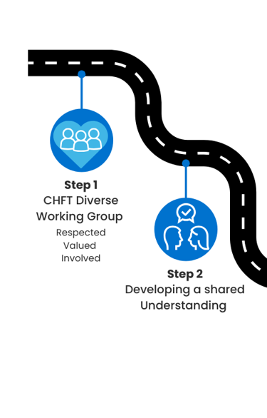
Our Person Centred Care Journey

Slide 3
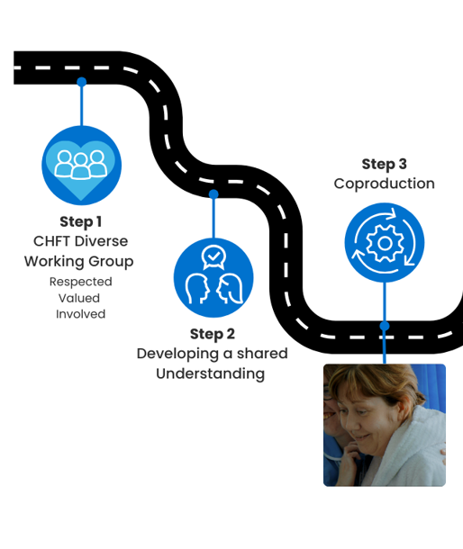
Our Person Centred Care Journey

Slide 4

Person Centred Care at CHFT
https://youtu.be/DEl5lqpFe14

Slide 5
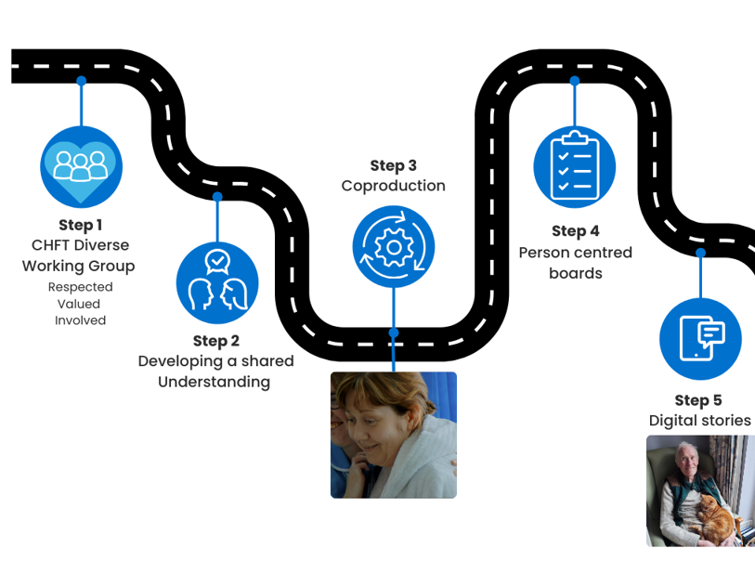
Our Person Centred Care Journey

Slide 6
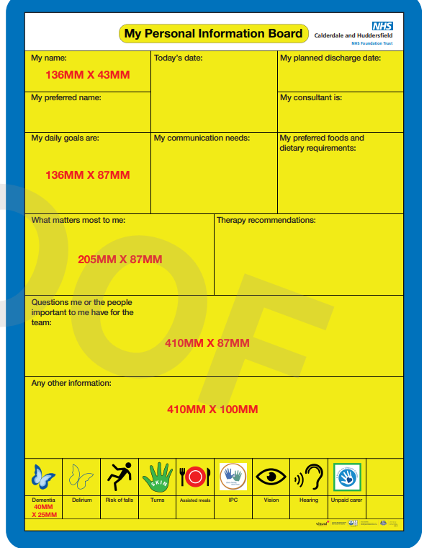
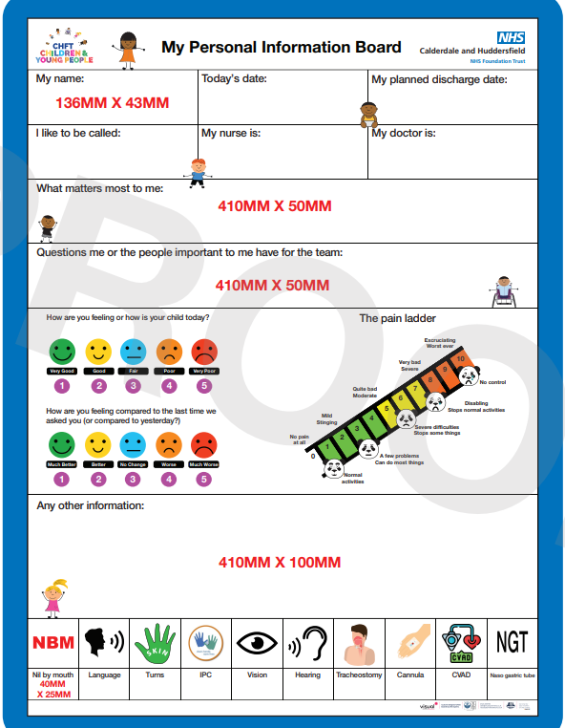
Adult In Patient and Paediatric Person Centred Boards

Slide 7
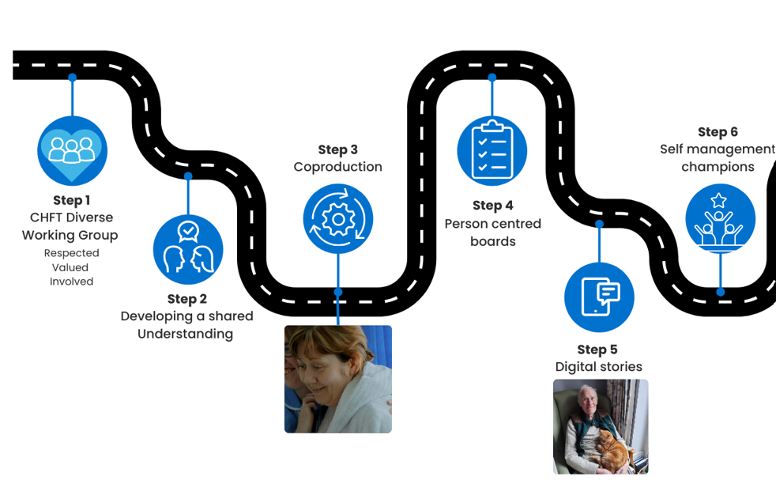
Our Person Centred Care Journey

Slide 8
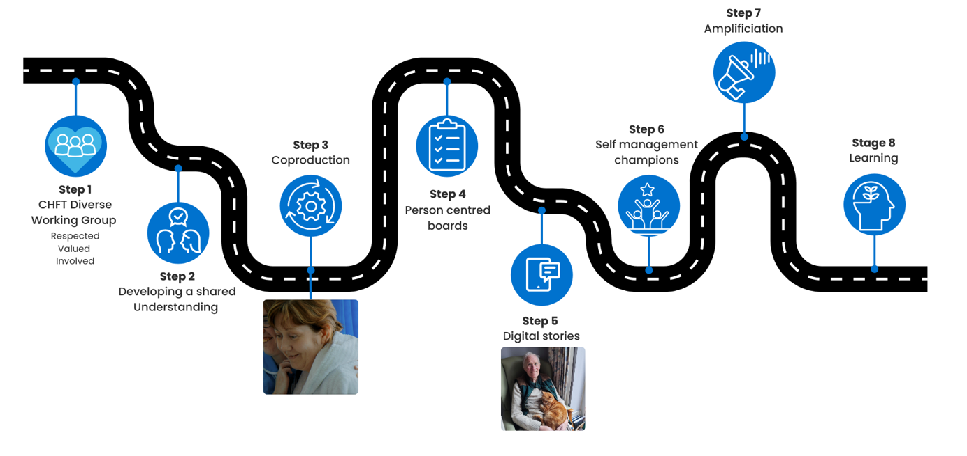
Our Person Centred Care Journey

Slide 9
Digital Story and Our Contact Details
Renee.Comerford@cht.nhs.uk
Vicki.Drummond@cht.nhs.uk
Carers and Person Centred Care

