Slide 1

CNWL Our Voice: Creating an Employee Experience Listening culture

Slide 2

Who we are at CNWL
CNWL is a large, diverse organisation, providing healthcare services for people with a wide range of physical and mental health needs; employing over 9000 staff providing 300+ health services across 150 sites and in the community, in a range of diverse communities, with 100+ first languages spoken.
Services offered are across mental health, addictions, sexual health, community health, health and justice services (across prisons in London), and physical health services, prioritising delivering care as close to home as possible.
CNWL’s organisational culture is guided by a SCARF behavioural framework: Safe, Compassionate, Accountable, Reflective, and Fair.

Slide 3



Our Challenge
What we know
Staff wellbeing is directly linked to engagement and quality of patient care
What we had
Our only employee listening touch point was the annual Staff survey that provided, inflexible offline reports, restricted to senior leadership, offered lagging indicators and ultimately had limited impact
Our Objective
Create a real-time people insights system that empowers our front line managers with actionable data and drives targeted interventions to improve staff outcomes locally and organisation-wide

Slide 4
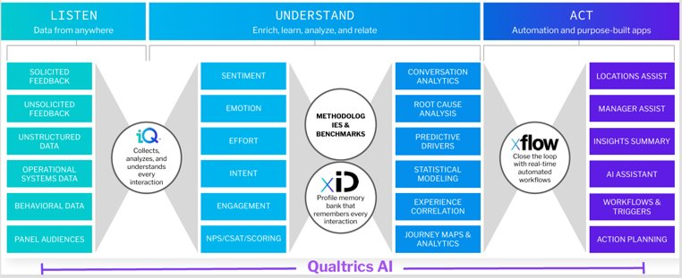
Our Solution – Our Voice
We partnered with Qualtrics to develop a Staff Engagement and Experience Platform. – Our Voice
This intelligent software, supported by Qualtrics, engages individuals and teams at all levels​
It allows managers to improve effectiveness and make informed people and business decisions.​
It can measure and analyse the sum of all experiences an employee has throughout their relationship with an organisation​
This creates an industry leading employee experience and a reliable listening culture at CNWL

Slide 5
Show Explainer Video

Slide 6



How we did it
Leadership & Team: Spearheaded by CNWL’s Director of People & Culture and Staff Engagement Team.
Key Partners:
Qualtrics: Technology & advisory partner, providing EX expertise.
7Seas: Engagement and communications agency.
Zill: Implementation and delivery management.
Staff Coordination Centre & NHS England: Supported initial data transition.
Staff & Stakeholder Involvement: Feedback sessions and working groups shaped system design, dashboards, resources, and action guidance.
Iterative Approach: Ensured the initiative addressed real staff needs and priorities.
Ongoing Collaboration: Qualtrics partnership evolves “Our Voice,” integrating new listening touchpoints and relevant data for staff and patient experience.

Slide 7
Impact and Results
Accelerated Insight Delivery
Shared with execs two weeks after survey close
Allowing trust to grasp themes much earlier
Empowered Front Line Managers
Dashboard shared alongside supporting resources.
60% logins in first two months
Enhanced Inclusion and Equity
Driving Targeted Action & Best Practice
The centralised action planning tool allows managers to gather ideas and resources in the trust.
Persona analysis, identifying colleagues whose experience deviates significantly from the average, supporting highly targeted inclusion efforts and addressing health inequalities for seldom-heard voices.
Over 400 actions created around feeling valued, burnout, development and psychological safety
Allowed teams to share their culture-building strategies, bringing scores to life and promoting best practices.
Influencing Organisational Strategy
Directly influence Recognition Strategy with analyse key drivers of outcomes like Engagement & Morale, alongside open comment feedback
Analysis revealed that feeling recognised by the organisation was the number one driver of employees' intention to stay with the Trust.

Slide 8
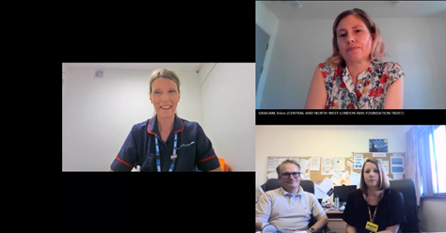
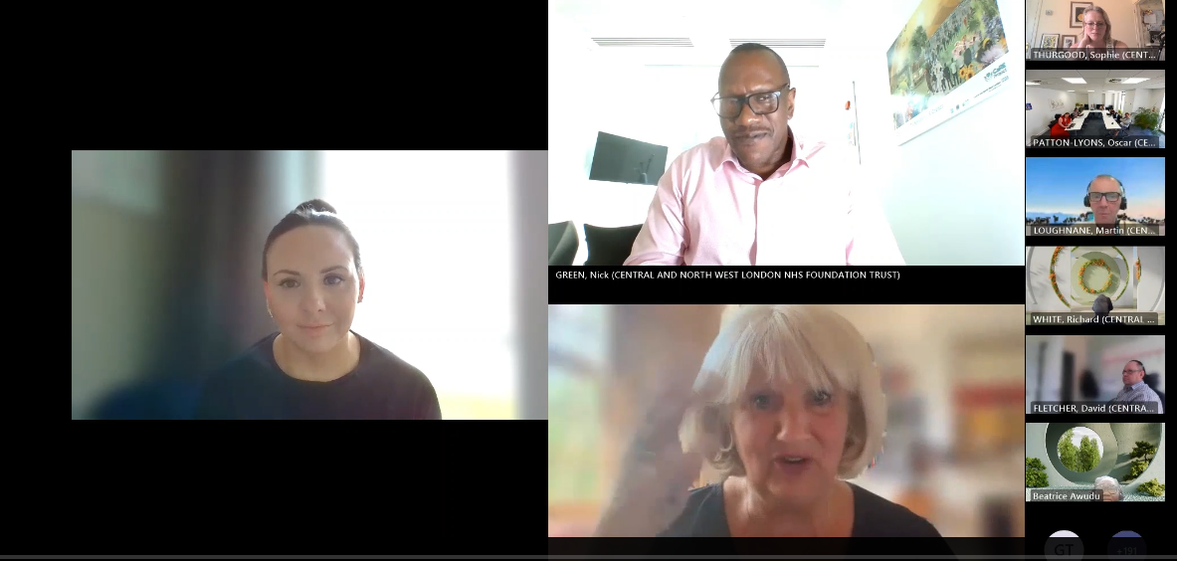

Creating Awareness of Our Voice
Brand & Communication: Developed a unique “Our Voice” brand with logo, imagery, and taglines.
Newsletter: Regular updates, resources, training, and videos sent directly to all employees.
Survey Feedback & Action Week: Encouraged active participation, celebrated team successes, and achieved 500+ attendees, overcoming frontline staff engagement challenges.
Manager Enablement: Skills sessions to foster a proactive listening culture; recorded for those unable to attend live.
Central Hub: Dedicated Trustnet page housing all “Our Voice” resources, including action planning and awareness videos.
Staff Experience Community of Practice: Cross-organisational network sharing insights, improving processes, and championing a continuous listening culture.

Slide 9
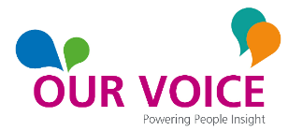







Next Steps
Personas: Understanding Employee Experiences by demographics
Cultural Diagnostic Tool to identify closed cultures our wards. DEI dashborrd
Develop pulse survey methodology - an ongoing conversation with staff
Lifecycle Surveys on platform - onboarding, check-ins, exit surveys
Partering with Picker for 2025 Survey, improving dashboards based on feedback with new HR & Exec pages
Transformation and Productivity – Combine workforce, experience and productivity data to create early warning signs
Ongoing monitoring of team support, action plans and impact
Ad Hoc Surveys

Slide 10
“Pharmacy staff now feel more confident that our voices are not only heard but taken seriously. Since its implementation, OneVoice has significantly transformed how our managers gather, interpret, and act upon feedback from the pharmacy staff. We are in the early stages at the moment of using it but in time we will use it a lot more.”
Testimonies
Overall, people were willing to give it a go and were pleasantly surprised by how much the platform offers to support action planning. I also had feedback from two staff members who are usually quite sceptical about initiatives like this — they felt it was genuinely staff-focused and said they would be taking it back to their teams to build an action plan. That felt like a really positive win!
Very easy to use. Helps identify staff groups least satisfied and where improvements most needed
Easy access, headline survey results with areas to celebrate and where improvement is needed.
Having staff voices heard.

