Slide 1


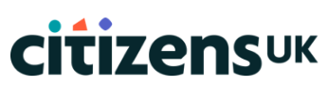
Health Equity Action Leadership
A people-powered approach to health equity
Beth Brown | Director of Patient Experience and Community Engagement, Barts Health NHS Trust
Emmanuel Gotora | Assistant Director, Citizens UK / Lead Organiser, TELCO Citizens

Slide 2
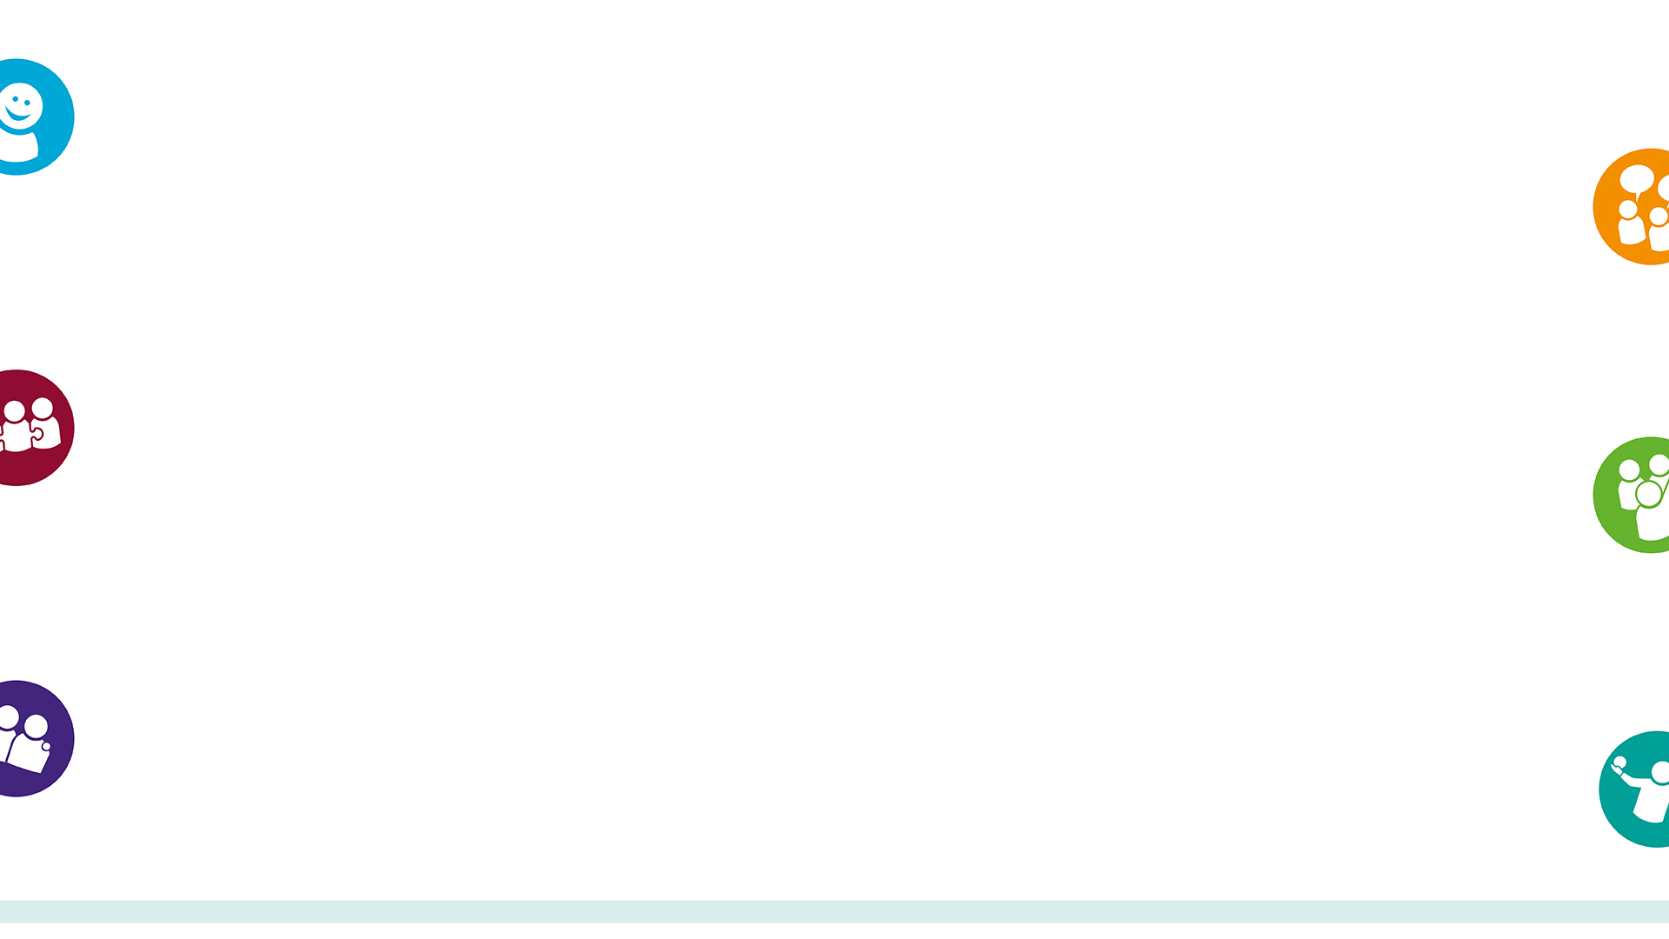
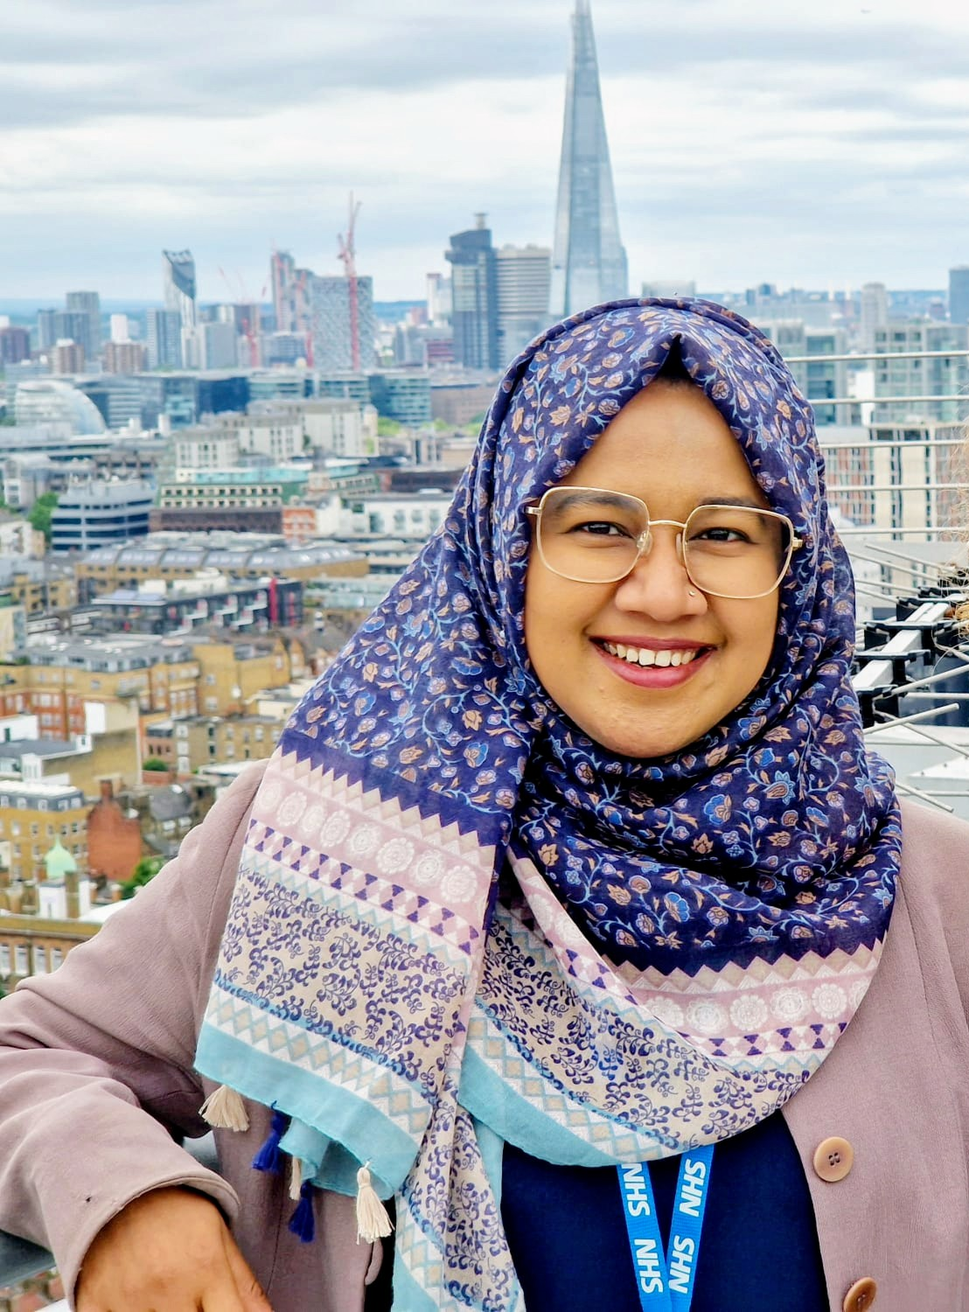
Our partnership
TELCO: the founding chapter of Citizens UK with over 50,000 people from 80 member institutions (schools, universities, religious groups, migrant groups, and other community organisations).
Citizens UK: the UK’s biggest and most diverse people-powered alliance, using community organising to build positive relationships between communities and a better, fairer society.
Barts Health NHS Trust is a group of five hospitals providing specialist and routine care to over 2.5 million people across north east London and beyond.
Afsana Salik
Senior Community Organiser, TELCO / Community Engagement Officer, Barts Health

Slide 3
Why Health Equity Action Leadership (HEAL)?
Covid-19 pandemic highlighted and exacerbated existing inequalities and barriers to how healthcare was accessed and received (i.e. language, mistrust, cultural differences)
TELCO mobilised quickly to help Barts Health reach underserved communities
HEAL aimed to strengthen this partnership further and build stronger relationships between Barts and our local communities
HEAL aimed to engage and develop the leadership capacity of local communities to play a role in transforming health services, be better equipped to help tackle health inequalities, and foster community ownership of health outcomes.
The project had three core aims using the Citizens UK change model:
Strengthen institutions | Develop leaders in the community | Organise together across difference
Structured listening in trusted community spaces
Structured listening in trusted community spaces
Structured listening in trusted community spaces
Structured listening in trusted community spaces
Structured listening in trusted community spaces
Disconnect emerged between available support and community awareness
Disconnect emerged between available support and community awareness
Disconnect emerged between available support and community awareness

Slide 4
What we did
Structured listening in trusted community spaces
Disconnect between health service and public awareness
HEAL Champion

Slide 5
HEAL Champion pilot programme
HEAL Champions received bilingual training in health literacy and how to navigate Barts Health (access, services, support, giving feedback, etc.) and in community organising
HEAL Champions in their home institutions host HEAL Hubs to discuss health, and empower their community as services users but also as transformation partners
HEAL Champions support two-way relational sharing to feed insight directly back into Barts to inform improvement and into TELCO to inform campaign priorities.
"The HEAL training was incredibly empowering. It provided us with simple yet essential information on navigating Barts Health from the perspectives of both a patient and a visitor, information that was entirely new to me. This is crucial because it allows HEAL champions to pass on what we’ve learned to others in our community. In doing so, we can correct misunderstandings and share vital resources and information that, despite being readily available, remain largely unknown to many. Grasping this information is key to better managing our health. Furthermore, the HEAL training empowers leaders to advocate effectively for themselves or others.”
Steering Committee member / HEAL Champion
Before training: 87% not at all confident giving feedback or finding information about healthcare services.
After training: 100% very confident in both.​
HEAL Champions on the training:​
"Eye-opening, empowering, clear guidance, fostering trust, inspiring to engage others."​

Slide 6

HEAL Assembly

Slide 7
Next steps
Formal evaluation and the Steering Committee will guide development
Recruit next cohort of institutions / HEAL Champions
Expand the model across TELCO and beyond
Deepen the relationships and build the partnership, guided by community need.

Slide 8
Key learning
1. Start with Relationships, Not Services: In community organising we say people before programme, building trust takes time. Real change begins with listening to communities, understanding their lived experiences, and valuing their voices as equal partners in shaping healthcare solutions.
2. Train and Empower Local Leaders: Investing in community leadership through training in health literacy and organising creates a sustainable foundation for long-term engagement, advocacy, and cultural change.
3. Co-Production Leads to Stronger Outcomes: Designing solutions with communities rather than for them results in more relevant, equitable, and effective services.
4. Embed Equity at Every Level: Addressing health inequalities is not just a project goal, it must be a guiding value, influencing how resources are allocated, decisions are made, and success is measured.
5. Partnership is Power: Collaboration between the NHS, community organisations, and local leaders creates the conditions for systemic change. HEAL shows that when institutions and communities come together with mutual respect, lasting transformation is possible.

