Slide 1

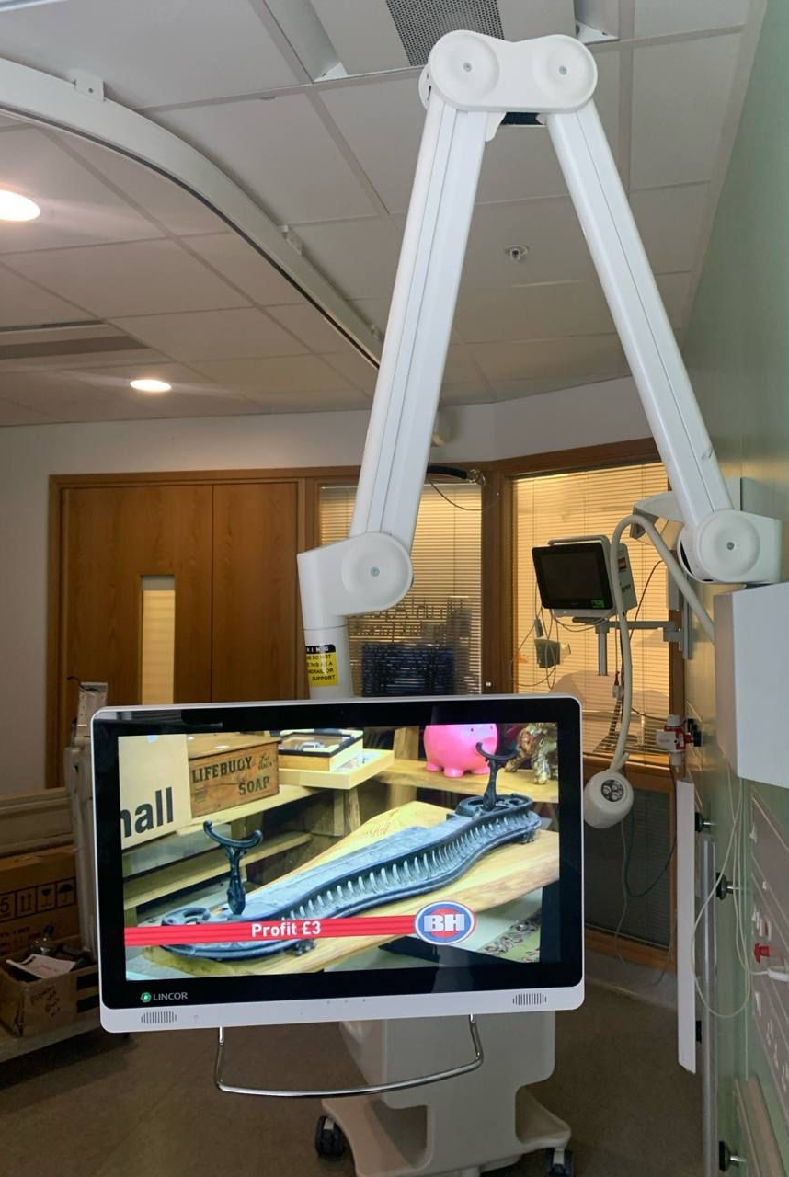

The Need & Context
Challenges of Hospital Stays
Hospital stays can be isolating for children and families, especially during long or protective isolation periods. This is intensified by lack of access to home comforts including entertainment.
Limitations of Legacy Systems
Legacy bedside systems at GOSH offered very limited entertainment, lacked integration with health records and did not provide equitable experience via accessibility features
Guided by Patient Feedback and Stakeholders
After input from patients via GOSH’ Young People’s Forum (supported by Friends and Family Test data) and staff, it was clear a new soluton for bedside digital experience was required
Patient-Centered Digital System
Our mandate based on feedback, was to provide a holistic digital system, to entertain, inform and give our patients a sense of normalcy and comfort whilst away from home
Notes:
--- This slide references information from the following file: https://goshnhs.sharepoint.com/sites/PatientBedsideEntertainment/_layouts/15/Doc.aspx?sourcedoc=%7B791FB446-2A4B-48C2-B6E3-F0C2CA0C61F5%7D&file=PENA%20presentation%20.pptx&action=edit&mobileredirect=true,https://goshnhs-my.sharepoint.com/personal/kajal_joshi_gosh_nhs_uk/_layouts/15/Doc.aspx?sourcedoc=%7B5A53DFB3-82CB-435C-AB28-8EFF90539DA3%7D&file=Pena%20Awards%20application%20v0.7.docx&action=default&mobileredirect=true Hospital stays can be isolating and disruptive for children and families, especially those facing long inpatient periods or protective isolation. At Great Ormond Street Hospital (GOSH), legacy bedside systems offered limited entertainment and no integration with health records, creating inequitable access to digital tools across over 390 bedspaces. The Patient Bedside Digitisation Platform was conceived to address these gaps by providing equitable, age-appropriate access to health information, education, entertainment, and social connection. The initiative was guided by patient feedback, including insights from the Young People’s Forum (YPF), and supported by data from Friends and Family Tests (FFT). The platform aims to restore a sense of normalcy and empowerment for patients during their hospital stay, aligning with GOSH’s mission to deliver safer, smarter, and kinder care.

Slide 2
Platform Development
Notes:
--- This slide references information from the following file: https://goshnhs.sharepoint.com/sites/PatientBedsideEntertainment/_layouts/15/Doc.aspx?sourcedoc=%7B791FB446-2A4B-48C2-B6E3-F0C2CA0C61F5%7D&file=PENA%20presentation%20.pptx&action=edit&mobileredirect=true,https://goshnhs-my.sharepoint.com/personal/kajal_joshi_gosh_nhs_uk/_layouts/15/Doc.aspx?sourcedoc=%7B5A53DFB3-82CB-435C-AB28-8EFF90539DA3%7D&file=Pena%20Awards%20application%20v0.7.docx&action=default&mobileredirect=true What We Built

Slide 3
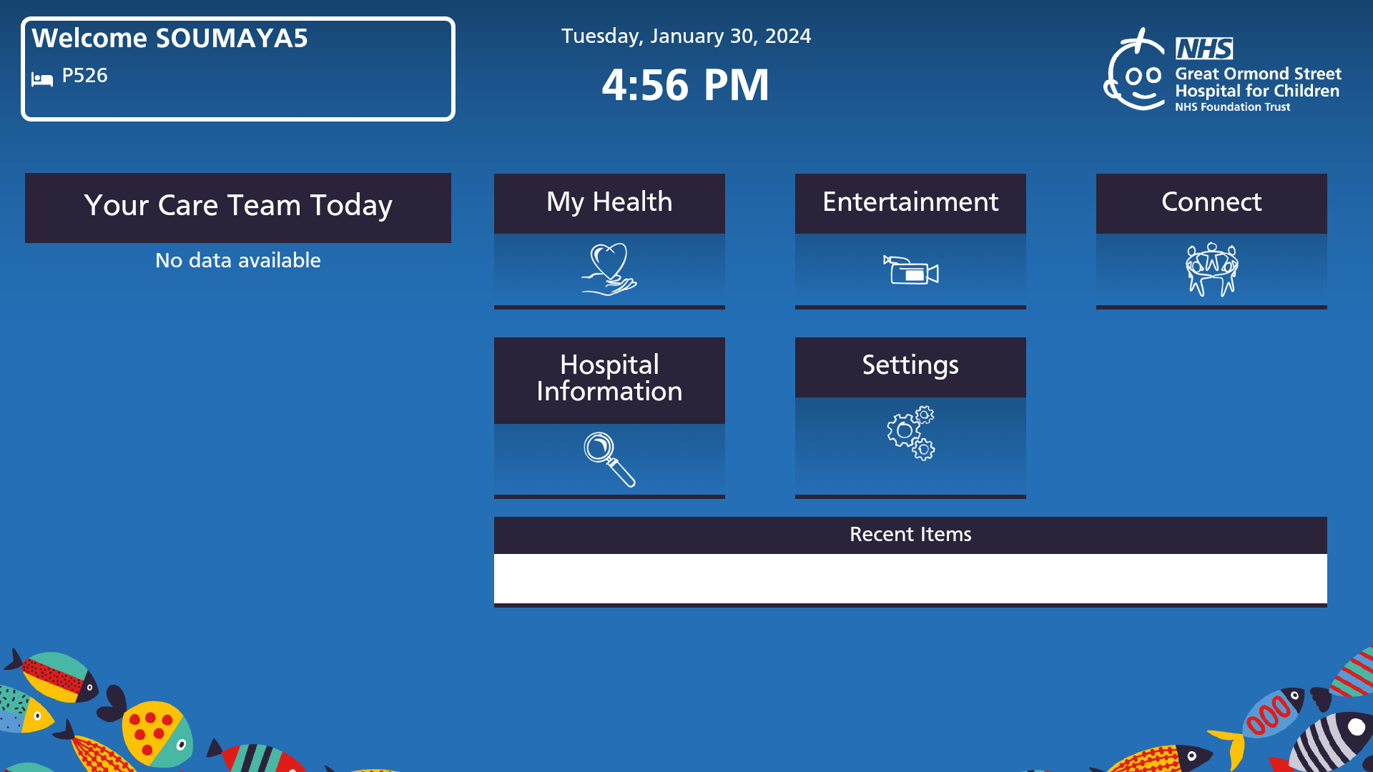
What We Built
Collaborative Co-Production
The platform was co-developed by patients, carers, clinicians, ICT teams, and external partners to ensure it meets diverse needs.
Personalised Bedside Access
Touchscreen terminals provide patients personalised access to their health records through integrated MyChart Bedside app.
Accessible and Inclusive Design
The platform features Bluetooth devices, simplified interfaces, and multilingual support to enhance accessibility.
We’re working with the team at Paramount+ to offer free access to their platform for all, helping us meet our goal for equity of access to all patients.
Entertainment That Feels Like Home
Live TV at the Bedside: Patients can watch a selection of Sky HD channels directly on their bedside screens, thanks to support from Sky TV.
Familiar Streaming Apps: Popular services like Netflix, Prime Video, Disney+ and BBC iPlayer are available, so patients can enjoy their usual entertainment while in hospital.
Modular and Scalable System
Designed for easy future enhancements and replication across various healthcare settings with modular architecture.
Notes:
--- This slide references information from the following file: https://goshnhs.sharepoint.com/sites/PatientBedsideEntertainment/_layouts/15/Doc.aspx?sourcedoc=%7B791FB446-2A4B-48C2-B6E3-F0C2CA0C61F5%7D&file=PENA%20presentation%20.pptx&action=edit&mobileredirect=true,https://goshnhs-my.sharepoint.com/personal/kajal_joshi_gosh_nhs_uk/_layouts/15/Doc.aspx?sourcedoc=%7B5A53DFB3-82CB-435C-AB28-8EFF90539DA3%7D&file=Pena%20Awards%20application%20v0.7.docx&action=default&mobileredirect=true The Patient Bedside Digitisation Platform is a bespoke solution co-produced by patients, carers, clinicians, ICT teams, and external partners. Each bedspace is equipped with a touchscreen terminal integrated with Epic’s MyChart Bedside, enabling personalised access to health records. The platform includes curated apps for education, entertainment, socialisation, and dietary guidance, with accessibility features such as Bluetooth-enabled devices, simplified user interfaces, and multilingual support. ADT feeds from Epic trigger personalised experiences based on patient demographics and clinical status. The system was designed with modularity and scalability in mind, allowing for future enhancements and replication across other healthcare settings.

Slide 4
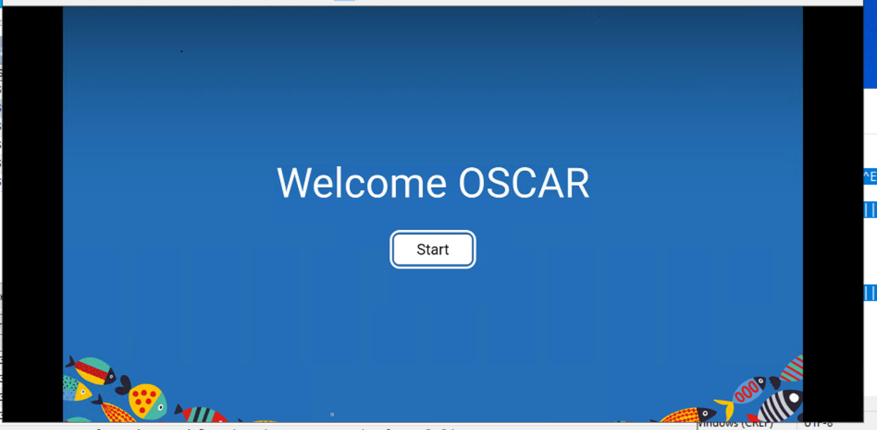

Slide 5
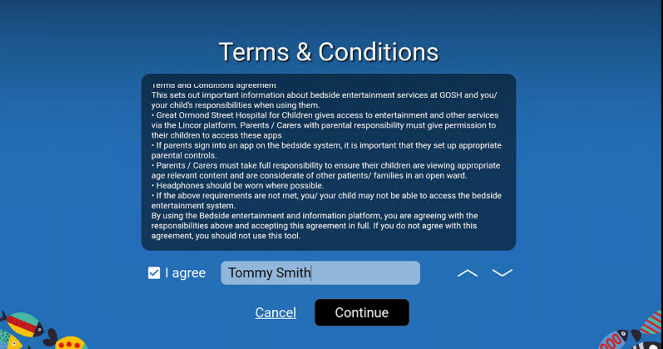

Slide 6
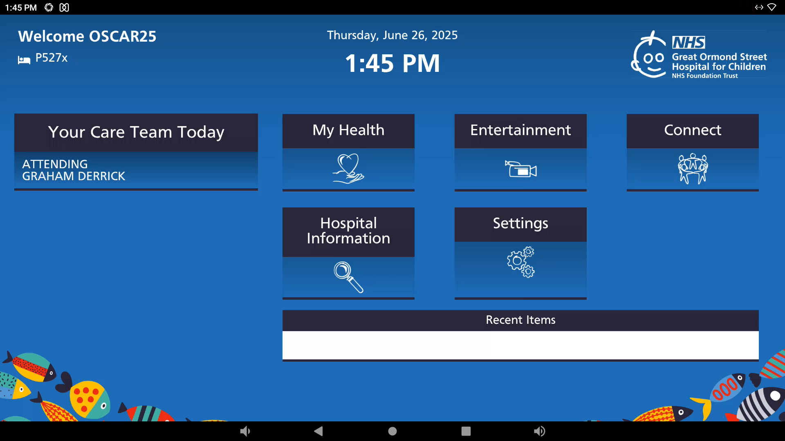

Slide 7
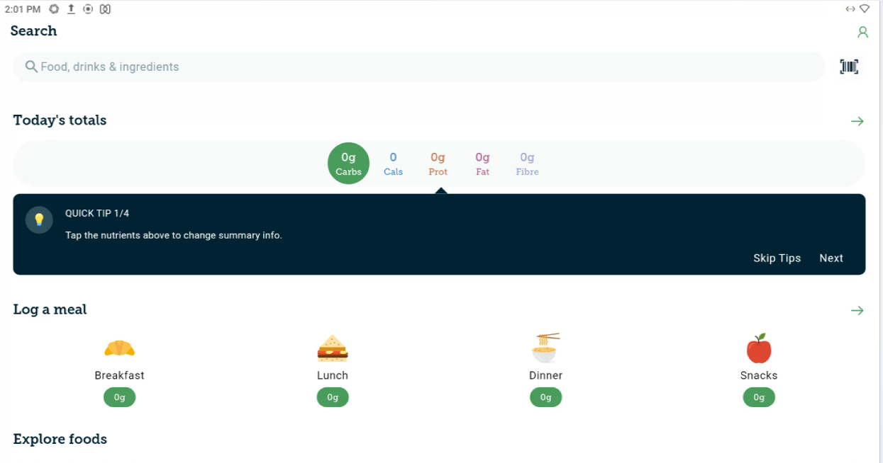

Slide 8
Stakeholder Engagement
Notes:
--- This slide references information from the following file: https://goshnhs.sharepoint.com/sites/PatientBedsideEntertainment/_layouts/15/Doc.aspx?sourcedoc=%7B791FB446-2A4B-48C2-B6E3-F0C2CA0C61F5%7D&file=PENA%20presentation%20.pptx&action=edit&mobileredirect=true,https://goshnhs-my.sharepoint.com/personal/kajal_joshi_gosh_nhs_uk/_layouts/15/Doc.aspx?sourcedoc=%7B5A53DFB3-82CB-435C-AB28-8EFF90539DA3%7D&file=Pena%20Awards%20application%20v0.7.docx&action=default&mobileredirect=true Involvement & Inclusion

Slide 9
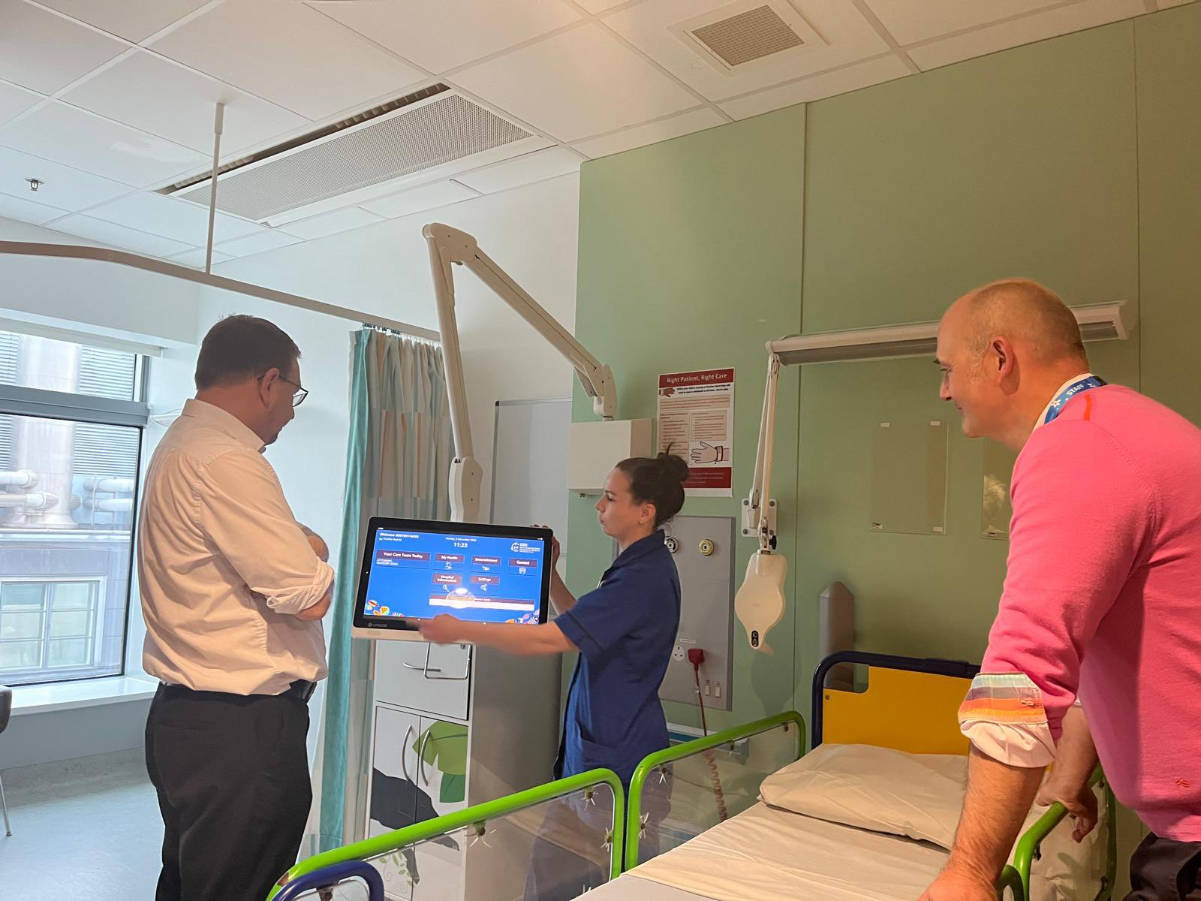
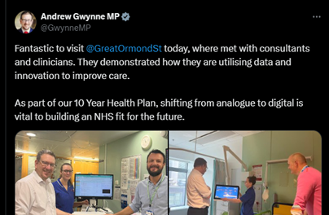
Involvement & Inclusion
Stakeholder Co-Production
The project involved multiple stakeholders including our exceptional youth forum of patient advocates and staff champions for continuous feedback.
Accessibility Prioritisation
Accessibility features were designed to support visual, auditory, and cognitive impairments from launch to ensure equitable experience
Partnerships for Content
Collaborations with organisations like Carbs &Cals, Singing Hands enriched the platform’s diverse content offerings.
Modern and easy to use
The platform puts user experience at the heart of functionality, with touchscreen access, accessibility tools, modern apps integration and health record access all in one system
A visit from a minister at GOSH 'Andrew Gwynne – December 2024'
Notes:
--- This slide references information from the following file: https://goshnhs.sharepoint.com/sites/PatientBedsideEntertainment/_layouts/15/Doc.aspx?sourcedoc=%7B791FB446-2A4B-48C2-B6E3-F0C2CA0C61F5%7D&file=PENA%20presentation%20.pptx&action=edit&mobileredirect=true,https://goshnhs-my.sharepoint.com/personal/kajal_joshi_gosh_nhs_uk/_layouts/15/Doc.aspx?sourcedoc=%7B5A53DFB3-82CB-435C-AB28-8EFF90539DA3%7D&file=Pena%20Awards%20application%20v0.7.docx&action=default&mobileredirect=true The project was deeply rooted in co-production, involving a wide range of stakeholders from inception to rollout. The Young People’s Forum played a central role in design decisions, while ward walk-arounds and staff champions ensured continuous feedback. Accessibility was prioritised from the outset, with features tailored to diverse needs including visual, auditory, and cognitive impairments. Partnerships with content providers such as Singing Hands, Carbs & Cals, and Sunrise Wheels Up! enriched the platform’s offerings. The initiative also addressed health inequalities by ensuring every patient had access to the same digital tools, regardless of background or ability.

Slide 10
Impact and Outcomes
Notes:
--- This slide references information from the following file: https://goshnhs.sharepoint.com/sites/PatientBedsideEntertainment/_layouts/15/Doc.aspx?sourcedoc=%7B791FB446-2A4B-48C2-B6E3-F0C2CA0C61F5%7D&file=PENA%20presentation%20.pptx&action=edit&mobileredirect=true,https://goshnhs-my.sharepoint.com/personal/kajal_joshi_gosh_nhs_uk/_layouts/15/Doc.aspx?sourcedoc=%7B5A53DFB3-82CB-435C-AB28-8EFF90539DA3%7D&file=Pena%20Awards%20application%20v0.7.docx&action=default&mobileredirect=true Outcomes & Impact

Slide 11
Outcomes & Impact
Improved Patient Experience
The platform enhanced patient experience by providing easy access to entertainment and health-related digital content, giving patients and families comfort and a sense of normalcy. Patients can now access school resources and watch their favourite content at the bedside.
Clinical Engagement & Coordination
The My GOSH bedside app now allows patients and families easy access to key healthcare information, including upcoming appointments, test results and more. This provides greater visibility and a feeling of control over care whilst reducing some clinical workload by reducing requests for this data. Donated apps like Carbs & Cals are also helping patients improve diet management
Positive Feedback and Validation
Feedback from patients and staff has been excellent, highlighting ease of use, improved communication and overall experience. We believe the system sets a new benchmark for patient bedside experience which we plan to continually build upon.
Notes:
--- This slide references information from the following file: https://goshnhs.sharepoint.com/sites/PatientBedsideEntertainment/_layouts/15/Doc.aspx?sourcedoc=%7B791FB446-2A4B-48C2-B6E3-F0C2CA0C61F5%7D&file=PENA%20presentation%20.pptx&action=edit&mobileredirect=true,https://goshnhs-my.sharepoint.com/personal/kajal_joshi_gosh_nhs_uk/_layouts/15/Doc.aspx?sourcedoc=%7B5A53DFB3-82CB-435C-AB28-8EFF90539DA3%7D&file=Pena%20Awards%20application%20v0.7.docx&action=default&mobileredirect=true The platform has demonstrated measurable improvements in patient experience and clinical engagement. Installed across 390+ bedspaces, it replaced outdated systems and provided equitable access to digital content. Utilisation reports show high engagement with entertainment apps (e.g., YouTube Kids, CBeebies), health portals, and educational tools. Feedback from FFT and YPF has been overwhelmingly positive, citing ease of use, improved communication, and reduced anxiety. Clinical teams report enhanced coordination and reduced documentation errors. The Carbs & Cals app has been particularly beneficial for diabetes management and staff education. These outcomes validate the platform’s role in transforming bedside care.

Slide 12
Governance and Data Protection
Notes:
--- This slide references information from the following file: https://goshnhs.sharepoint.com/sites/PatientBedsideEntertainment/_layouts/15/Doc.aspx?sourcedoc=%7B791FB446-2A4B-48C2-B6E3-F0C2CA0C61F5%7D&file=PENA%20presentation%20.pptx&action=edit&mobileredirect=true,https://goshnhs-my.sharepoint.com/personal/kajal_joshi_gosh_nhs_uk/_layouts/15/Doc.aspx?sourcedoc=%7B5A53DFB3-82CB-435C-AB28-8EFF90539DA3%7D&file=Pena%20Awards%20application%20v0.7.docx&action=default&mobileredirect=true Data, Safety & Governance

Slide 13
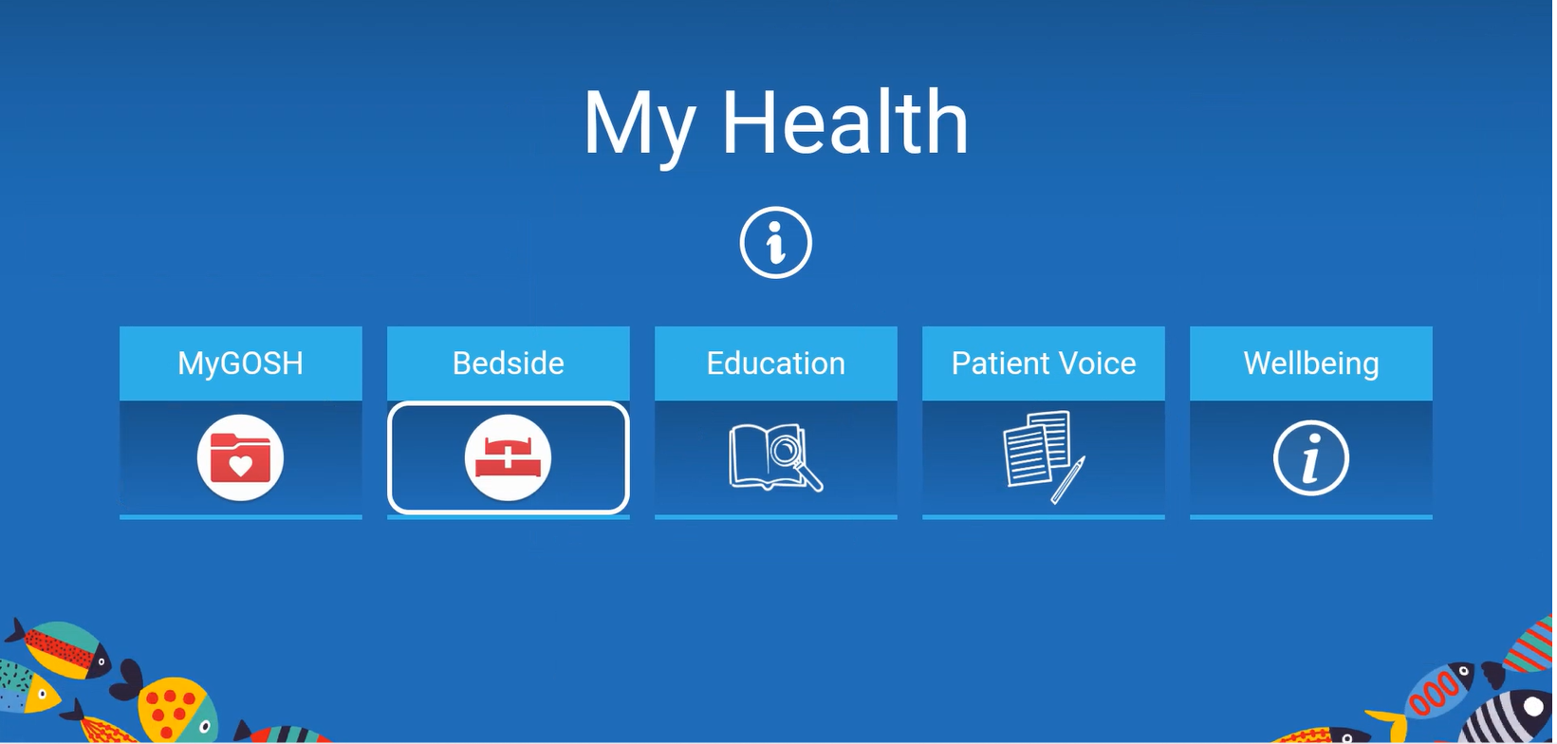
Data, Safety & Governance
Governance and Compliance
The platform follows robust governance frameworks ensuring GDPR compliance and completion of DPIA for data protection.
Data Security Measures
Role-based access, encryption, and secure authentication safeguard sensitive patient information effectively.
Safeguarding and Content Control
Curated content with age-appropriate filters ensures safe and appropriate access for all users.
Business Continuity and Trust
Vendor policies and regular audits support business continuity and reinforce trust among patients and staff.
Notes:
--- This slide references information from the following file: https://goshnhs.sharepoint.com/sites/PatientBedsideEntertainment/_layouts/15/Doc.aspx?sourcedoc=%7B791FB446-2A4B-48C2-B6E3-F0C2CA0C61F5%7D&file=PENA%20presentation%20.pptx&action=edit&mobileredirect=true,https://goshnhs-my.sharepoint.com/personal/kajal_joshi_gosh_nhs_uk/_layouts/15/Doc.aspx?sourcedoc=%7B5A53DFB3-82CB-435C-AB28-8EFF90539DA3%7D&file=Pena%20Awards%20application%20v0.7.docx&action=default&mobileredirect=true Robust governance frameworks underpin the platform’s operation, ensuring safety, privacy, and compliance. A comprehensive DPIA was completed, and the system adheres to GDPR and other healthcare regulations. Role-based access controls, encryption, and secure authentication protect patient data. Safeguarding is embedded through curated content and age-appropriate filters. Business continuity is supported by vendor policies and regular audits. The platform’s design mitigates risks while enabling secure, personalised access to health information, reinforcing trust among patients, families, and staff.

Slide 14
Scalability and Future Vision
Notes:
--- This slide references information from the following file: https://goshnhs.sharepoint.com/sites/PatientBedsideEntertainment/_layouts/15/Doc.aspx?sourcedoc=%7B791FB446-2A4B-48C2-B6E3-F0C2CA0C61F5%7D&file=PENA%20presentation%20.pptx&action=edit&mobileredirect=true,https://goshnhs-my.sharepoint.com/personal/kajal_joshi_gosh_nhs_uk/_layouts/15/Doc.aspx?sourcedoc=%7B5A53DFB3-82CB-435C-AB28-8EFF90539DA3%7D&file=Pena%20Awards%20application%20v0.7.docx&action=default&mobileredirect=true Spread, Learning & Sustainability

Slide 15
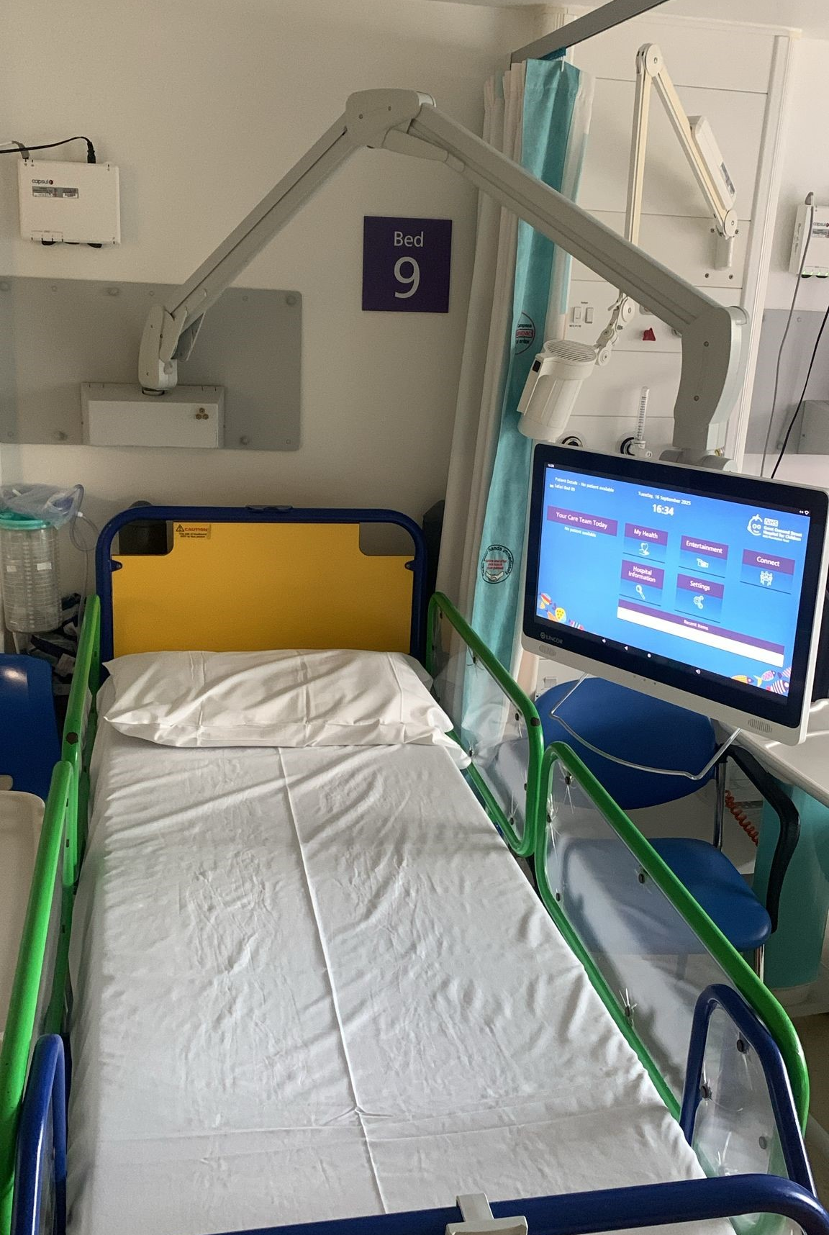
Spread, Learning & Sustainability
Scalable Modular Architecture
The platform’s modular design supports replication and scalability across multiple NHS trusts and departments for long-term sustainability.
Strategic Partnerships
Collaborations with vendors like Lincor enable customisation and integration with Epic, establishing a model for future partnerships. We continue to deliver new and innovative content partnerships with the likes of Paramount +, Carbs & Cals and singing hands.
Future Roadmap & Innovation
Planned future features include secure family video calling, expanded content partnerships and ongoing co-design with stakeholders to improve patient care.
Knowledge Sharing & Adoption
A case study is being developed to share learnings and encourage adoption, attracting interest from hospitals and policymakers.
Notes:
--- This slide references information from the following file: https://goshnhs.sharepoint.com/sites/PatientBedsideEntertainment/_layouts/15/Doc.aspx?sourcedoc=%7B791FB446-2A4B-48C2-B6E3-F0C2CA0C61F5%7D&file=PENA%20presentation%20.pptx&action=edit&mobileredirect=true,https://goshnhs-my.sharepoint.com/personal/kajal_joshi_gosh_nhs_uk/_layouts/15/Doc.aspx?sourcedoc=%7B5A53DFB3-82CB-435C-AB28-8EFF90539DA3%7D&file=Pena%20Awards%20application%20v0.7.docx&action=default&mobileredirect=true The platform is built for scalability and long-term sustainability. Its modular architecture allows replication across departments and other NHS trusts. Partnerships with vendors like Lincor have enabled customisation and integration with Epic, setting a precedent for future collaborations. A roadmap includes secure family video calling, expanded content partnerships, and continuous co-design with stakeholders. The initiative has garnered interest from other hospitals and policymakers, including a demonstration to MP Andrew Gwynne. A case study is being developed to facilitate knowledge sharing and adoption. The platform exemplifies how digital innovation can be scaled to enhance patient care system-wide.

Slide 16

Any Questions

